Slide 1
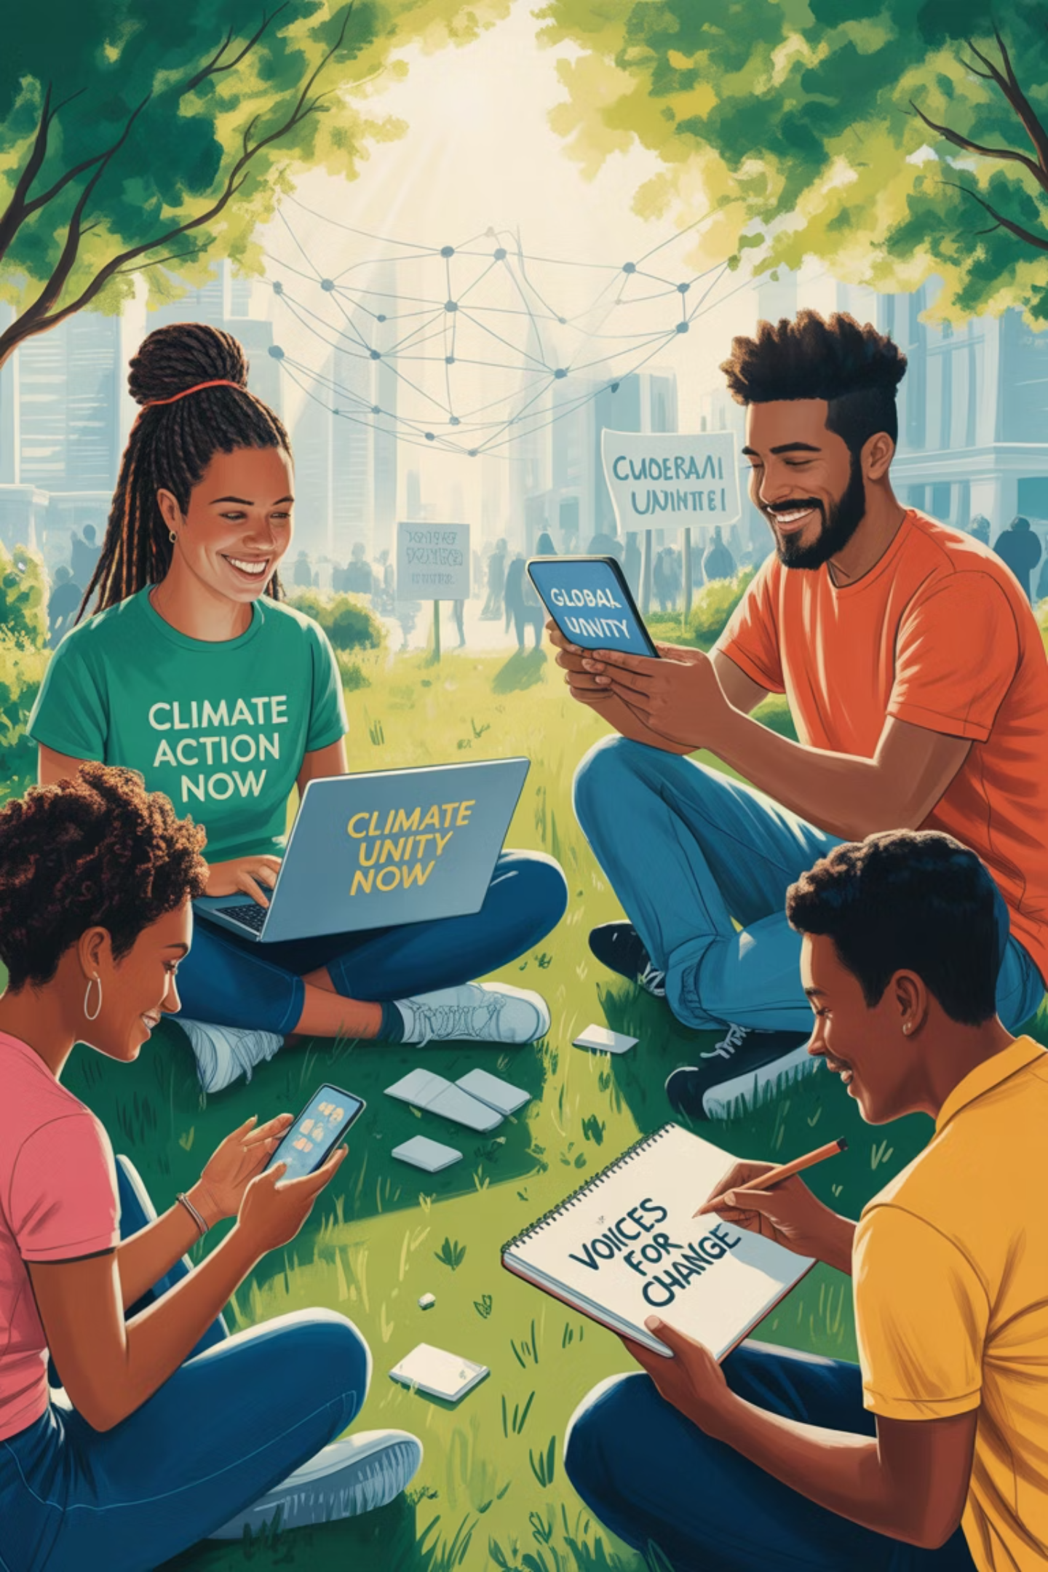

MEDIActive Youth: Informing the Balkans
Youth Media Activism
Power and Pitfalls in the Digital Age

Slide 2
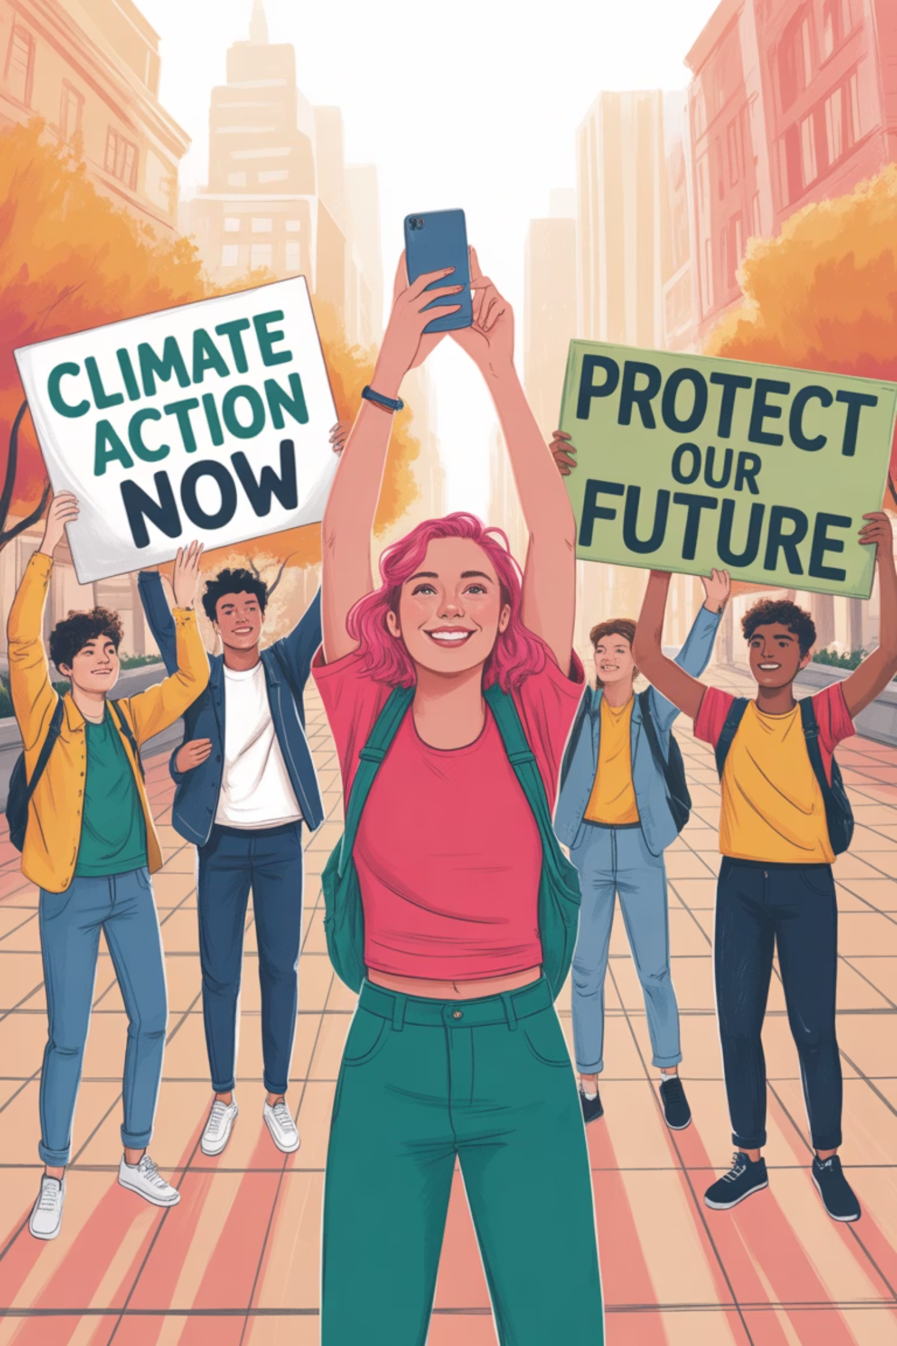
Youth activism has been a powerful force for social change throughout history. In the modern era, it has evolved with digital technology, creating new opportunities and challenges. This presentation explores how young people use media for social change, the impact of social media on political awareness, and the critical skills needed to navigate today's information landscape.

Slide 3
Defining Youth Activism
Active Participation
Beyond Demonstrations
Evolving Definition
Young people actively promoting social change through protests, advocacy campaigns, awareness-raising, civic engagement, and volunteering
Includes subtler forms like education initiatives and skill-building for civic participation
Has expanded over time to encompass diverse approaches to fostering active citizenship
As scholar Ron Kassimir highlights, the condition of youth directly influences society's aspirations and challenges, underscoring the significance of their activism.

Slide 4
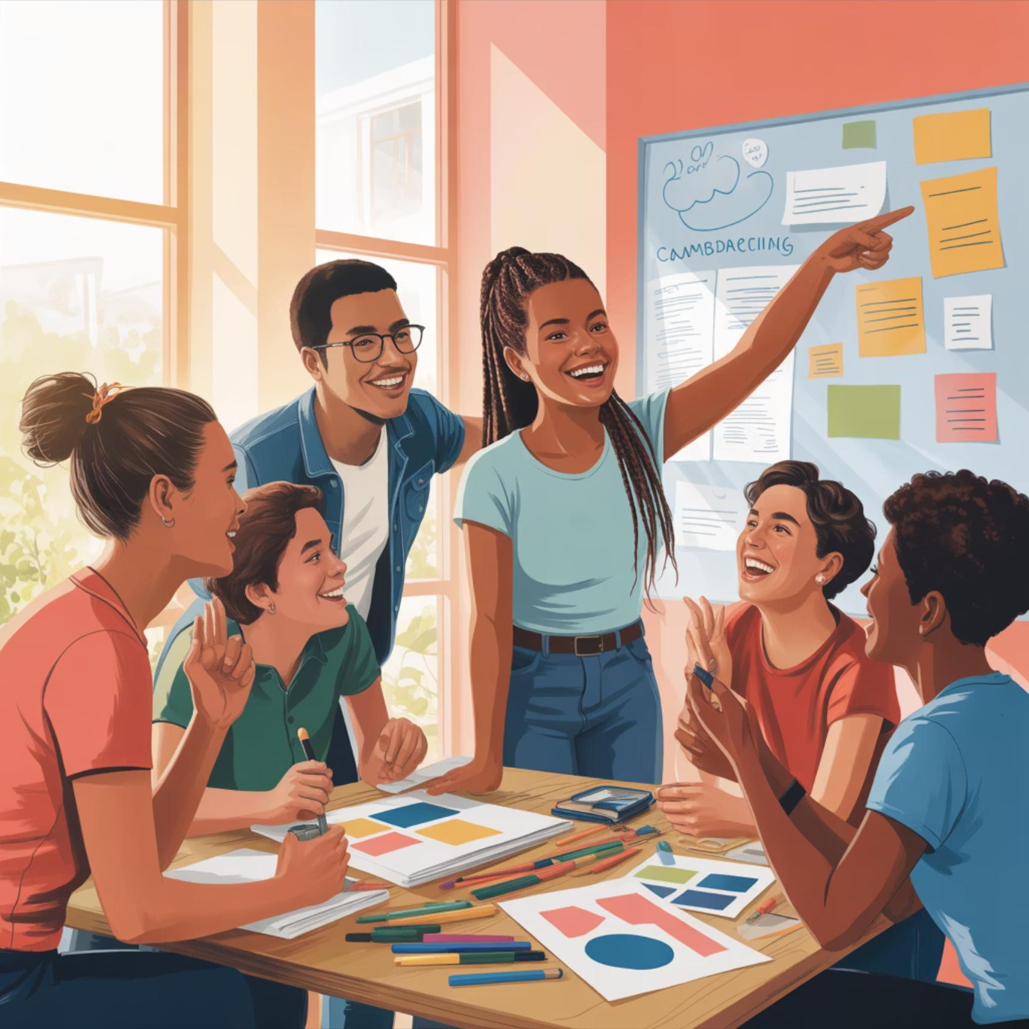
Why Youth Activism Matters
Young people bring fresh perspectives, energy, and commitment to addressing social issues
Their involvement helps shape future leadership
Sustains democratic participation
Essential for addressing 21st-century challenges
Creates positive change for communities and beyond
The digital age has transformed youth activism by providing new tools for engagement, but also presents challenges like sustaining long-term commitment, addressing the digital divide, and countering government surveillance.

Slide 5
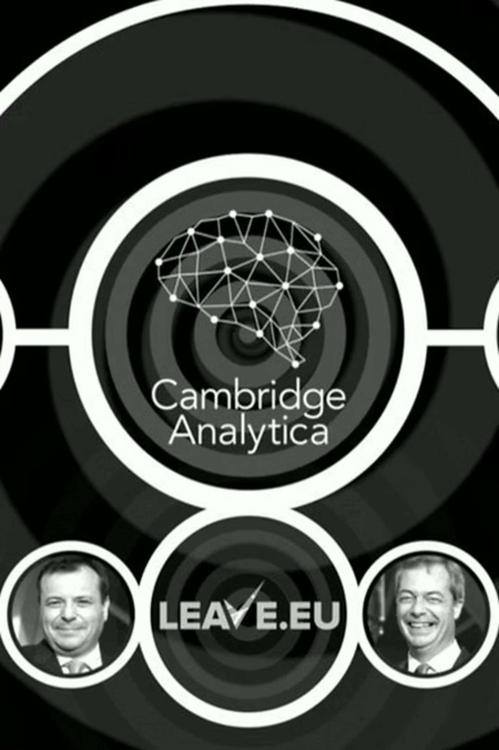



Social Media's Influence on Politics
Cambridge Analytica
Leveraged Facebook data to target undecided voters through personalized campaigns in Brexit and Trump's election
Platform Manipulation
Mobilized passive individuals in Brexit and suppressed potential votes for Hillary Clinton
Recent Example
Elon Musk amplified misinformation on X (Twitter), including a falsified video about Kamala Harris with 120-130 million views

Slide 6
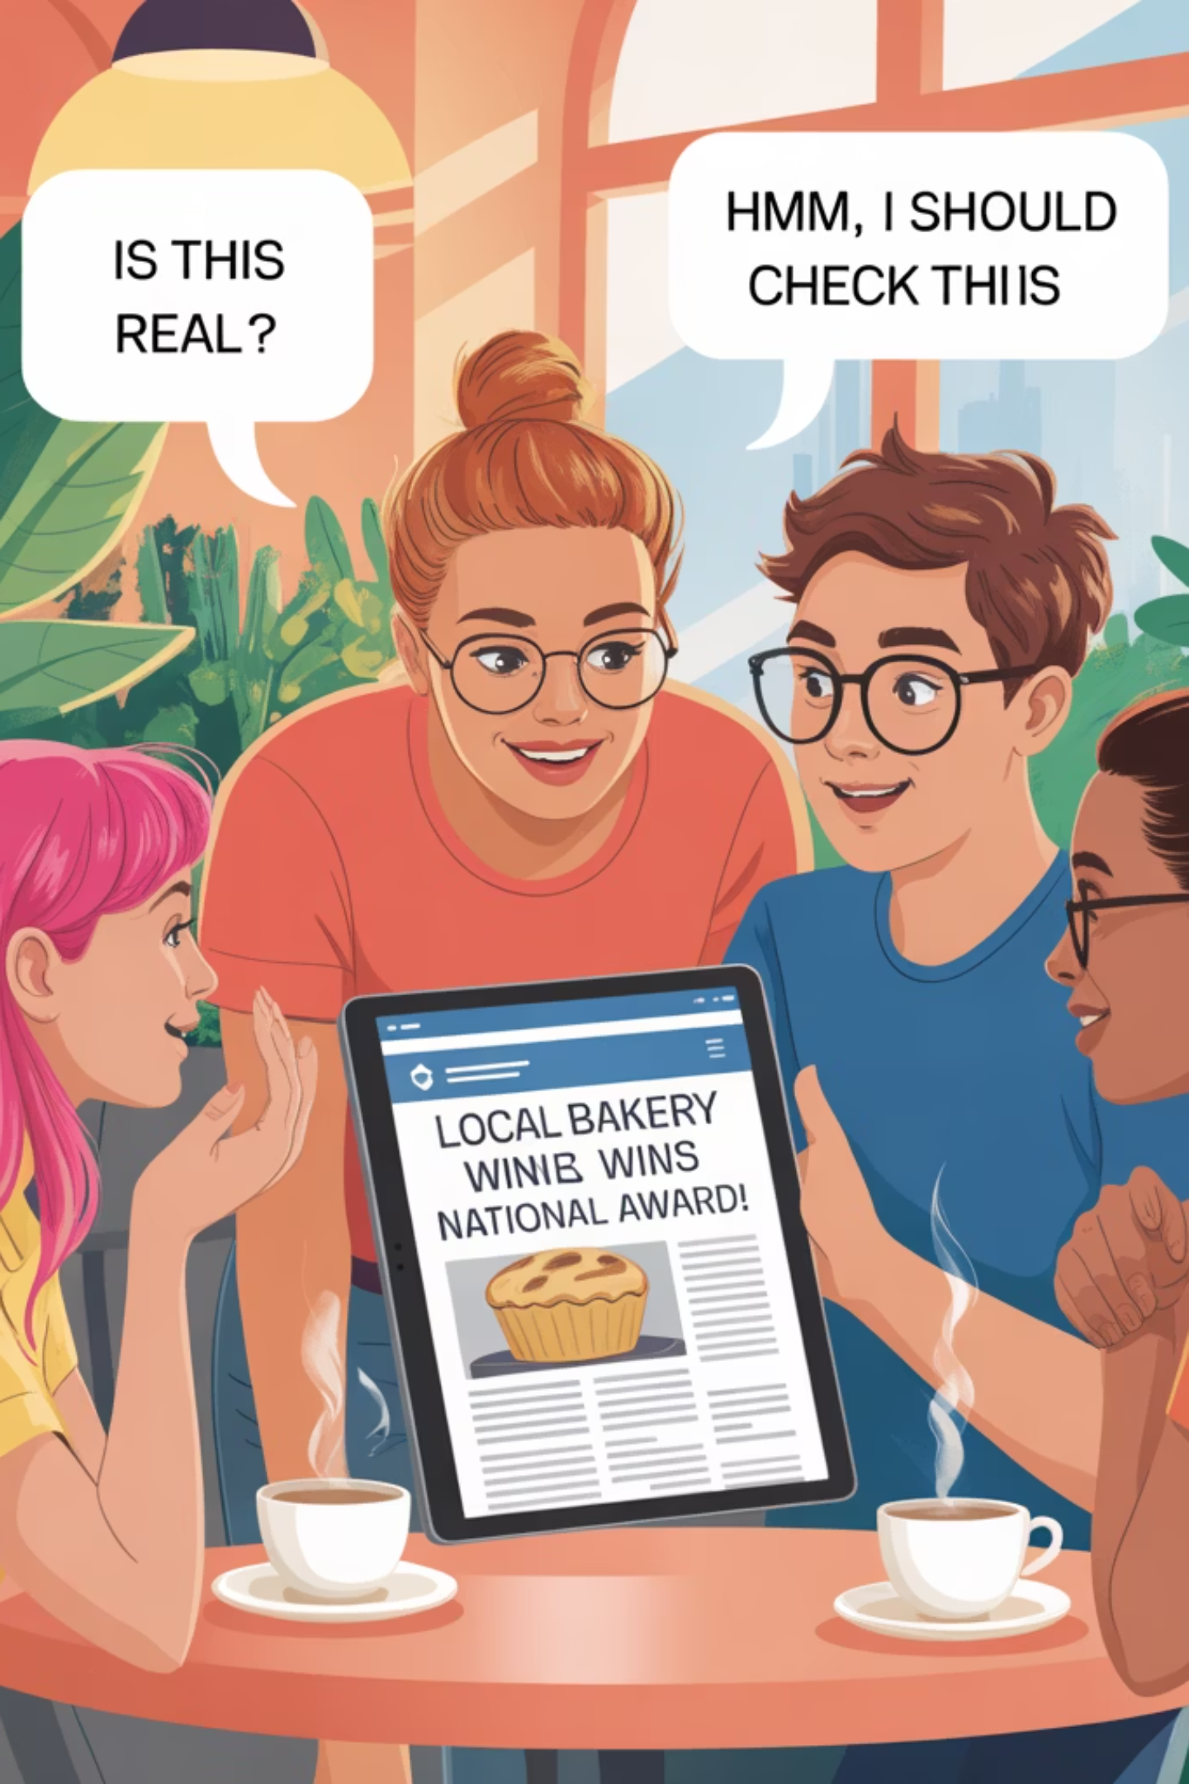

Youth Media Consumption Patterns
According to the European Commission, over 40% of youth encounter fake news daily, with few verifying the accuracy of such information.
Key Trends
Concerns
Young people spend significant time online
Many lack media literacy
Susceptible to misinformation
Rely on social media as primary news source
Vulnerable to manipulation
Prefer private messaging platforms like Instagram and Messenger

Slide 7
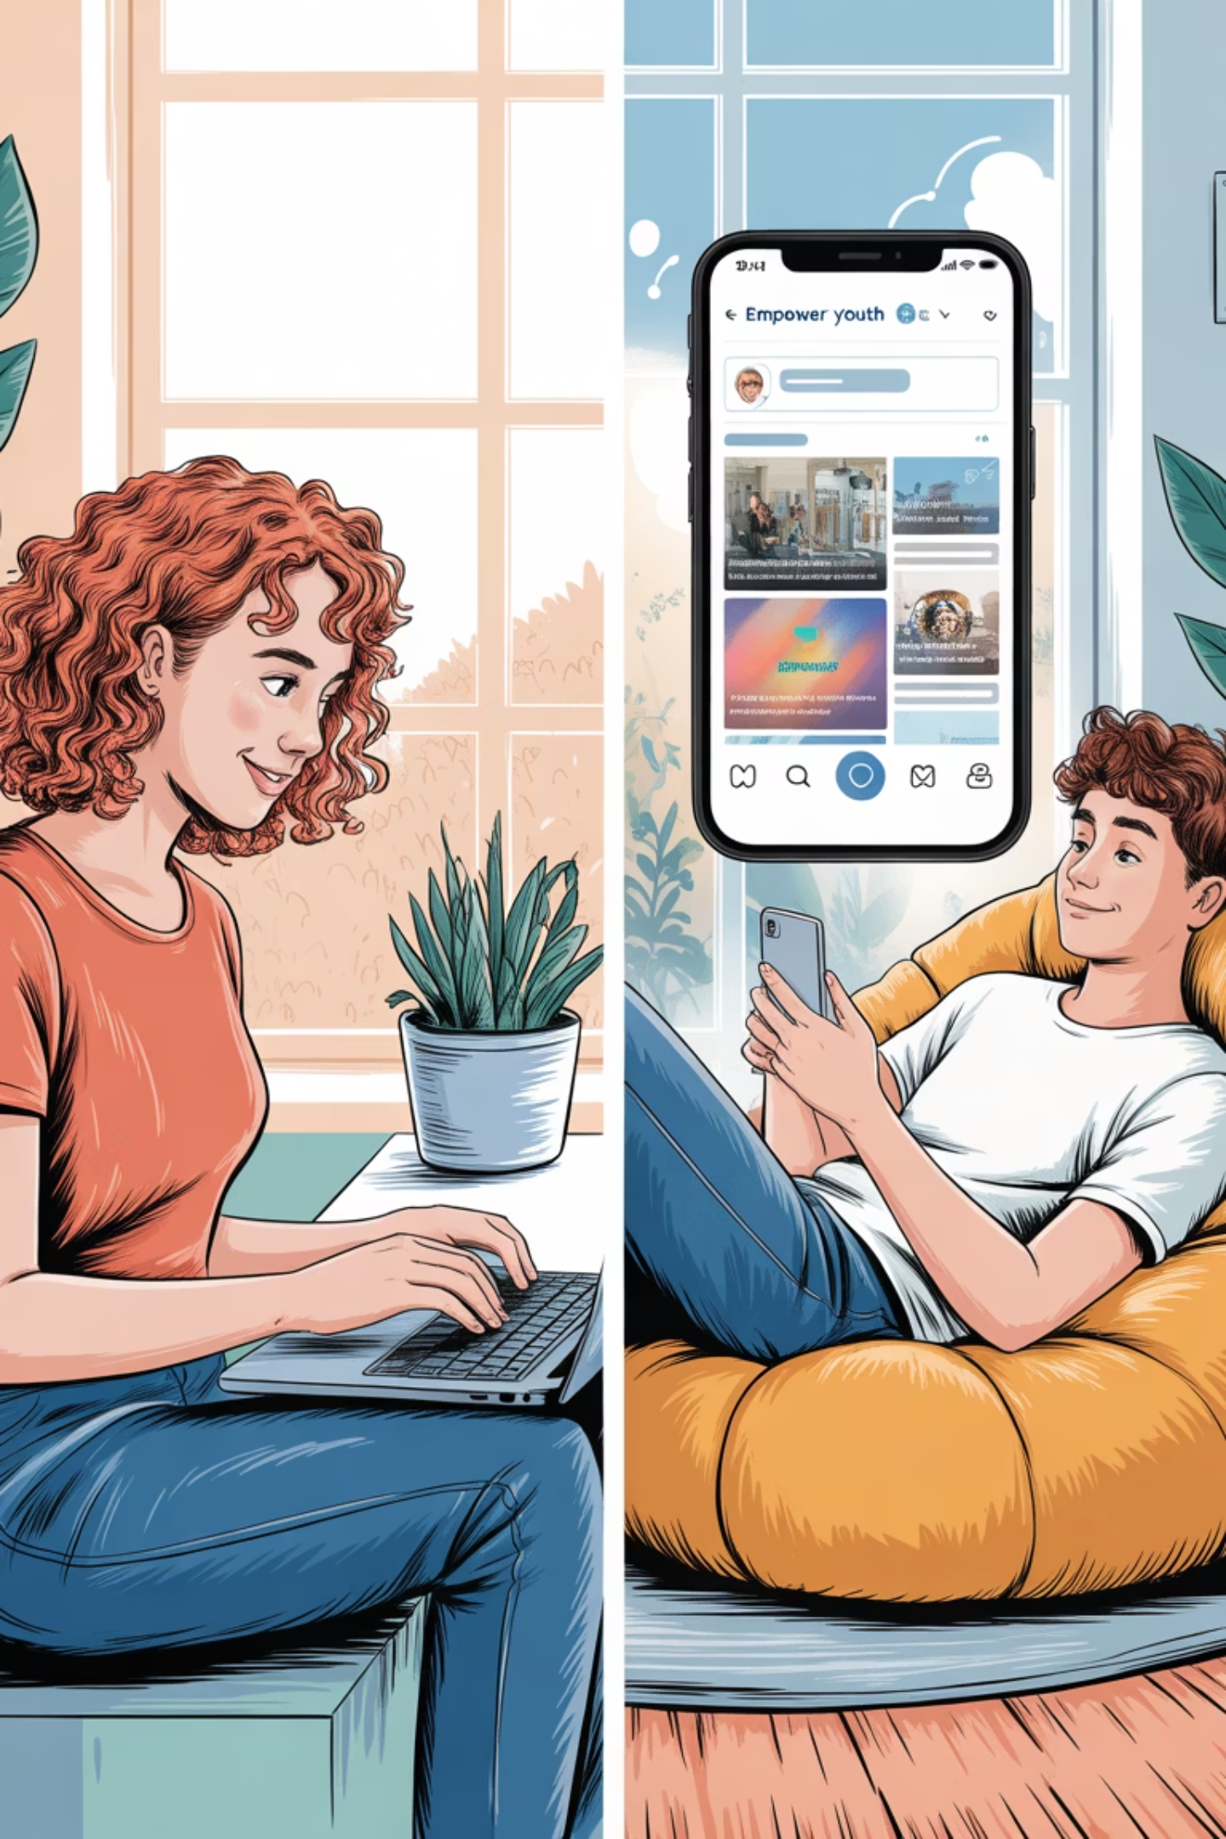
The Dual Nature of Social Media Activism
Optimistic View
Youth activism has evolved to include social media engagement, volunteer work, and non-traditional movements
Pessimistic View
Critics argue today's youth are more self-centered and less civically engaged than previous generations
Reality
While a minority leverage social media to enhance political awareness, most fall into entertainment-focused or passive usage

Slide 8
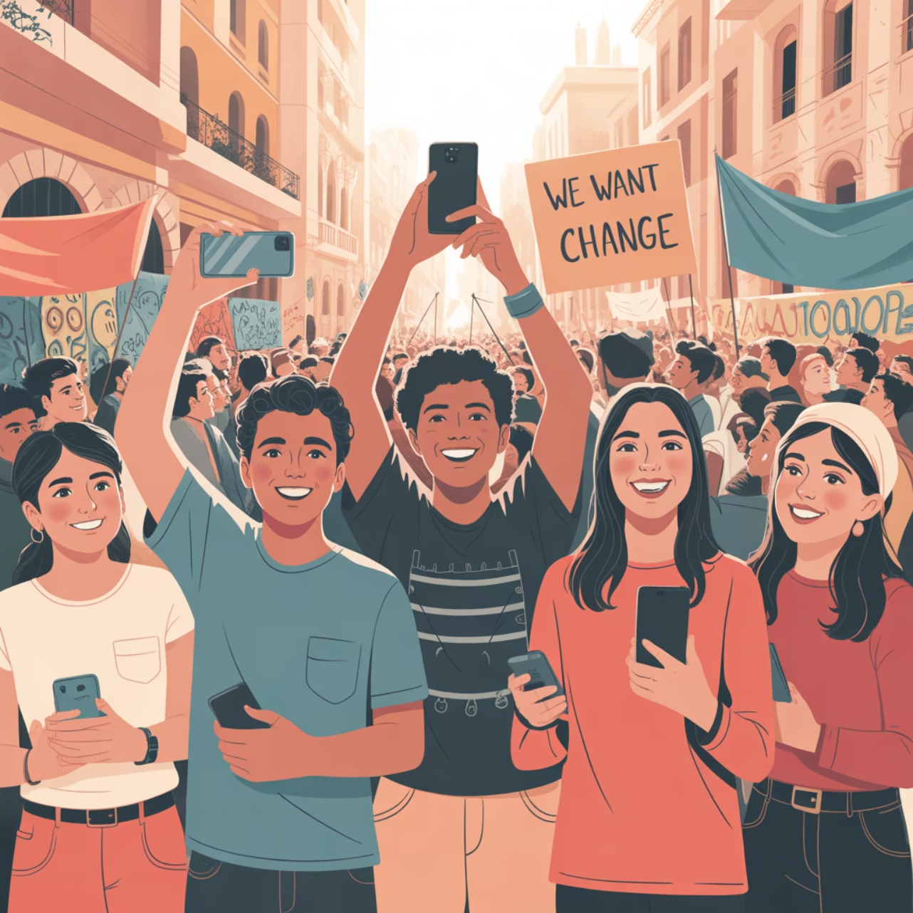
Case Study: The Arab Spring
Beginning in 2010, this wave of protests and revolutions reshaped the Middle East. Young activists used platforms like Facebook, Twitter, and YouTube to:
Organize demonstrations
Raise awareness
Exchange information in countries such as Tunisia and Egypt
Circumvent state censorship
Enable mass mobilization
Government attempts to block internet access—such as Tunisia's website restrictions and Egypt's five-day internet blackout—only strengthened protestors' resolve.

Slide 9

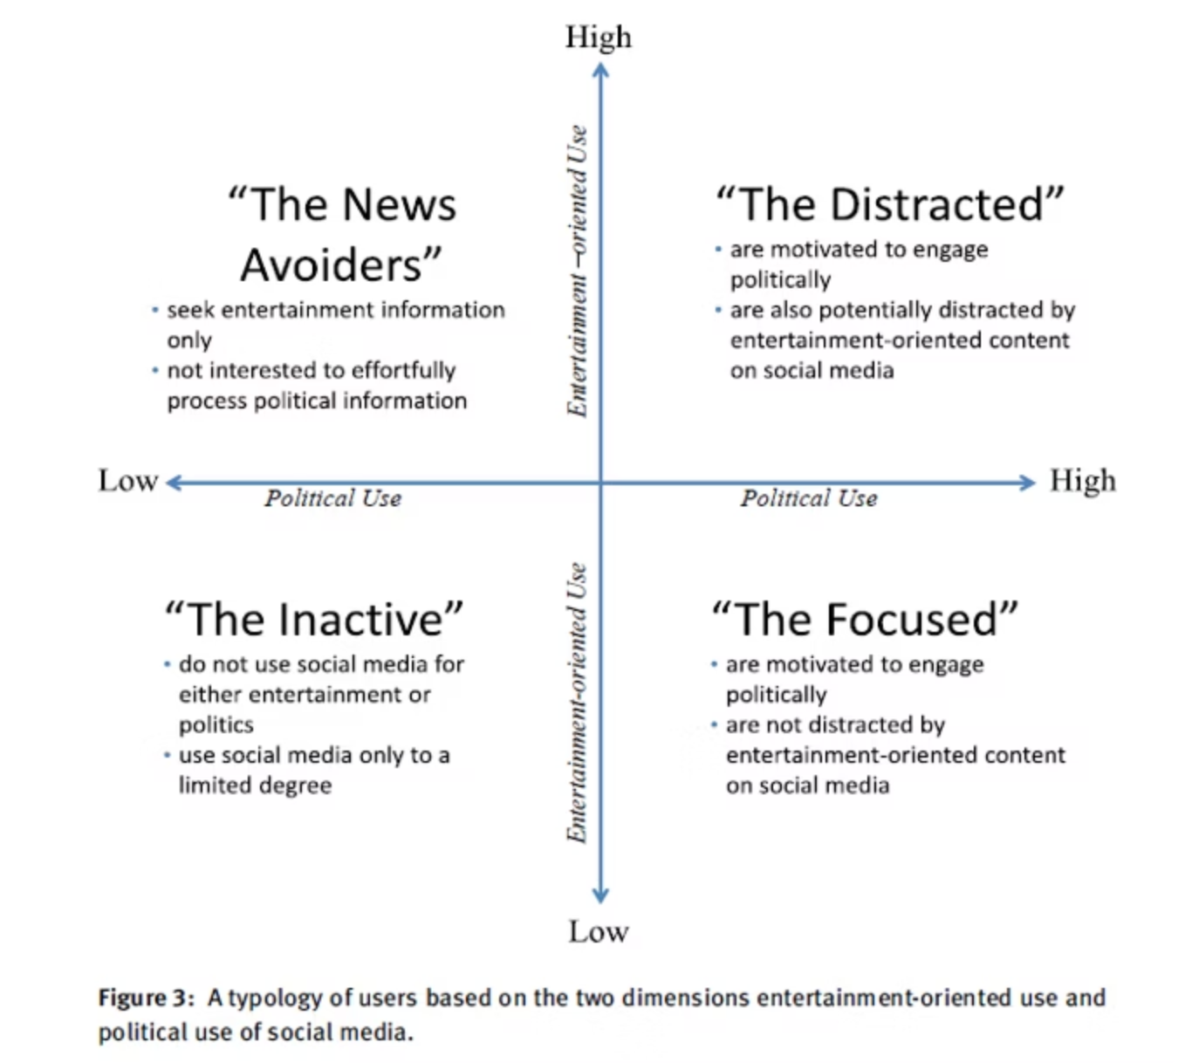



The Filter Bubble Problem
Research from the ADMe group in Vienna highlights that most young people use social media primarily for entertainment, with fewer engaging with political content.
Algorithm Trap
Most youths fall victim to algorithms that create "filter bubbles," restricting them to narrow, repetitive, and often biased information
Skills Gap
Only those equipped with skills to critically analyze and seek out diverse sources can harness social media for meaningful learning
Consequences
For others, these platforms can lead to intellectual stagnation, reinforcing simplistic views and discouraging deeper political awareness

Slide 10
Notable Examples of Youth Media Activism
1
2
Arab Spring
Black Lives Matter
Young activists used social media to organize uprisings across the Middle East, circumventing state censorship and enabling mass mobilization
Youth activists amplified the movement through hashtags and live streaming of protests, bringing police brutality issues to global attention
3
4
Climate Change
#MeToo Movement
Greta Thunberg and others used social media to organize global climate strikes and pressure world leaders for meaningful action
Largely driven by young activists, this movement spread rapidly through social media to address sexual harassment and assault worldwide

Slide 11

Conclusion: The Tool Analogy
Social media is like a Hilti screwdriver: a powerful tool that can only be effective if the user knows how to operate it.
Harnessing Full Potential Requires:
Critical media literacy
Active engagement with diverse perspectives
For the majority of young people who lack adequate "training" or experience, social media often serves as an obstacle rather than an enabler of political empowerment.
Well-developed political awareness
Traditional research skills
Ability to verify information

Slide 12
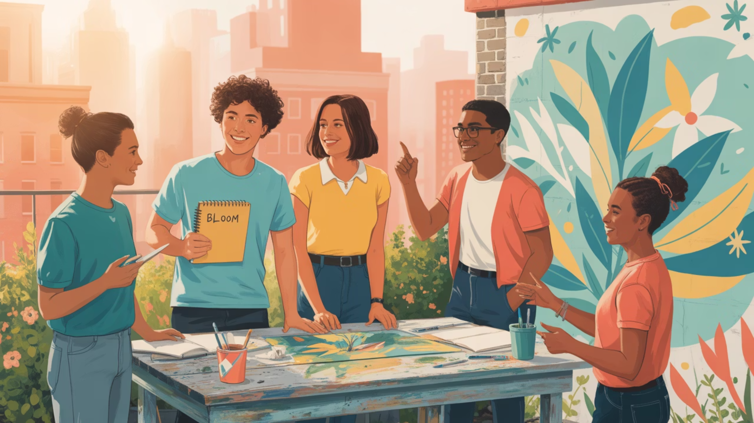
Thank You
Questions?

