Slide 1


MEDIActive Youth: Informing the Balkans
Logical Fallacies: Spotting and Avoiding Flawed Reasoning
Sharpening your critical thinking skills for clearer arguments and informed decisions.

Slide 2

Logical fallacies are errors in reasoning that undermine argument validity while appearing persuasive. Understanding these fallacies is essential for critical thinking, helping us evaluate arguments, distinguish sound reasoning from flawed logic, and navigate persuasive rhetoric in an era of misinformation.

Slide 3
Why Understanding Fallacies Matters
Critical Thinking
Communication Skills
Civic Participation
Equips individuals with the ability to evaluate arguments and distinguish sound reasoning from flawed logic
Enables students to present ideas clearly and defend them effectively against criticism
Empowers students to engage thoughtfully with complex issues and make informed decisions
In our polarized world, recognizing fallacies helps cultivate a generation of discerning, reflective, and responsible thinkers.

Slide 4
Common Logical Fallacies (Part 1)
Straw Man
Slippery Slope
Misrepresenting someone's argument to make it easier to attack.
Assuming one step will inevitably lead to a negative chain of events.
"You're against space exploration? So you're okay with ignoring scientific progress?"
"If we allow one late submission, soon no one will follow deadlines."
Ad Hominem
Appeal to Authority
Attacking the person instead of the argument.
Assuming something is true because an authority figure says so.
"You can't trust their opinion on climate change - they didn't even finish college!"
"This product must be great—an athlete endorses it!"

Slide 5
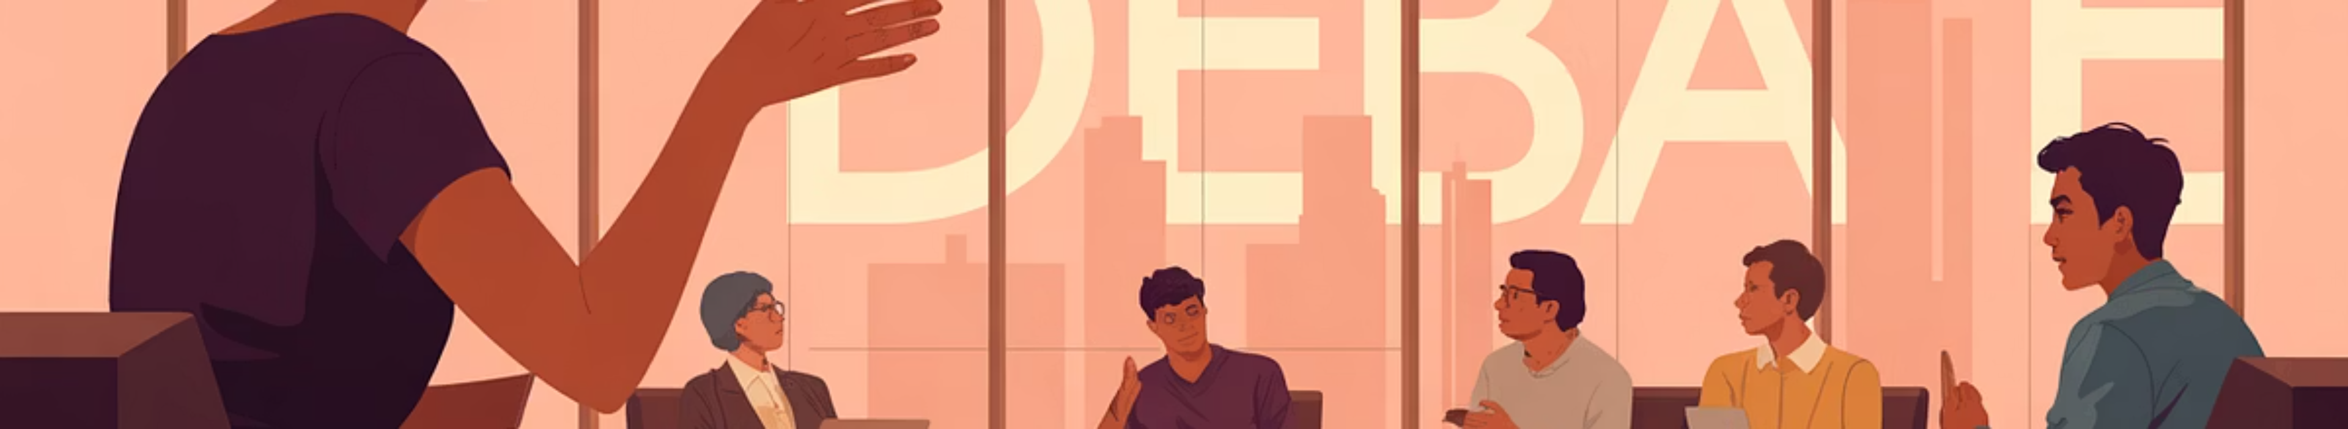
Common Logical Fallacies (Part 2)
False Dilemma
Bandwagon Fallacy
Red Herring
Presenting only two options when more exist, forcing an oversimplified choice.
Assuming something is true or good because it is popular or widely accepted.
Introducing an irrelevant topic to divert attention from the original issue.
"You're either with us or against us."
"Everyone else is buying this product, so it must be the best."
"Why worry about climate change when there are people who don't have enough to eat?"

Slide 6
Common Logical Fallacies (Part 3)
Circular Reasoning
Hasty Generalization
Using the conclusion as a premise, assuming what you're trying to prove.
Drawing a conclusion based on insufficient or unrepresentative evidence.
"I'm trustworthy because I always tell the truth, and you can trust me to say that."
"I met two rude tourists from that country - everyone there must be rude."
Appeal to Emotion
Post Hoc Ergo Propter Hoc
Using emotional appeals instead of logic to persuade.
Assuming that because one event followed another, it was caused by it.
"Think of all the starving children - don't you want to donate today?"
"I started wearing this bracelet, and now my grades are better - it must be lucky!"

Slide 7
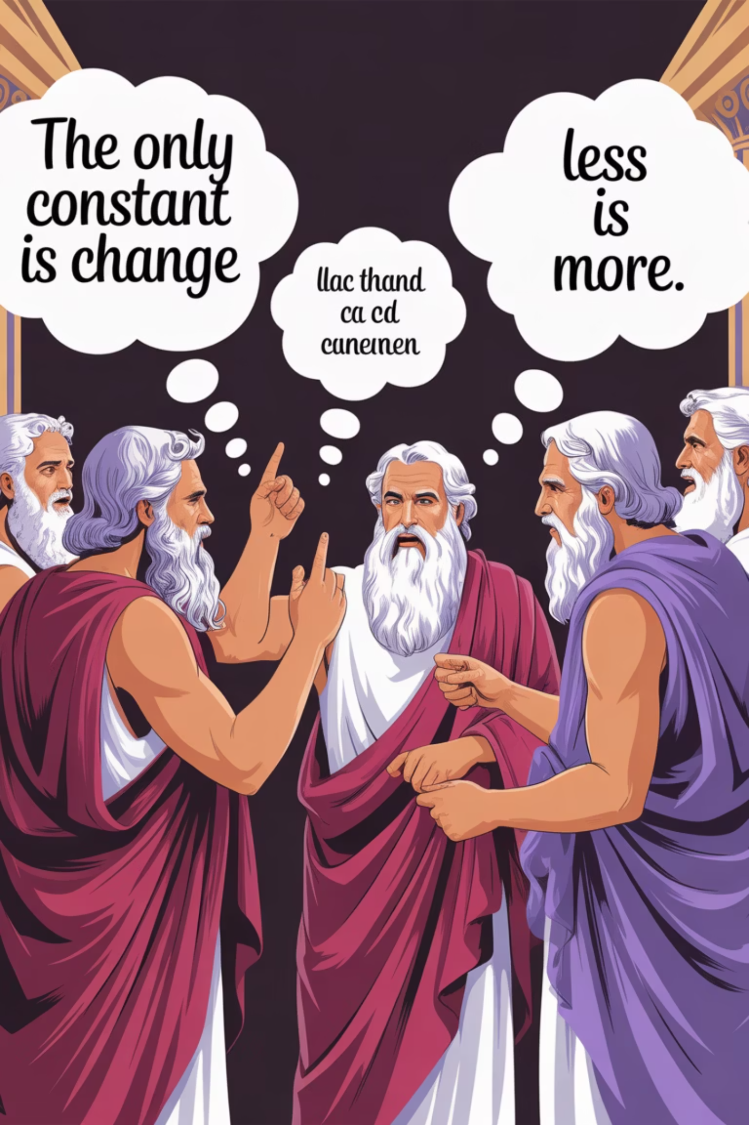
Sophisms and Paradoxes
While logical fallacies represent flawed reasoning, sophisms and paradoxes present intellectual puzzles that challenge our thinking in different ways:
Sophisms
Paradoxes
Derived from Greek "sophia" (wisdom)
From Greek "para" (contrary) + "doxa" (opinion)
Deceptive arguments crafted to mislead
Statements leading to contradictions
Used by ancient Greek "sophists" - intellectual tricksters
Stimulate critical thinking
Often catalyze intellectual advancements
Focus on appearances rather than genuine insight

Slide 8
Famous Paradoxes
Epimenides Paradox
Eubulides' Paradox
Zeno's Paradoxes
"All Cretans are liars." If Epimenides is Cretan and this is true, then he's lying, making it false. If it's false, then not all Cretans lie, potentially making it true - creating an endless loop.
"What I am saying now is a lie." If true, then it must be false; if false, then it must be true - a contradiction.
Achilles and the Tortoise: Despite being faster, Achilles theoretically never overtakes a tortoise given a head start.
Arrow Paradox: A flying arrow occupies a space at any given instant, making it theoretically motionless.

Slide 9

The Twin Paradox
A fascinating paradox that challenges modern physics:
One twin travels in a spaceship at near light speed while the other remains on Earth
Due to time relativity, time slows down for the traveling twin
Upon returning after 20 Earth years, the traveling twin has aged only about 10 years
Despite seeming impossible, this outcome is consistent with Einstein's theory of relativity

Slide 10
Why Do We Fall for Logical Fallacies?
Cognitive Biases
Mental Shortcuts
Confirmation bias leads us to favor information that aligns with existing beliefs while ignoring contrary evidence
Reliance on heuristics to process complex information quickly results in oversimplifications and errors in judgment
Emotional Influences
Social Pressures
Fear, anger, or excitement cloud thinking by overriding rational analysis with impulsive reactions
Desire to conform or gain approval makes us more likely to accept popular yet flawed arguments
Understanding these tendencies is essential for recognizing and resisting fallacies, enabling clearer, more rational decision-making.

Slide 11
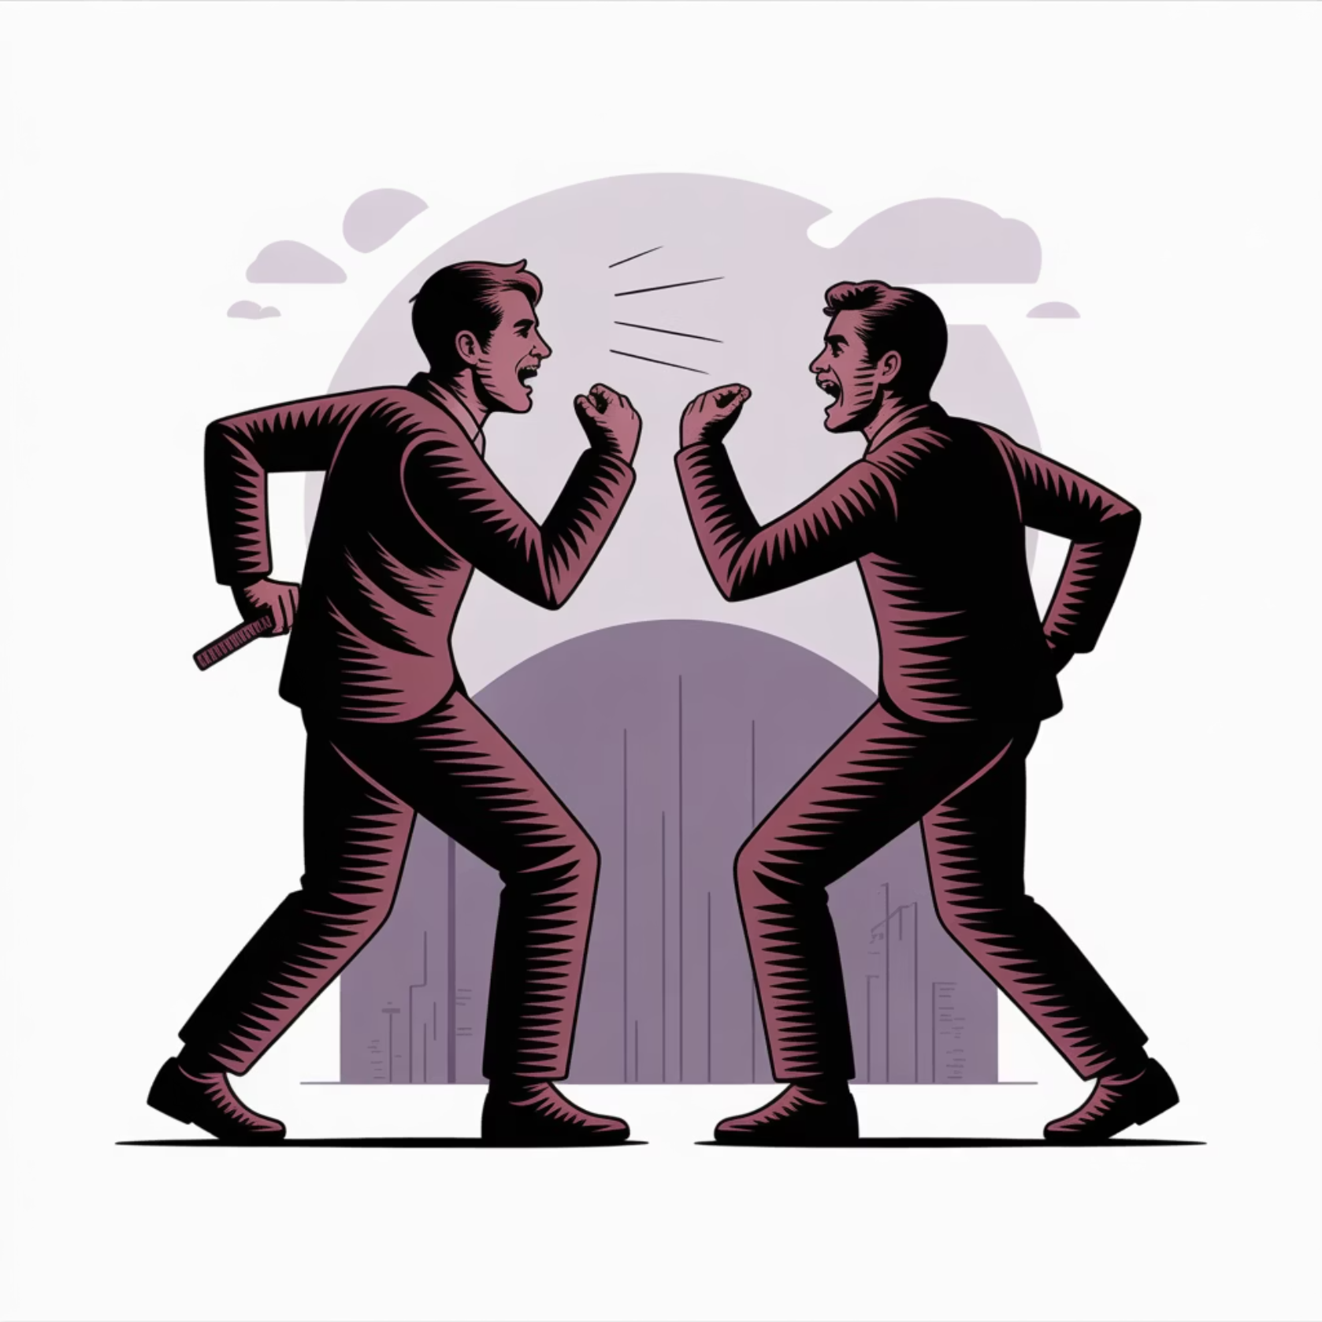
Useful Resources
Websites to Explore
Thou Shall Not Use Logical Fallacies: yourlogicalfallacyis.com
Your Bias Is: yourbias.is
PRECOBIAS pedagogical resources: precobias.eu/toolkits
These resources offer posters, cards, and comprehensive information on logical fallacies and cognitive biases to help you develop stronger critical thinking skills.

Slide 12
Thank You!
Questions?

