Slide 1
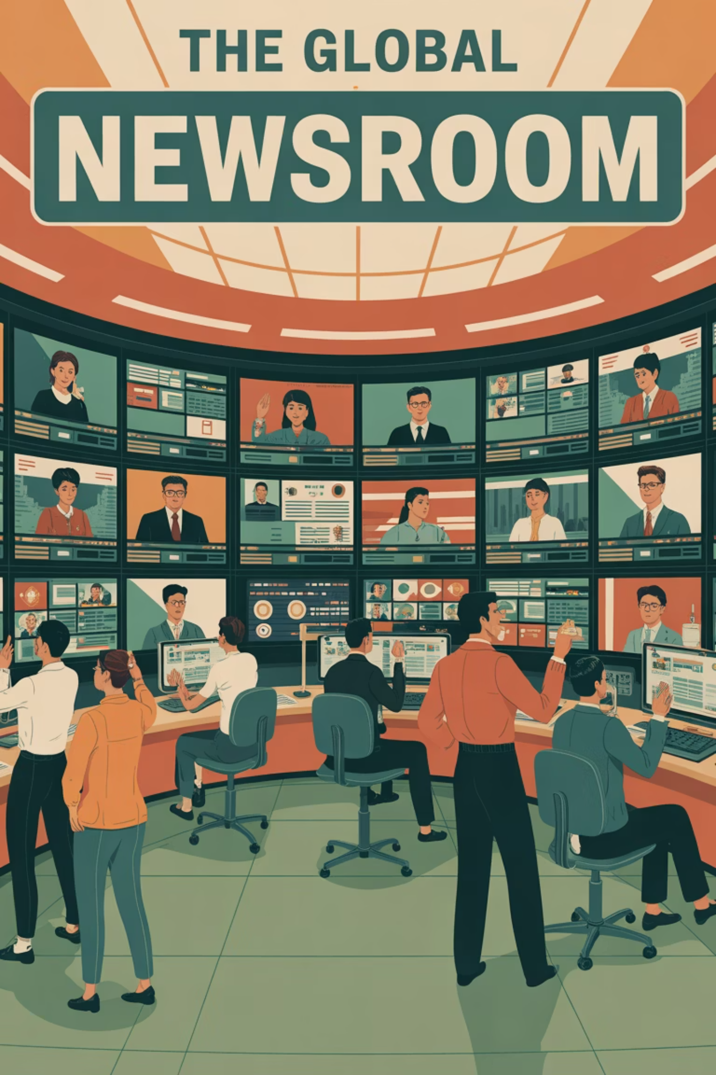

MEDIActive Youth: Informing the Balkans
Global Perspectives on News
News reporting varies significantly across the world, shaped by political, cultural and economic contexts.

Slide 2
Understanding Global News Differences
Political Frameworks
Cultural Contexts
Economic Factors
Regulatory environments and press freedom levels vary dramatically between countries, affecting how news is reported.
Cultural norms and values shape the focus and tone of reporting across different regions.
Funding models and corporate interests influence editorial decisions and coverage priorities.
Our goal is to equip readers with the tools to critically evaluate news from a global perspective.

Slide 3

News Media Across Countries
United States
United Kingdom
Highly competitive media landscape with strong investigative journalism tradition, but increasingly polarized between partisan outlets like Fox News and MSNBC.
Mix of public service (BBC) known for neutral reporting and commercial outlets, including sensationalist tabloids like The Sun.
China
Heavily government-controlled media landscape with state-run outlets like Xinhua and China Daily that align with government policies.

Slide 4

More Global Media Environments
Russia
These contrasting media environments highlight how dramatically news reporting differs across the globe. While some countries enjoy press freedom, others struggle with censorship and political control, which can fundamentally change the narrative of global events.
Dominated by state-controlled outlets like RT and Sputnik that reflect government perspectives. Opposition media faces significant censorship.
India
Diverse media landscape with thousands of outlets serving 1.4+ billion people. Press freedom exists but political and corporate interests significantly influence reporting.

Slide 5

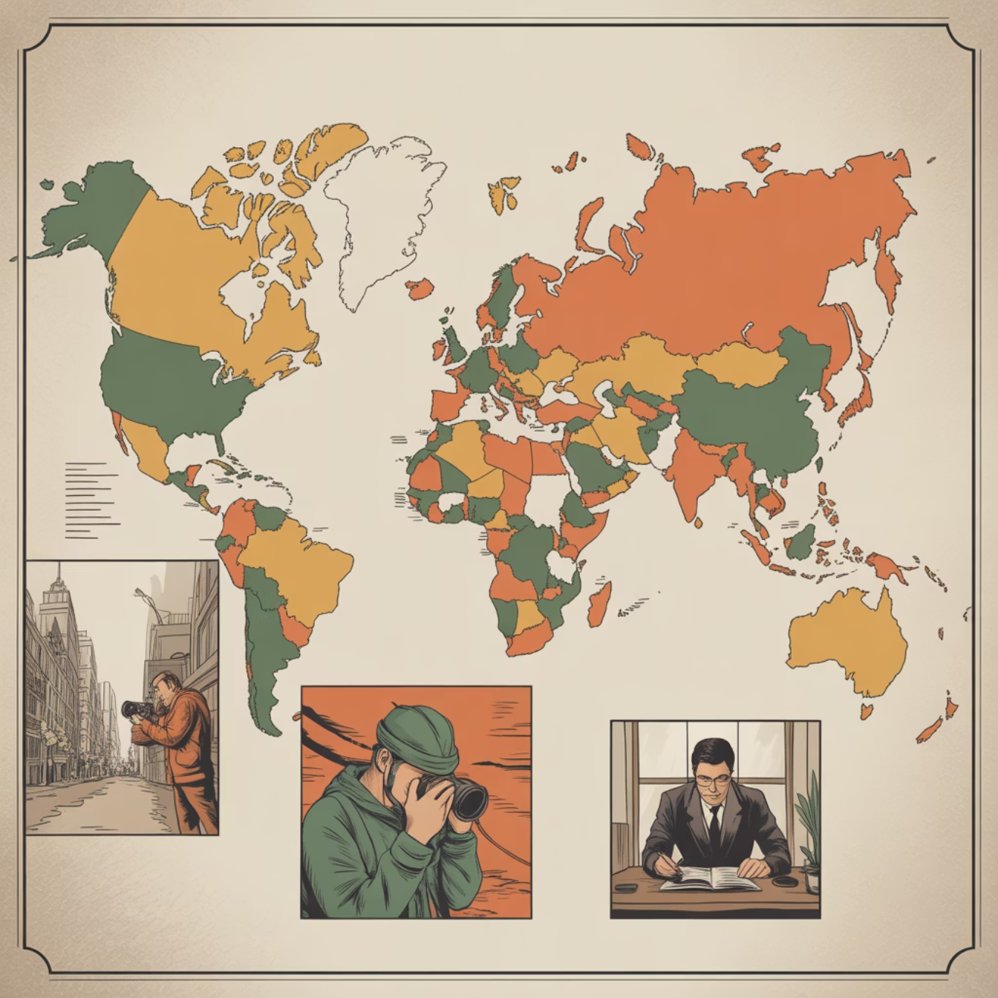
Government Control and Cultural Influence
Government Control
Organizations like Reporters Without Borders track press freedom globally through their annual Press Freedom Index rankings.
In authoritarian regimes like North Korea or Saudi Arabia, news is tightly controlled with severe restrictions on journalists. Critical views are suppressed.
In contrast, Western European democracies offer strong press freedom protections, though political and corporate influences still affect coverage.
Cultural Norms
Western outlets often emphasize individual freedoms and human rights, while many Asian news sources prioritize collective well-being and national stability.

Slide 6



Cultural Reporting Differences
Japan
African Countries
Middle East
Media outlets like NHK World known for measured, restrained reporting reflecting cultural values of harmony and social responsibility.
Local news agencies emphasize community-based reporting and developmental issues like education, health, and infrastructure.
Coverage often focuses on regional stability, religious considerations, and community impacts.
These cultural differences create distinct news narratives that reflect each society's values and priorities.

Slide 7
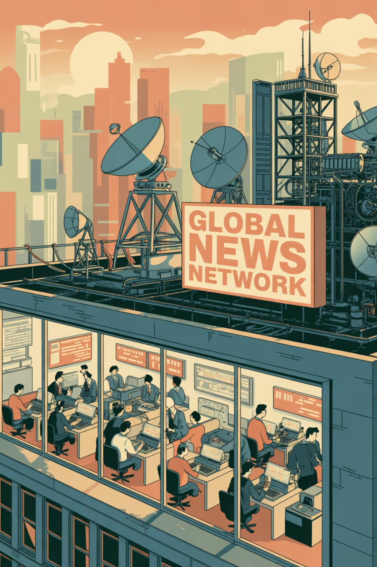
Major International News Agencies
Reuters (UK)
One of the largest agencies with a reputation for objective reporting. Many smaller organizations rely on Reuters for international coverage.
Associated Press (US)
Operates on a cooperative model, with content syndicated across thousands of media outlets worldwide.
Agence France-Presse
Strong presence in Europe and Africa with multilingual reporting from a distinctly European perspective.
Al Jazeera (Qatar)
Major player in international news that often challenges Western narratives, especially regarding the Arab world.

Slide 8
Critical News Consumption
The Global News Ecosystem
Becoming a Critical News Consumer
Smaller or less resourced outlets often republish content from major agencies, meaning that how news is framed by organizations like Reuters or AP can shape public perception worldwide.
Recognize the political and cultural context of news sources
Seek multiple perspectives on important events
Consider who owns or funds the news organization
Be aware of international agency influence
By understanding these dynamics, readers can better appreciate the diversity of news perspectives and critically engage with global reporting.

Slide 9

Thank You!
Questions?

