Slide 1

News Literacy: Navigating the Information Age
In today's fast-paced world, understanding news is more crucial than ever. This presentation will equip you with the tools to critically analyze information, identify biases, and evaluate the accuracy of news sources.

Slide 2
Lesson 1
Defining News Literacy
Critical Analysis
Beyond Fact-Checking
Examine Motives
The ability to critically analyze news sources, identify biases, and evaluate information accuracy.
Goes beyond simple fact-checking to recognize different news content types: hard news, editorials, opinion, and sponsored content.
Encourages examining the motives behind stories: Is it to inform, convince, or entertain? Are there political, commercial, or ideological motivations?

Slide 3

The Role of News in Society
Shapes Public Understanding
Keeps citizens informed about events and issues, from local to international.
Tool for Accountability
Holds powerful institutions accountable by reporting on government and corporate practices.
Fosters Social Cohesion
Connects communities through shared information, promoting mutual understanding.

Slide 4



Why News Literacy Matters Now More Than Ever
The internet has democratized information, but also created an environment where misinformation, propaganda, and sensationalism thrive.
Information Overload
Misinformation & "Fake News"
Equips Individuals
Challenging to distinguish credible information from falsehoods or biased narratives.
Empowers people to make informed decisions based on reliable information.
Spreads rapidly, fueling fear, anger, and confusion, with real-world consequences.

Slide 5

Practical Applications of News Literacy
01
Source Verification
Check the origin of a news story for reputation and professionalism.
02
Cross-Referencing
Don’t rely on a single source; cross-check with other reputable outlets.
03
Understanding Biases
Recognize that all media outlets may have biases; read across diverse perspectives.
04
Fact-Checking Tools
Use websites like Google Fact Checking or the International Fact Checking Network.
05
Mindful Sharing
Verify credibility before sharing on social media to reduce misinformation.

Slide 6
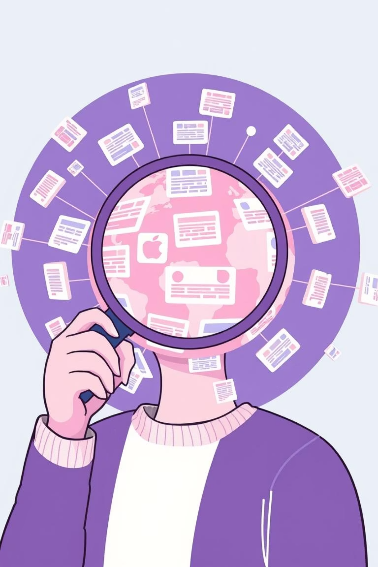



Empowering Informed Citizens
To conclude:
Cultivate Critical Thinking
Build Resilience to Misinformation
Question sources, identify biases, and seek deeper understanding beyond headlines.
Develop habits of verification and cross-referencing to navigate the complex information landscape.
Foster a More Informed Community
Your ability to discern truth contributes to collective knowledge and strengthens democratic processes.

Slide 7
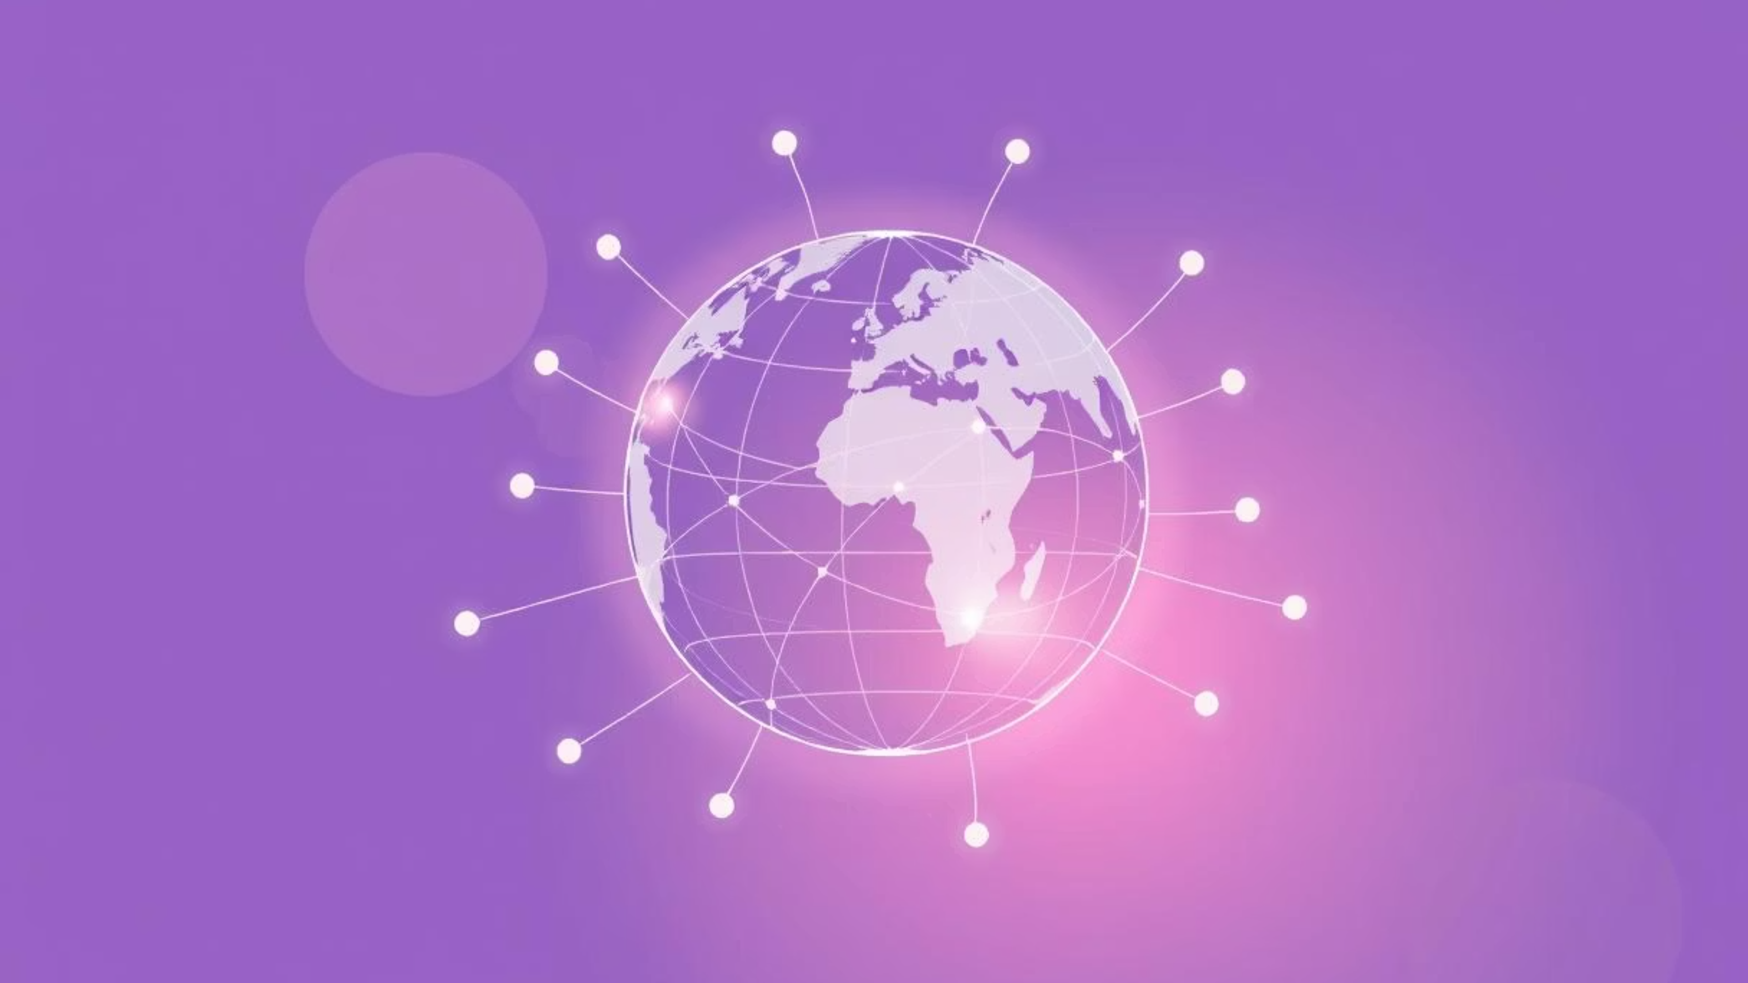
Thank You!

