Slide 1
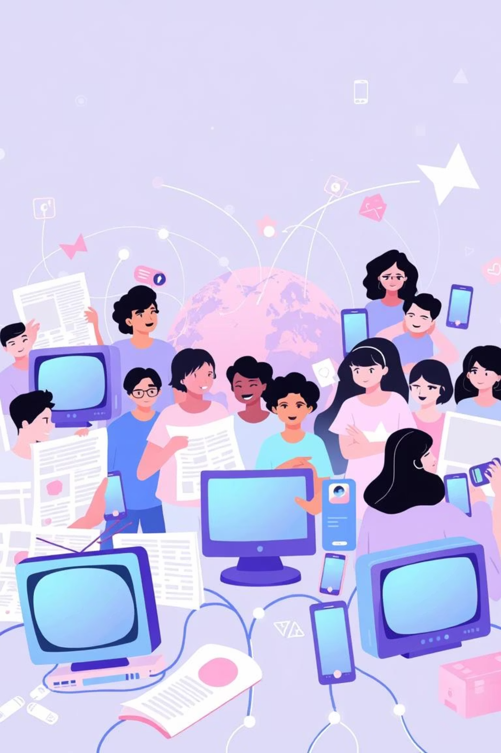
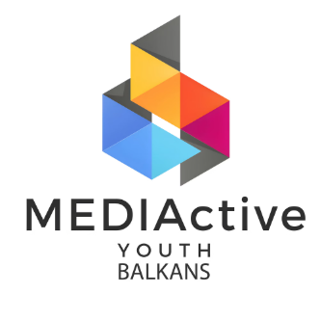
MEDIActive Youth: Informing the Balkans
The Evolving Media Landscape
How communication platforms have transformed, from traditional dominance to the rise of digital and social media, shaping an interconnected global community.

Slide 2
Introduction
Traditional vs. Digital Media
Traditional Media
Digital Media
Dominated by TV, radio, newspapers, and magazines. Characterized by one-way communication, editorial oversight, and structured content. Often viewed as more reliable due to established journalistic practices.
Emerged with the internet, enabling interactive, faster, and two-way communication. Social media platforms further allow user-generated content and rapid information spread, though with lower credibility standards.

Slide 3
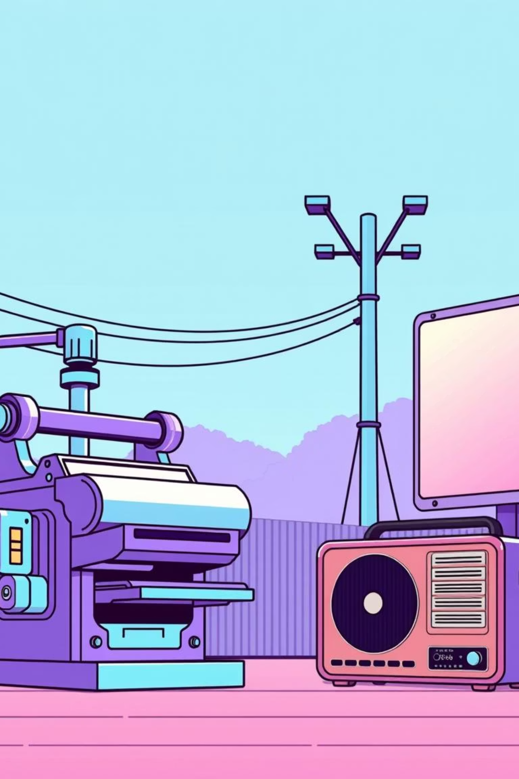
Traditional Media Types
Foundations of Mass Communication
1
2
Print Media
Broadcast Media
Newspapers, magazines, and journals. Known for in-depth reporting, analysis, and journalistic integrity.
Television and radio. Delivers content to wide audiences through regulated, scheduled programming.
3
Outdoor Media
Billboards, posters, and transit advertising. Maximizes visibility in public spaces with concise messaging.

Slide 4
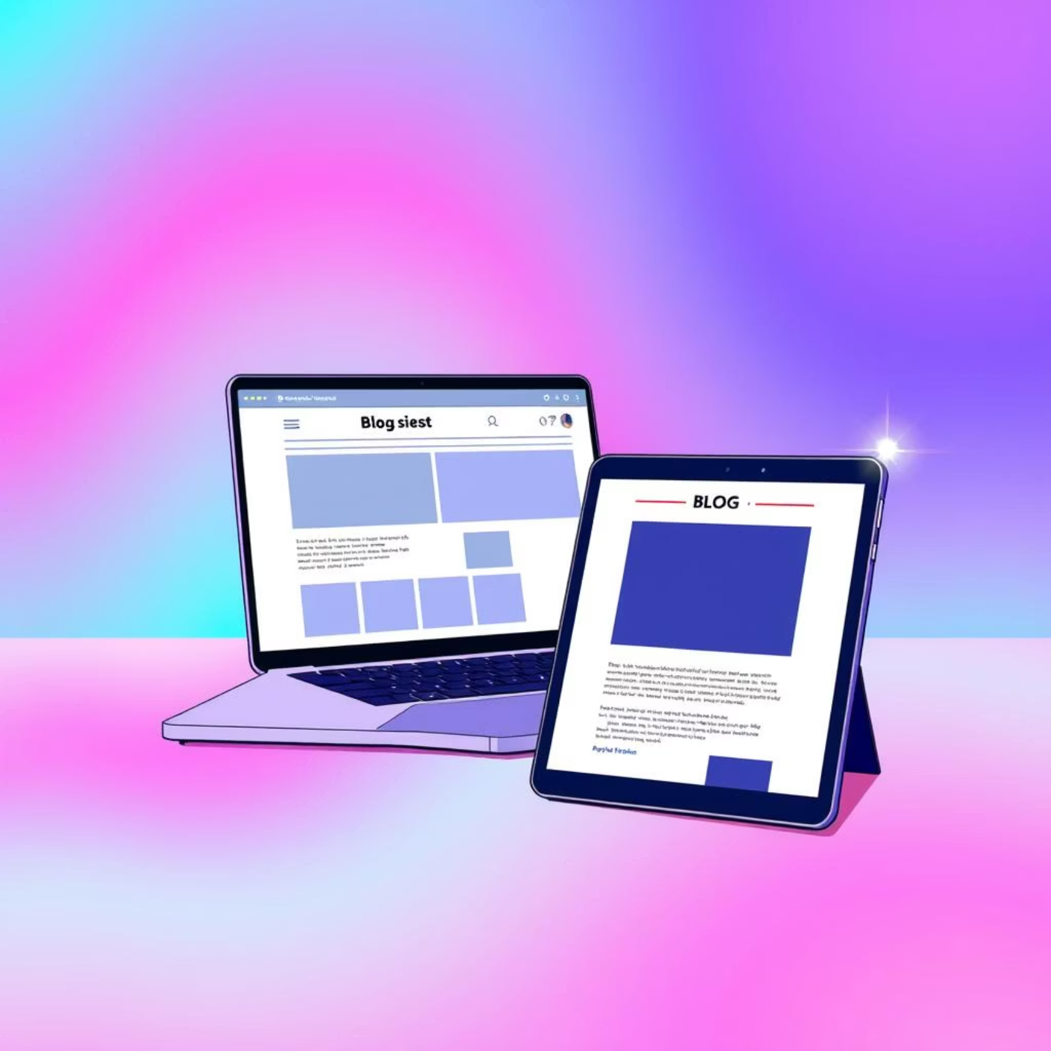
Digital Media
Transforming Information Flow
Digital media has revolutionized how information is created, shared, and consumed, breaking down traditional barriers and fostering interactive environments. Its reliance on the internet allows for near-instant global distribution and feedback.
Websites & Blogs
Foundational elements providing platforms for organizations, news, and individuals to share diverse content. Websites serve as official platforms, while blogs offer more personal, opinion-based content.

Slide 5



Social Media
User-Generated Content & Interactivity
Platforms
Video Streaming
Interactive Media
Facebook, Twitter, Instagram, LinkedIn redefine digital media through user-generated content and interactivity.
YouTube, Netflix, Twitch provide tailored content, with live streaming enhancing real-time interaction.
VR, AR, and interactive websites offer immersive experiences, allowing users to actively shape their content journey.

Slide 6
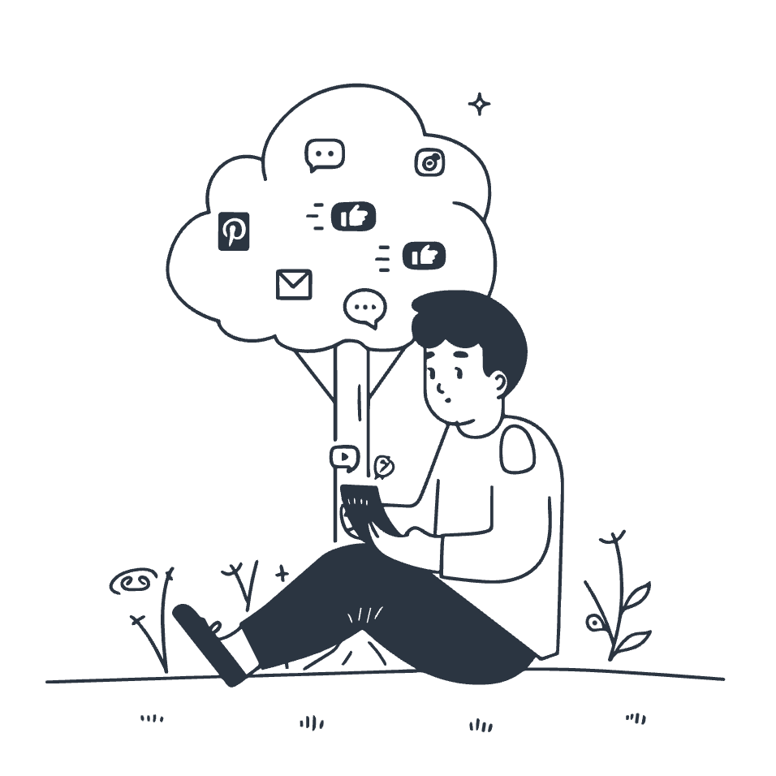
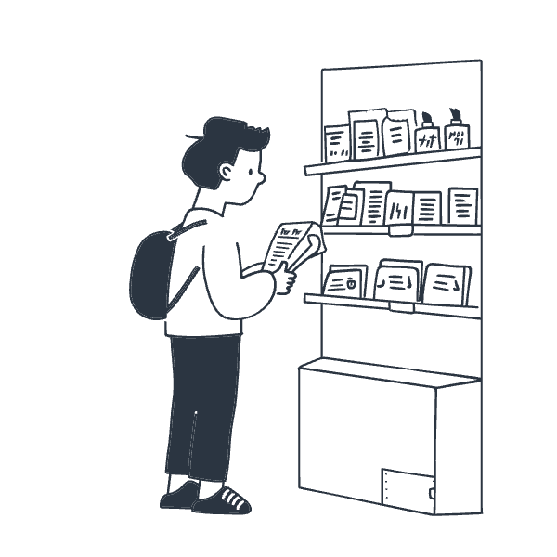
Comparing Media Types
Audience Interaction
Traditional Media
Digital Media
Known for one-way communication and passive consumption. Feedback mechanisms like letters to the editor are slow and limited.
Emphasizes two-way communication with immediate feedback via comments, shares, likes, and direct messaging.

Slide 7
Comparing Media Types
Accessibility & Customization
Traditional Accessibility
Digital Customization
Limited by geographical and timing constraints; content is available at set times or within specific areas.
Algorithms tailor content to user preferences, creating personalized experiences but potentially leading to "echo chambers."

Slide 8
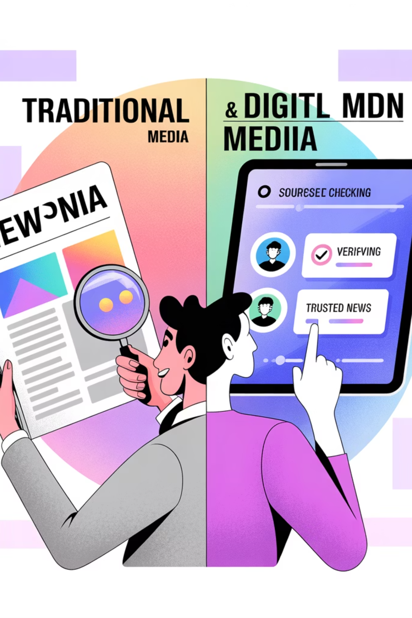
Comparing Media Types
Credibility & Fact-Checking
Traditional Media
Digital Media
Perceived as more credible due to high quality assurance, established editorial processes, and rigorous fact-checking.
Credibility is variable as anyone can publish content without strict control, contributing to the spread of misinformation. Fact-checking initiatives are crucial.

Slide 9
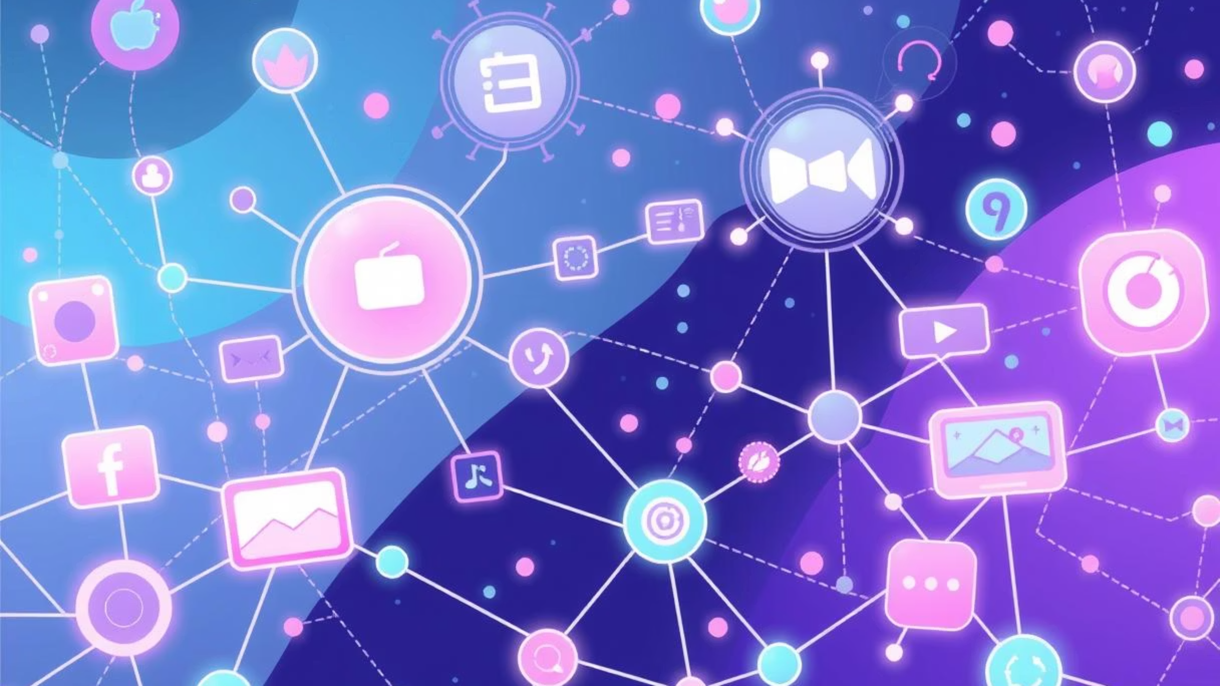
Conclusion
The Future of Media: Adapting to Change
The media landscape is in constant flux, marked by the ongoing convergence of traditional, digital, and social platforms.
This transformation empowers users with unprecedented access and interactivity, while also demanding increased media literacy and critical evaluation skills.
Understanding these dynamics is crucial for navigating an informed and engaged future.

Slide 10

Thank You
Questions?

