Slide 1
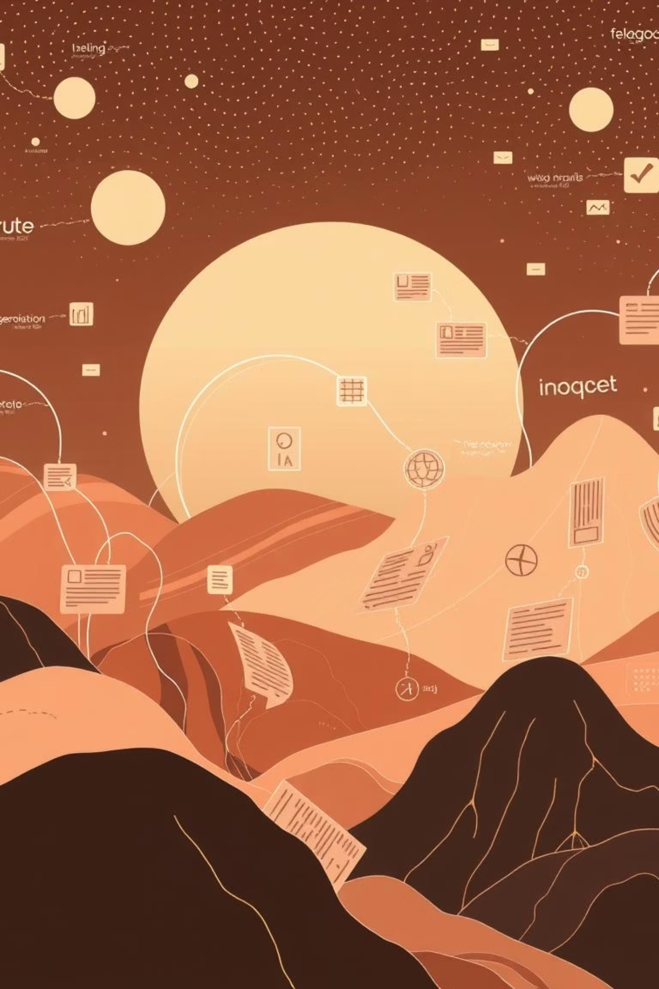

MEDIActive Youth: Informing the Balkans
Post-Truth & Information Disorder
Navigating the complex landscape of information in the digital age.

Slide 2
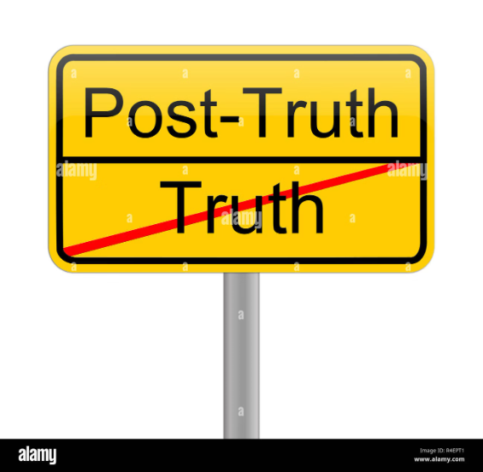
The Challenge of Information Overload
The internet is flooded with information, much of it false, placing the burden on individuals to discern truth. Widespread misinformation can lead to factually incorrect beliefs underpinning political and societal decisions, undermining community well-being.
To combat this, we must understand how people form opinions and how false information is created, disseminated, and why it's effective.

Slide 3
Understanding Post-Truth
"Post-truth is defined as relating to or denoting circumstances in which objective facts are less influential in shaping public opinion than appeals to emotion and personal belief."
Post-truth politics thrives in a polarized environment, where "the idea of truth is already split into notions of my truth vs. your truth," reinforcing existing social polarizations.

Slide 4



Information Disorder: A Broader View
The term "fake news" is insufficient, as not all misleading content is false. "Information disorder" encompasses varying degrees of deception and harm, from low-level pollution to profoundly misleading content.
Disinformation
Misinformation
Malinformation
Intentionally false content shared to cause harm (e.g., fabricated audio-visuals, conspiracy theories).
False information shared without intent to harm (e.g., inaccurate photo captions, statistics).
Genuine information shared to cause harm, often by moving private information to the public sphere (e.g., malicious distortion of context).

Slide 5
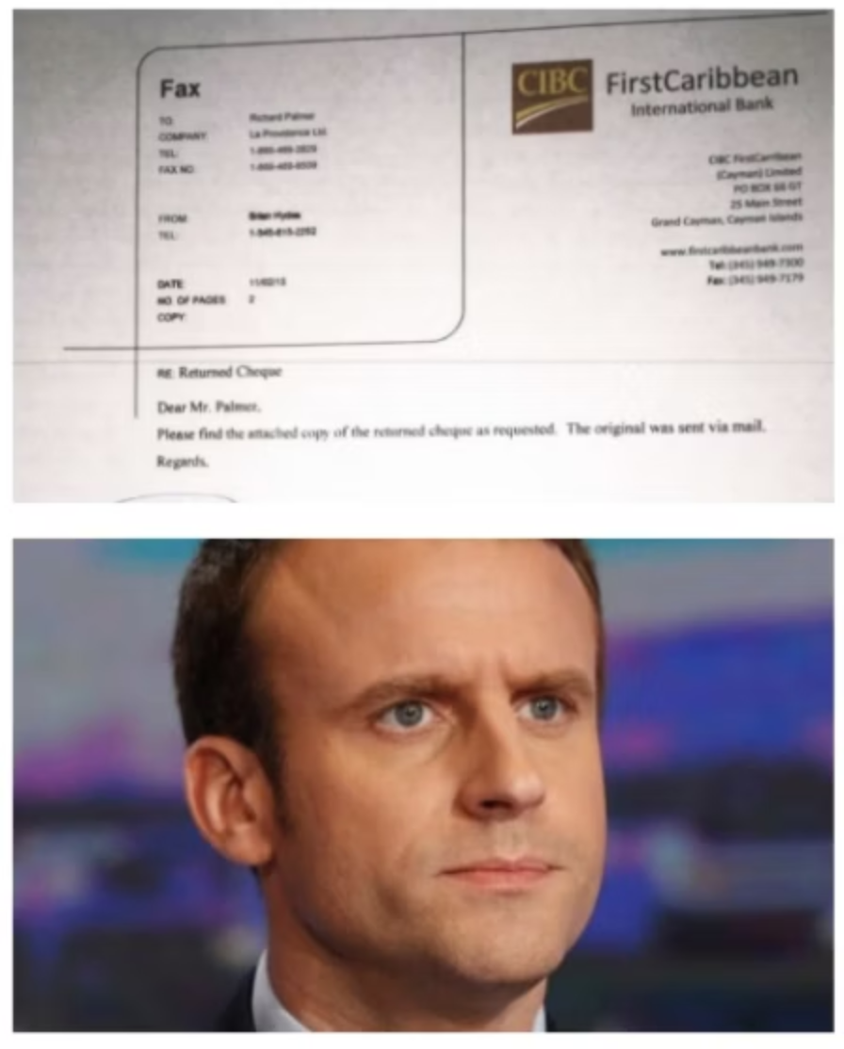
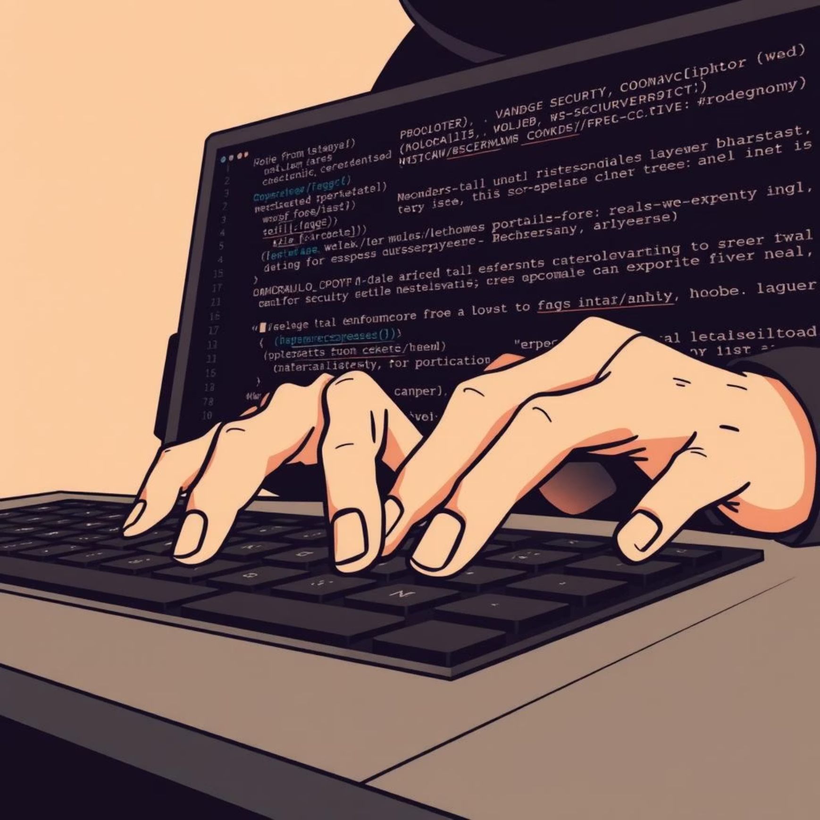
Disinformation in Action
Macron Offshore Account Rumor
Podesta Email Leak
During the 2017 French Presidential election, fabricated documents spread online claiming Emmanuel Macron had a secret offshore account in the Bahamas. The aim was to discourage voters from supporting him.
In 2016, John Podesta's emails were hacked and released by Wikileaks. While intelligence agencies found no forgery, the leak shed light on the presidential campaign's inner workings, causing harm through exposure of genuine information.

Slide 6
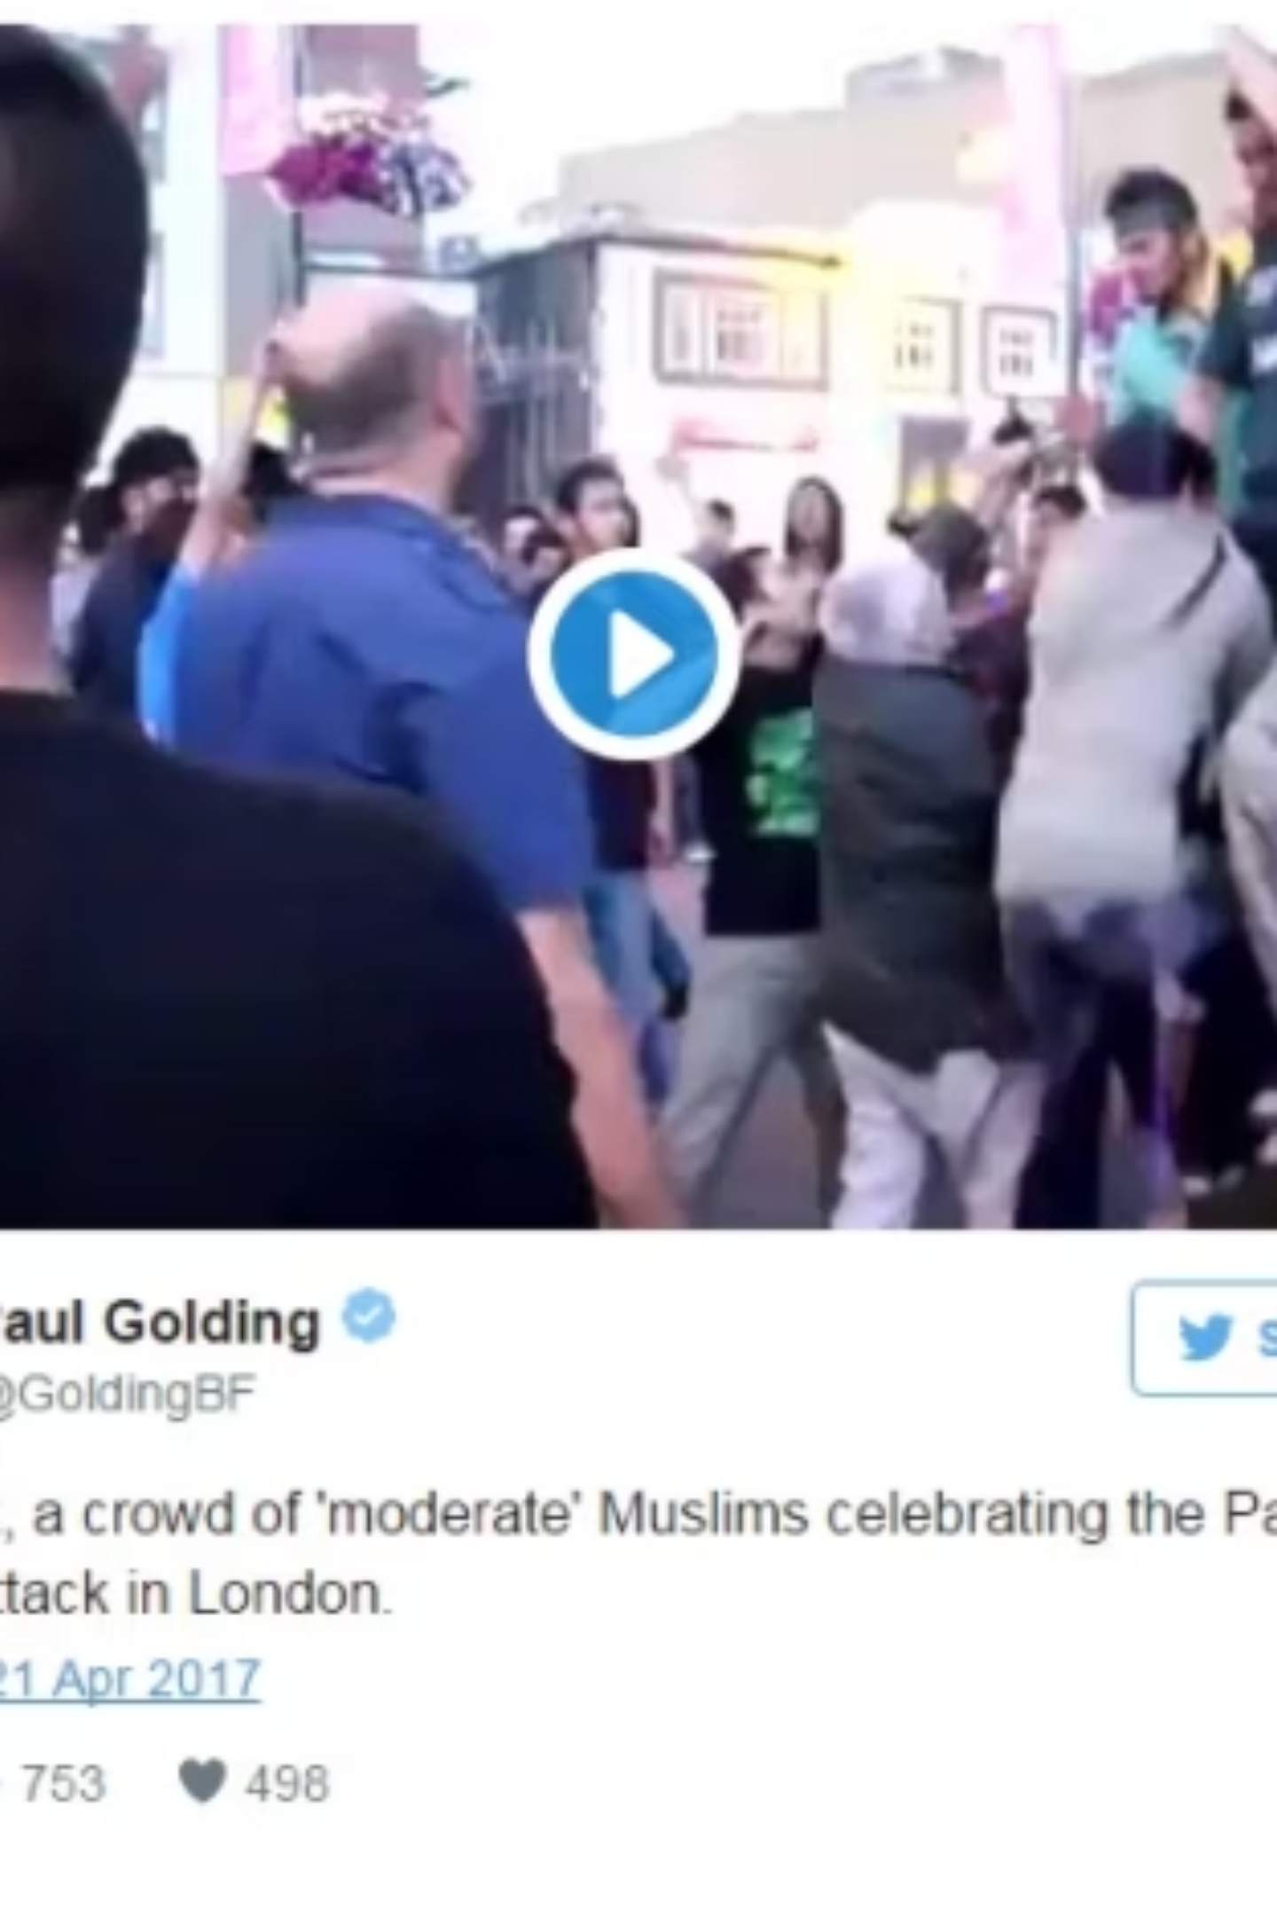
Misinformation Example
In 2017, after a terrorist attack in Paris, a video was shared claiming London Muslims were celebrating. The video was actually from 2009, showing Pakistanis celebrating a cricket victory. This is misinformation: false information shared by someone unaware of its falsity.

Slide 7

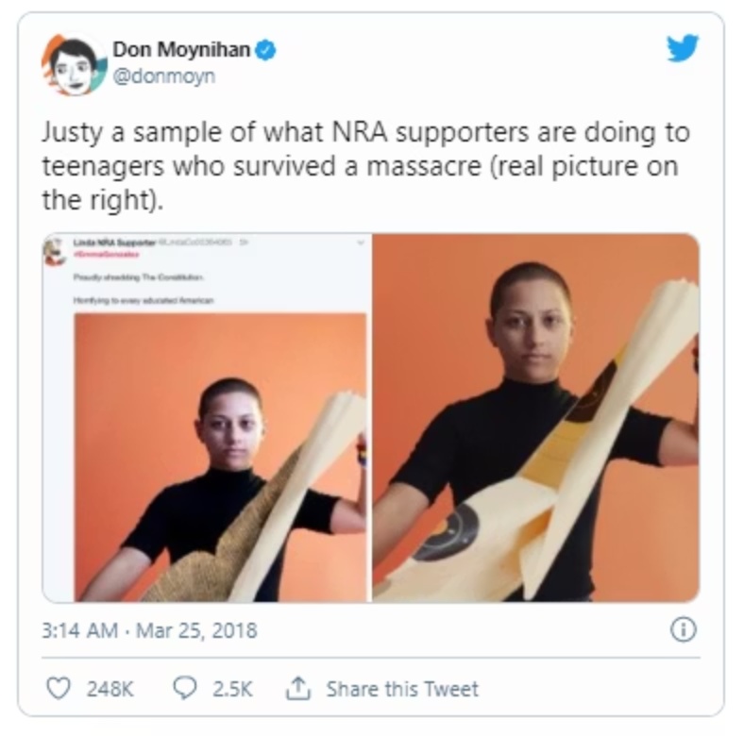
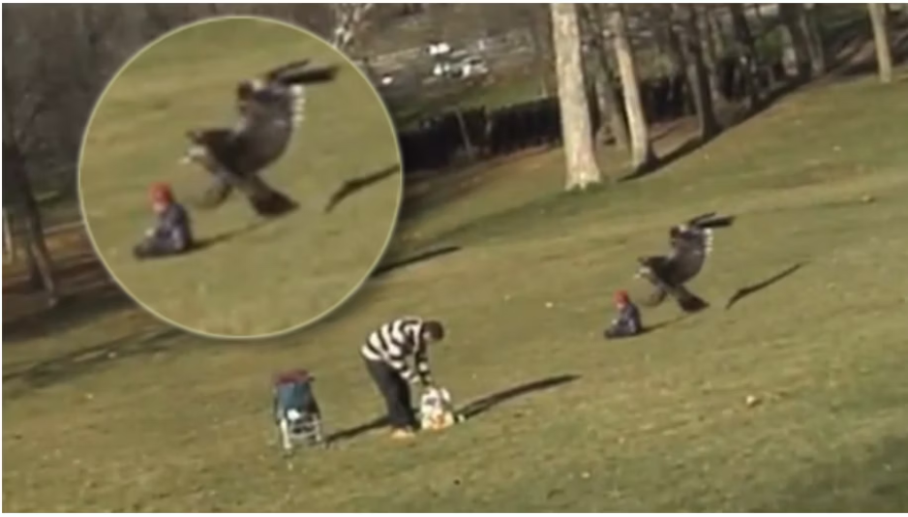
Types of Information Disorder: Manipulation
Manipulated Content
Fabricated Content
Deepfakes
Genuine content tampered with to deceive. Example: A video of Emma Gonzalez ripping a gun target was altered to show her ripping the US Constitution.
Content with no factual basis, entirely made up. Example: A hoax video of an eagle snatching a baby, created by design students.
Fabricated video and audio creating convincing but false representations of people.

Slide 8
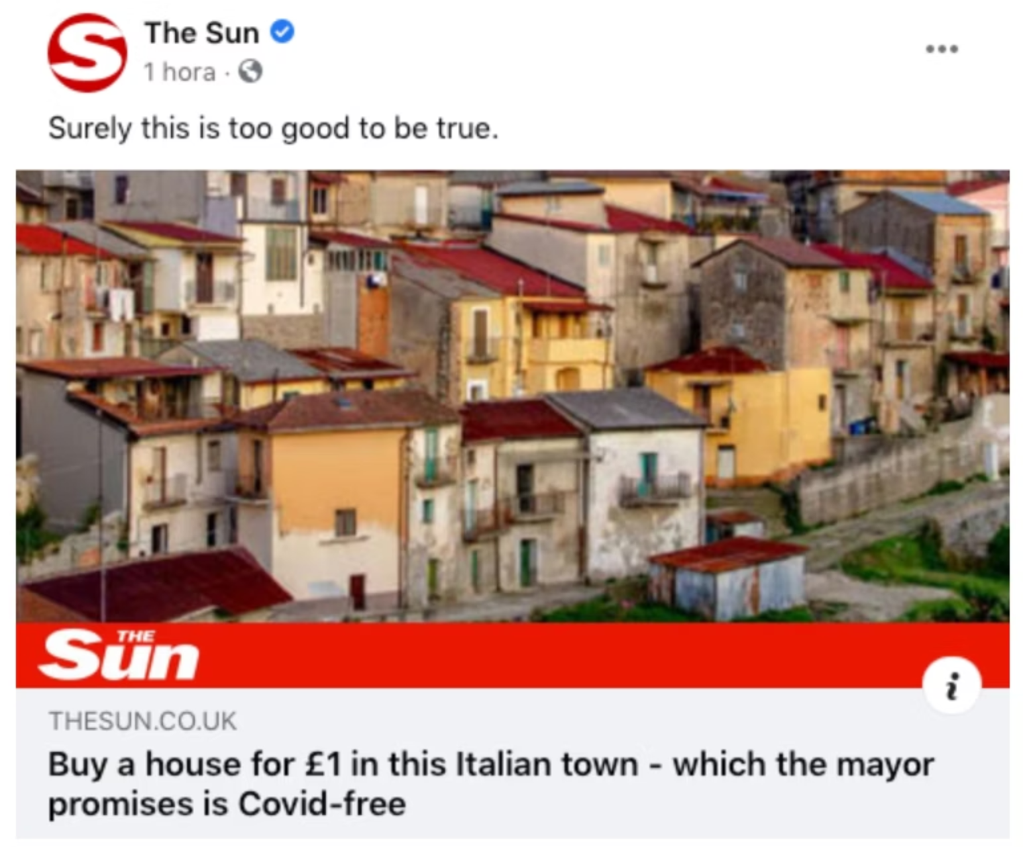
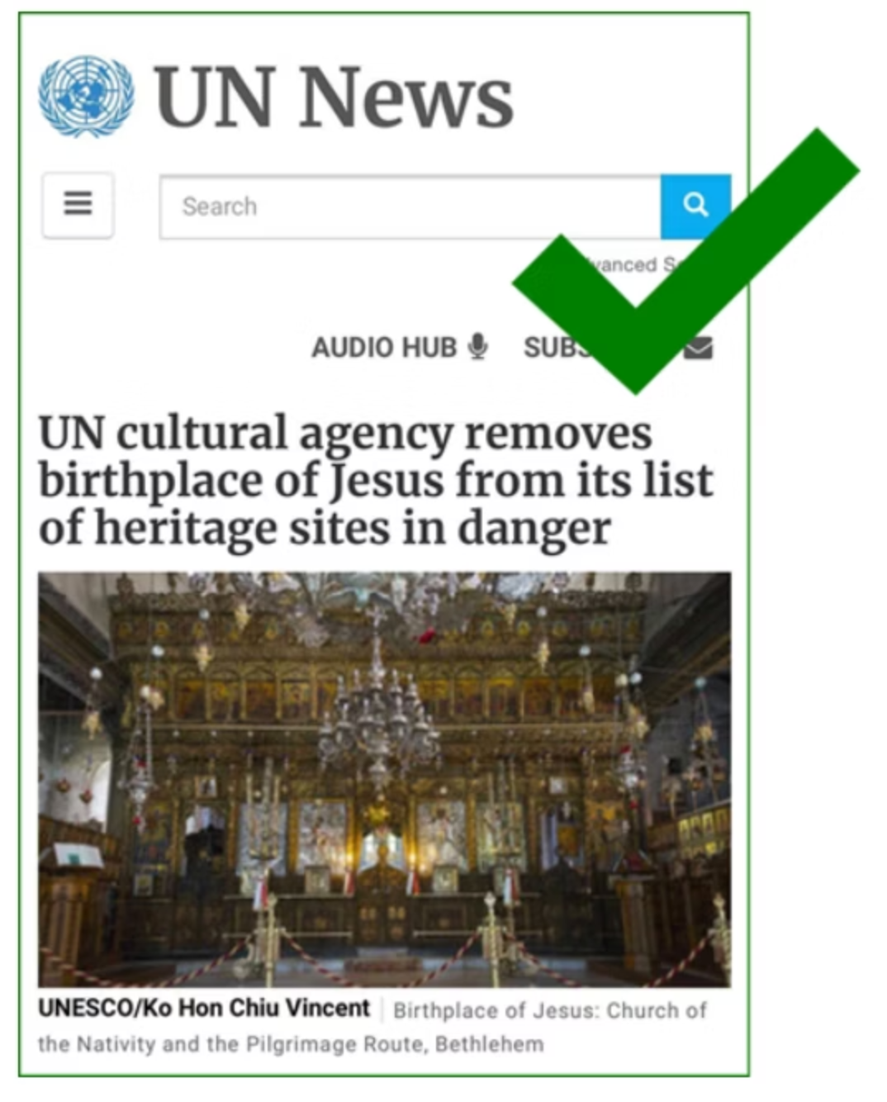
Types of Information Disorder: Context & Impersonation
Misleading Content & False Context
False Connection & Imposter Content
Authentic information presented out of context (e.g., partial quotes, selective statistics). Genuine content reframed with false contextual information (e.g., Hyde Park rubbish incorrectly linked to a protest).
Clickbait using misleading headlines. Impersonation of genuine sources (e.g., fake news sites using real brand logos).

Slide 9
Addressing Information Disorder
Navigating misinformation requires critical thinking and a multifaceted approach:
01
02
03
Education
Regulation
Technology
Promote media literacy to help individuals critically evaluate content.
Platforms must implement measures to reduce the spread of misinformation.
Develop tools to detect and flag fabricated content.

Slide 10
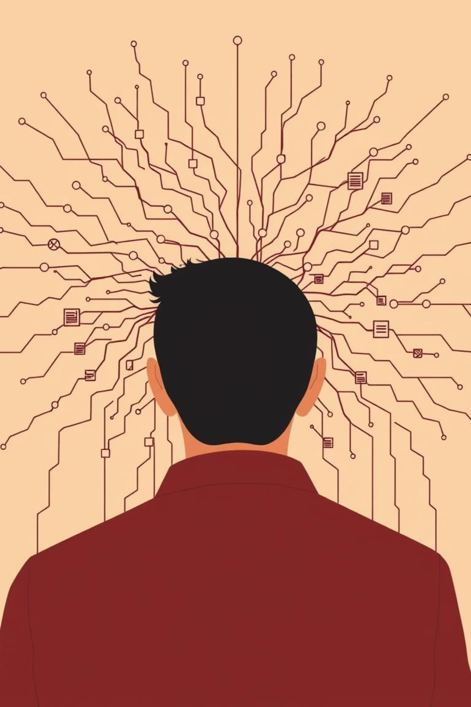
Fostering an Informed Future
Information disorder poses a complex challenge in our interconnected world, encompassing everything from unintentional misinformation to malicious disinformation and manipulation.
Understanding its various forms and impacts is the first step towards building resilience. By cultivating critical thinking, enhancing media literacy, and leveraging collective action, we can navigate this intricate landscape.

Slide 11
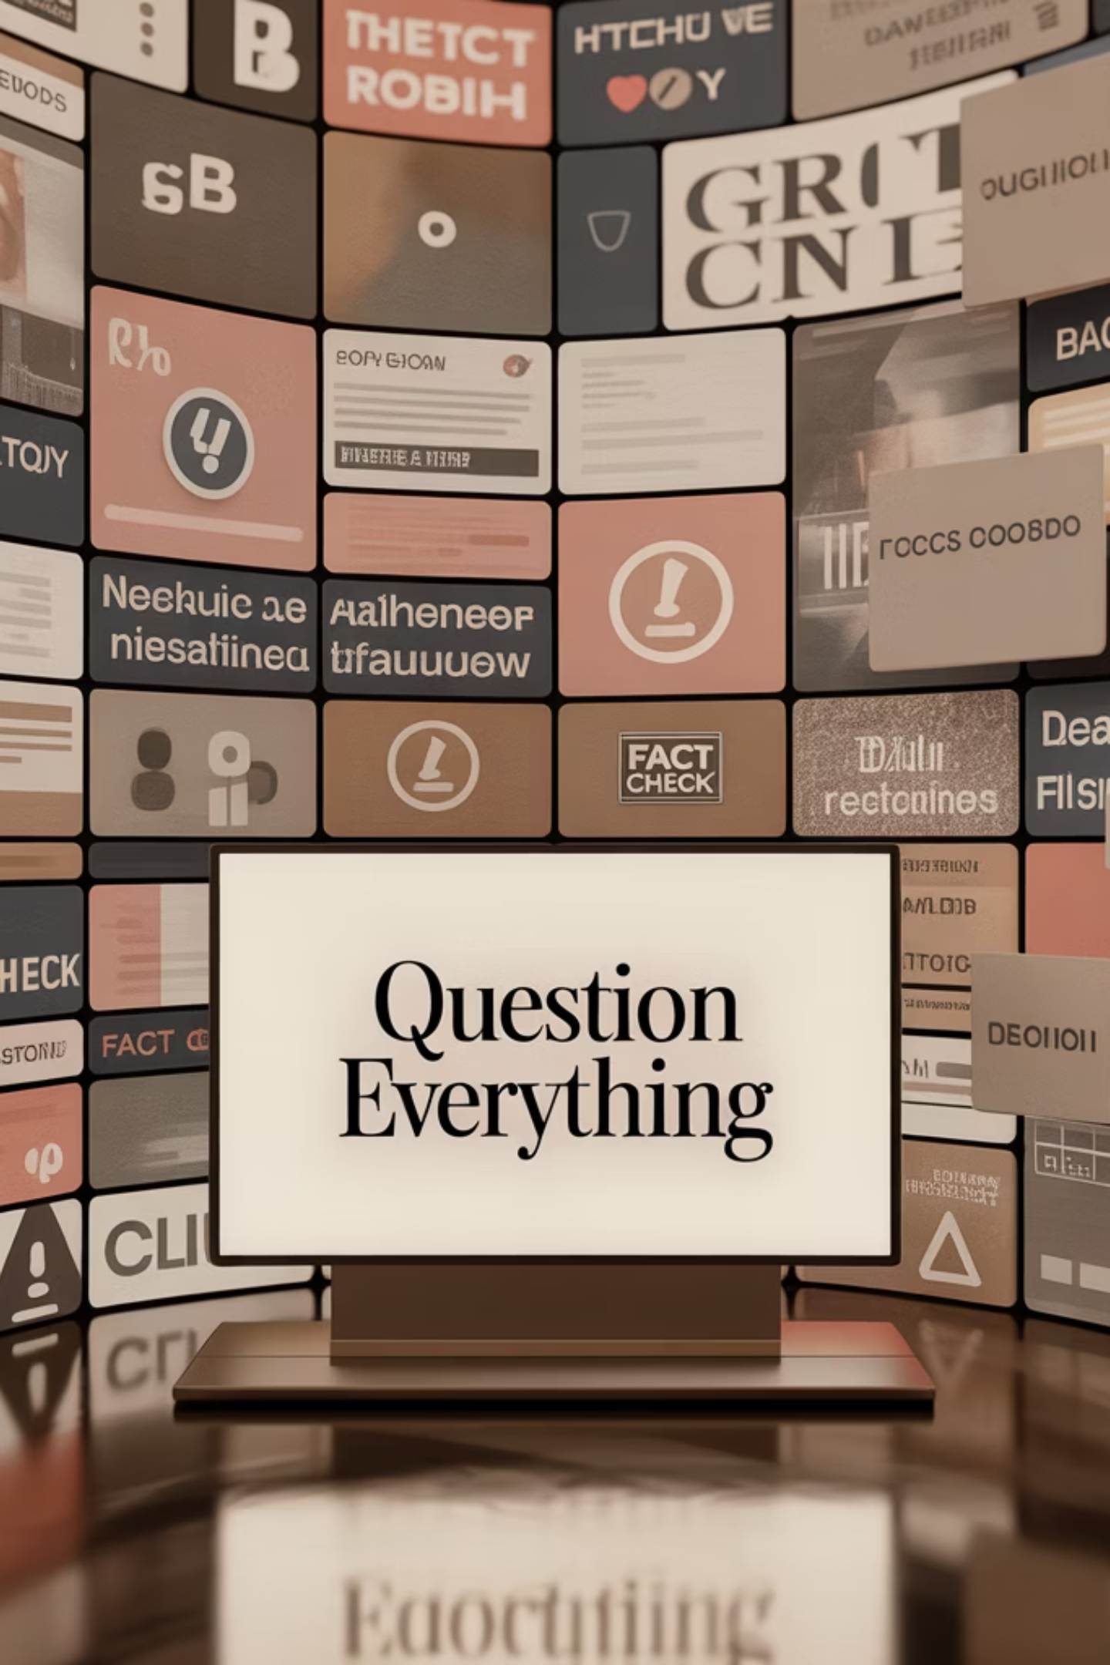
Thank You
Questions?

