Slide 1


MEDIActive Youth: Informing the Balkans
Effective Search Strategies
Navigating the Digital Information Ocean

Slide 2

The internet is like a massive library packed with information on virtually any topic, yet finding exactly what you're looking for can feel like hunting for a needle in a haystack.
With a few adjustments to your search habits, you can transform an overwhelming flood of data into a valuable resource.

Slide 3
Three Key Search Strategies:
Using Keywords and Operators
Using Advanced Search Tools
Cross-Checking Information
Learn how to refine searches with precise words and symbols to target exactly what you need.
Discover how to use filters and operators to narrow down results to the most relevant ones.
Understand how to verify facts and assess the credibility of sources to ensure reliability.
These strategies will help you save time, enhance your learning, and identify misleading or biased information before it influences your understanding of a topic.

Slide 4
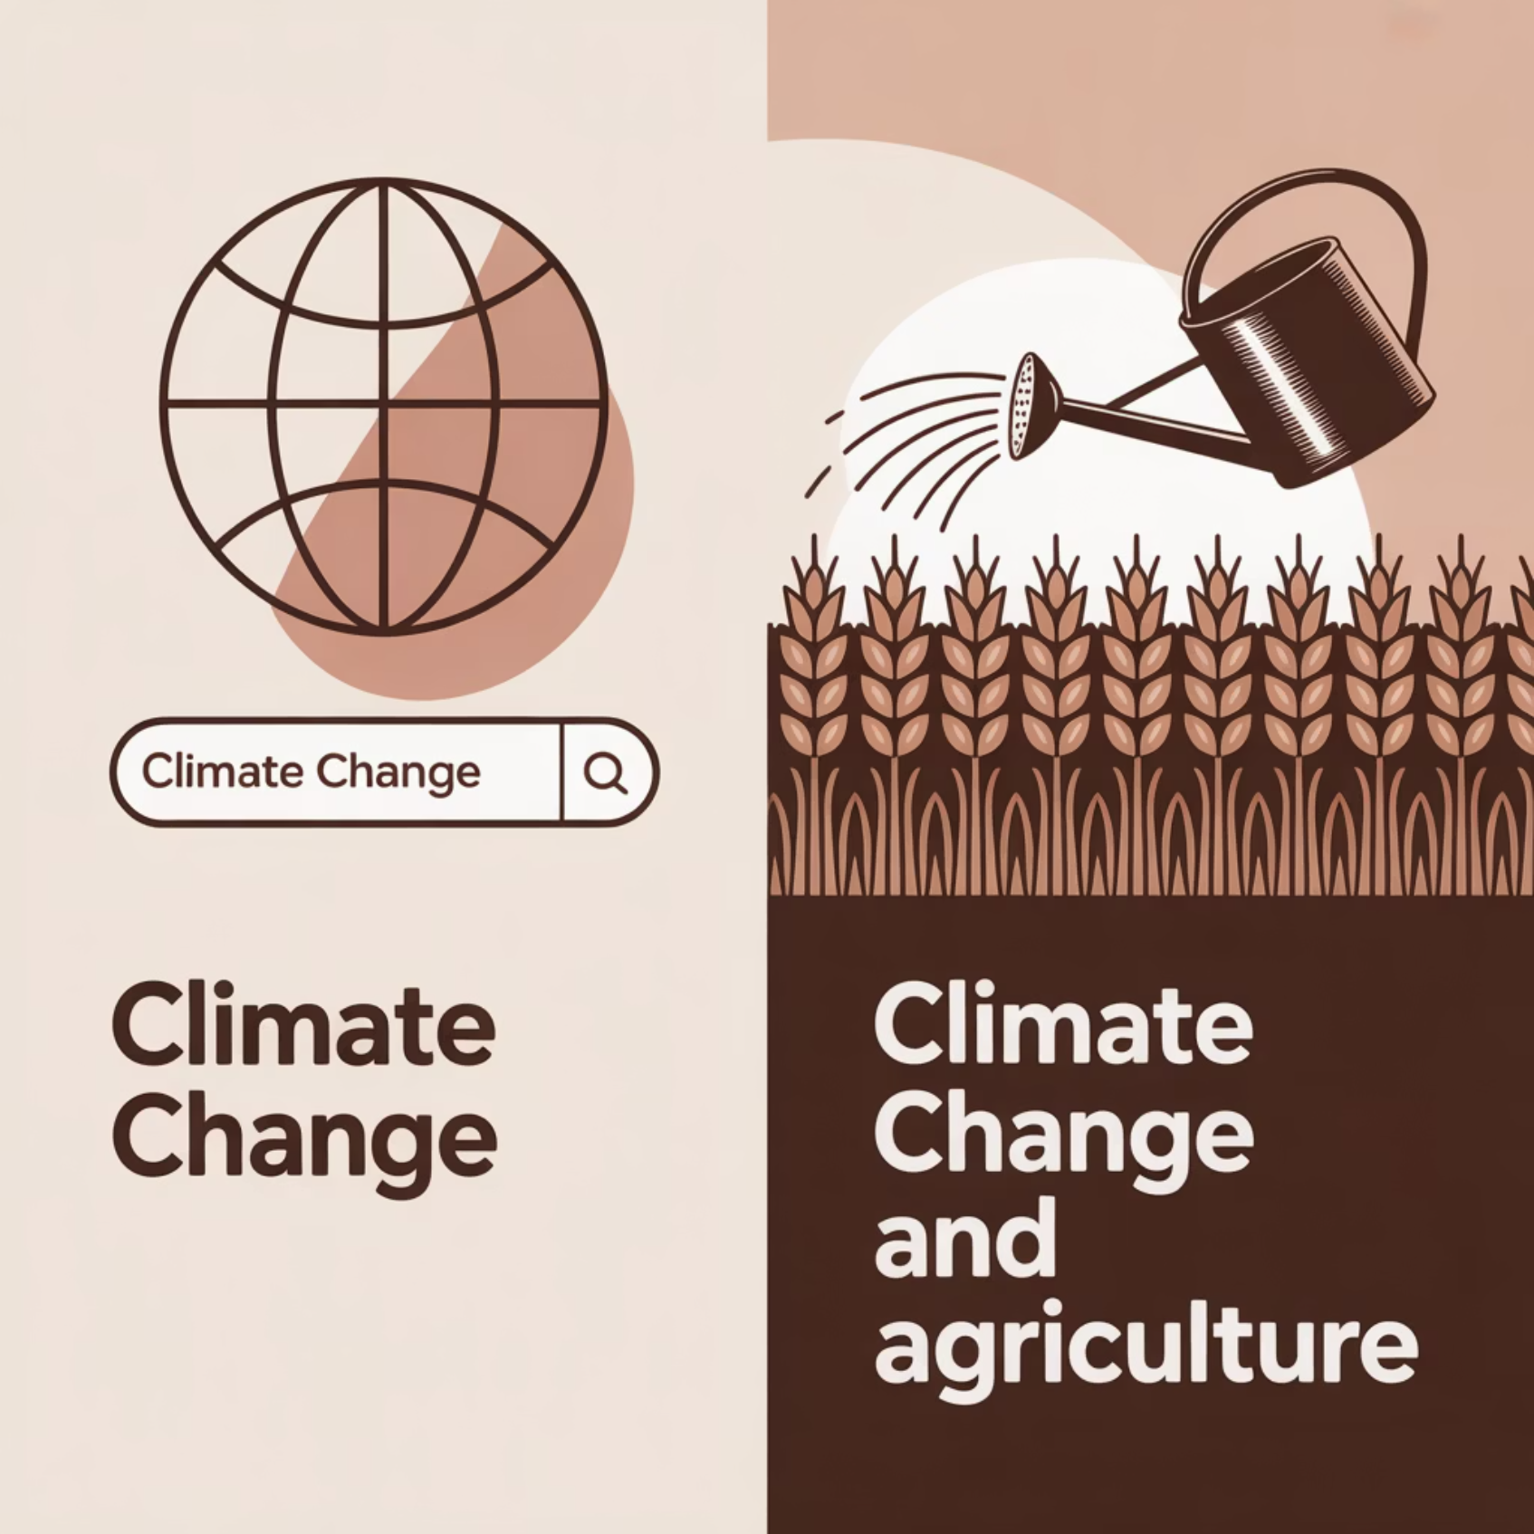
The Power of Precise Keywords
Keywords help search engines identify the main topics you're looking for. The more specific your keywords, the better your results will be.
Example: Researching climate change's impact on agriculture
Too broad: "climate change" (millions of unrelated results)
Better: "effects of climate change on agriculture" (narrowed focus)
Even better: "drought resistant crops climate change" (specific aspect)
Choosing precise keywords is the foundation of effective searching, helping you filter out irrelevant information from the start.

Slide 5
Search Operators: Refining Your Results
Quotation Marks " "
Minus Sign -
Search for exact phrases
Exclude specific terms
Example: "effects of climate change on agriculture"
Example: "climate change agriculture -economics"
Returns only results with that exact phrase
Excludes pages focused on economics
OR Operator
Asterisk * (Wildcard)
Include either term
Placeholder for missing words
Example: "climate change OR global warming"
Example: "climate * impact"
Brings results discussing either term
Returns "climate change impact" or "climate policy impact"
These operators give you greater control over search results, helping you find exactly what you need without sifting through irrelevant pages.

Slide 6

Advanced Search Tools: Precision at Your Fingertips
When basic search strategies aren't enough, most search engines offer advanced tools to help you dig deeper and refine your results even further:
Filter by:
Benefits:
Language
More precision in results
Region
Focus on exactly what you need
Date range (for latest updates)
Avoid irrelevant pages
File type (PDFs, Word documents, PowerPoint)
Find specific document formats

Slide 7

Cross-Checking Information: The Key to Reliability
One of the biggest challenges in today's information-heavy world is ensuring that what you find is credible. Misinformation and bias are widespread, making it crucial to cross-check facts from multiple sources.
Prioritize reputable sources:
Peer-reviewed journals
Government publications (.gov)
Academic institutions (.edu)
Well-established news organizations
Websites with citations and sources
Remember: Even sources that seem trustworthy at first glance should be checked. If two or more reputable sources corroborate the same information, you can be more confident in its accuracy.

Slide 8




Practical Example: Climate Change Research
Basic Search
Refined Search
"climate change"
"effects of climate change on agriculture" -economics site:.edu
Millions of results, many irrelevant to your specific needs
Academic sources focused specifically on agricultural impacts
Advanced Filters
Cross-Check
Add date filter for last 2 years, PDF file type
Compare findings across multiple academic sources
Recent academic papers in downloadable format
Verify key statistics with government reports
This progression shows how combining all three strategies leads to more reliable, relevant, and specific information than a basic search alone.

Slide 9
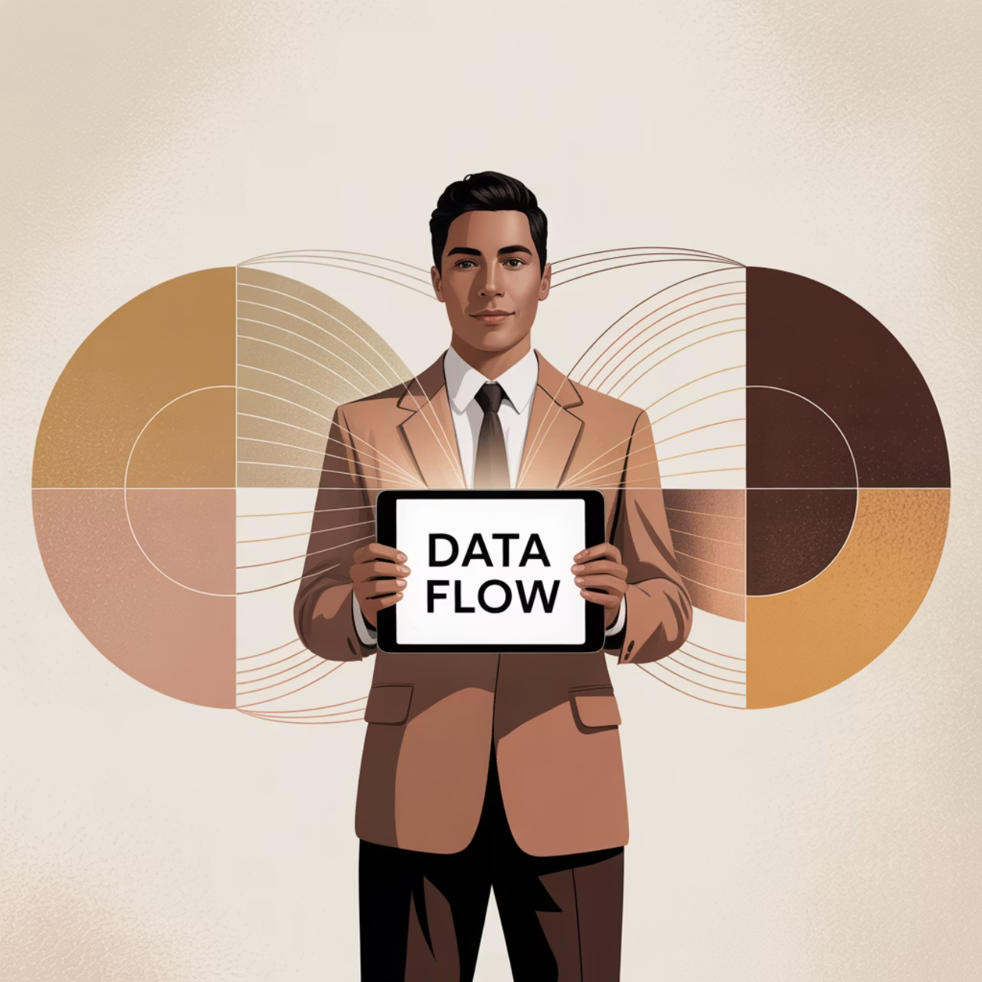
The Benefits of Mastering Search Skills
Save Valuable Time
Find what you need quickly without scrolling through pages of irrelevant results
Boost Research Quality
Access more precise, relevant information from credible sources
Ensure Accuracy
Identify and filter out misinformation by cross-checking facts
Make Better Decisions
Base your choices on reliable, comprehensive information

Slide 10




Common Search Pitfalls to Avoid
Using Too Many Keywords
Only Checking First Results
Overly complex searches can be too restrictive. Start specific and broaden if needed.
Top results aren't always the most accurate. Check multiple sources on the first few pages.
Relying on a Single Source
Ignoring Publication Dates
Always cross-check information across multiple reputable sources.
Outdated information can be misleading. Check when content was published.
Being aware of these common mistakes will help you develop more effective search habits and find more reliable information.

Slide 11

Key Takeaways: Searching Smarter, Not Harder
Remember:
Use precise keywords to target specific information
Employ search operators to refine results
Utilize advanced search tools for greater precision
Always cross-check information across multiple reliable sources
Practice these skills regularly to improve your digital literacy
Effective search skills aren't just for school—they're essential tools for everyday life in our information-rich world.
With practice, you'll find credible information faster, understand different perspectives, and make better-informed decisions. Make your searches smarter, not harder!

Slide 12
Thank you!
Questions?

