Slide 1


MEDIActive Youth: Informing the Balkans
Navigating the Maze of Fake News
Understanding Disinformation and Misinformation

Slide 2

In today's digital world, distinguishing between fact and fiction is essential. This presentation will help you identify "fake news" and understand the difference between disinformation and misinformation, providing practical tools to verify information and assess its reliability.

Slide 3
Learning Objectives
Define Key Terms
Identify Examples
Apply Verification Tools
Understand fake news, disinformation, and misinformation and how they differ from each other
Recognize real-world instances of disinformation and misinformation in media
Use practical tools and techniques to verify information and assess its reliability
By mastering these skills, you'll become a more critical consumer of information in our increasingly complex media landscape.

Slide 4
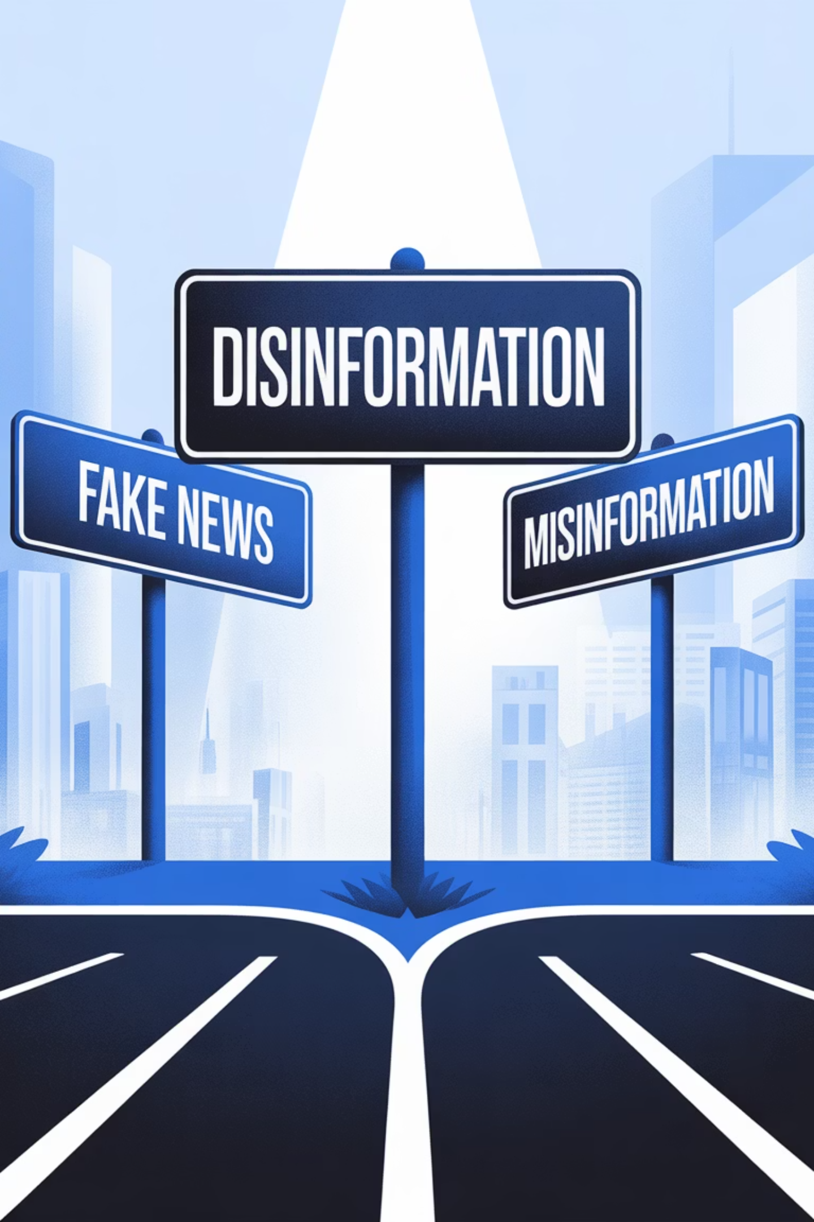
Understanding the Terminology
Fake News
Disinformation
False information presented as news. It can be spread through traditional media or social media.
False information that is intentionally created to mislead people.
Misinformation
Incorrect information that is shared without harmful intent, usually out of error or misunderstanding.

Slide 5
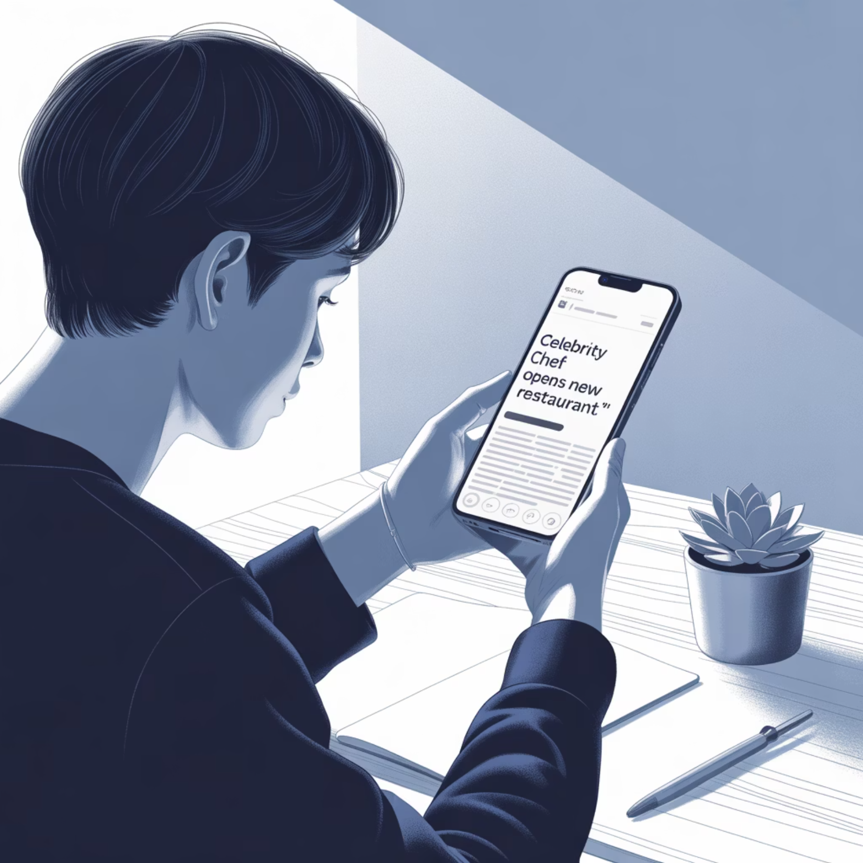
Example
Celebrity Career Change Rumor
As Misinformation: A rumor shared without fact-checking that a celebrity is quitting their career to start a new business.
As Disinformation: The same story deliberately created to promote an unrelated product by using the celebrity's name.
The key difference is in the intent behind the false information.

Slide 6



Why Do People Create and Share Fake News?
Financial Gain
Political Agenda
Entertainment
Creating fake news to attract clicks and generate advertising revenue
Using disinformation to sway public opinion or manipulate election outcomes
Satirical news that can sometimes be mistaken for real news if not labeled clearly
Think about a recent example where you encountered false information. Was it shared intentionally or by mistake? What might have motivated its creation?

Slide 7


Red Flags: How to Spot Fake News
Suspicious Sources
Information from unknown or unreliable sources, or those known for sensationalism
Exaggerated Headlines
"Shocking!" or "Unbelievable!" headlines designed to grab attention rather than inform
Emotionally Charged Language
Content designed to provoke anger or fear may be using emotion to manipulate
Lack of Evidence
Absence of sources, references, or evidence to support claims made in the article

Slide 8


Case Study: COVID-19 Misinformation
During the pandemic, rumors about "miracle cures" for COVID-19 circulated widely on social media.
As Disinformation:
As Misinformation:
Claims created by individuals wanting to sell specific products
Well-meaning shares by people who believed in unverified cures
Deliberately fabricated "studies" or "testimonials"
Misinterpreted scientific studies
Coordinated campaigns to undermine official health guidance
Cultural remedies shared without harmful intent

Slide 9

Practical Tools for Verifying Information
Fact-Checking Websites
Use sites like Faktograf (Croatia) or Raskrikavanje (Serbia) to verify news stories and claims.
Reverse Image Search
Use Google's Reverse Image Search or TinEye to check if an image has been altered or used out of context.
Source Verification
Trace information back to its original source. If it can't be linked to a trustworthy source, be skeptical.

Slide 10
Practical Application: Analyzing a Fake News Article
"Miracle Fruit Found in Albania Cures All Diseases!"
Red Flags in the Article:
Questions to Ask:
Extraordinary claims without scientific evidence
Who published this article?
Anonymous sources ("one resident," "local farmer")
Are there credible scientific studies cited?
Conspiracy theory elements ("Big Pharma doesn't want you to know")
Can this information be verified by other sources?
Why would a "miracle cure" not be widely reported?
Emotionally charged language ("miracle," "wonder cure")
What might be the motivation behind this story?
No verification from authorities or experts

Slide 11
Your Fake News Detection Checklist
1
2
3
Verify the Source
Check the Headline
Cross-Reference
Who is providing this information? Is it a credible news organization or an unknown website?
Is it trying to shock or scare you? Does it match the actual content of the article?
Can you find this news on other reputable sites? Do multiple sources confirm it?
4
5
Look for Evidence
Use Fact-Checkers
Are there sources or evidence to back up the claims? Are experts cited by name?
Have you verified the information with a reliable fact-checking site?
Remember: Staying informed means staying critical! By applying these tools and techniques, you can protect yourself from misleading information online.

Slide 12

Questions?
Thank You for Your Attention!

