Slide 1


MEDIActive Youth: Informing the Balkans
Fact-checking and Verification Tools
Navigating the information landscape with confidence.

Slide 2

In today's fast-paced digital world, misinformation and disinformation spread very fast, making it crucial to develop skills in fact-checking and information verification. The ability to critically go through news and data is essential for everyone, from journalists and educators to everyday users of media.
This presentation explores key tools and resources, effective techniques for verifying sources, and common pitfalls to avoid when doing fact-checking.

Slide 3
Agenda
1
Tools and Resources
2
Verification Techniques
3
Common Pitfalls
Explore freely accessible platforms designed to verify the authenticity of news, images, and other media
Learn effective methods for cross-referencing sources, checking images, and assessing credibility
Understand the mistakes people frequently make when verifying information
By the end of this presentation, you'll have practical knowledge to help combat false information and stay informed with facts.

Slide 4
Essential Fact-Checking Tools
Google Fact Check Explorer
Snopes
PolitiFact
Compiles fact-checks from reputable sources across the web, allowing users to search for claims and see how they have been evaluated.
One of the most well-known fact-checking websites, specializing in debunking myths, urban legends, and viral information.
Provides detailed fact-checking on political statements, grading them on a "Truth-O-Meter" to show how accurate they are.
Familiarity with these platforms enables users to perform quick fact-checks before sharing or relying on information.

Slide 5
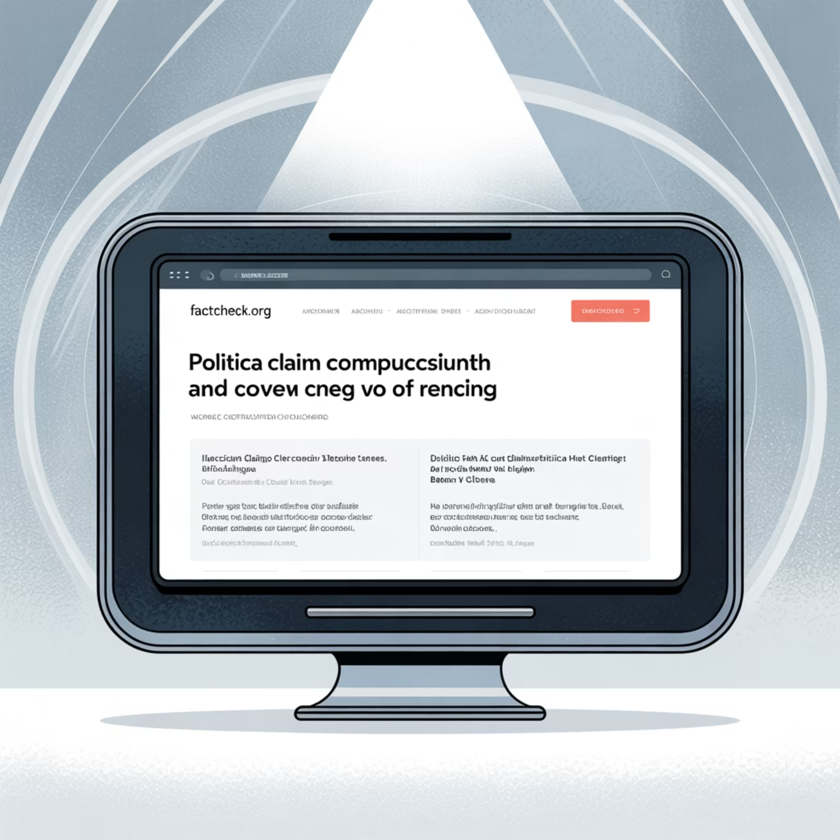
More Specialized Verification Tools
FactCheck.org
Visual Verification Tools
A non-partisan, non-profit organization that provides in-depth analysis and debunks false political and public policy claims.
TinEye: A reverse image search tool that helps verify the origin of an image
InVID: A browser extension that helps verify videos and images from social media
These tools are essential for identifying manipulated or out-of-context visuals that often spread rapidly online.

Slide 6



Cross-referencing with Reputable Sources
Always verify a claim by consulting multiple trustworthy sources.
Established News Outlets
Academic Journals
Official Reports
Organizations with strong editorial standards and fact-checking processes
Peer-reviewed publications with rigorous verification standards
Documents from reputable organizations like WHO or government agencies
Example: For medical claims, consult the World Health Organization or PubMed to confirm legitimacy.

Slide 7



Image and Video Verification Techniques
Images are often misused or taken out of context to mislead viewers.
Reverse Image Search
Use Google or TinEye to trace an image back to its original source
Check Metadata
Analyze information like location, time, and date of creation using tools like FotoForensics

Slide 8

Assessing Source Bias and Credibility
Understanding the bias or reputation of a source is vital for accurate fact-checking.
Media Bias/Fact Check
Ownership Research
Provides analysis of a source's political leaning, factual reporting record, and transparency
Investigate who owns the publication or website to understand potential conflicts of interest
Track Record Analysis
Examine the source's history of corrections, retractions, and accuracy
This allows you to determine whether a source is likely to present information accurately or if it might be changed due to bias.

Slide 9

Common Pitfalls in Fact-Checking
1
2
Confirmation Bias
Over-reliance on One Source
People often seek out information that supports their pre-existing beliefs. To avoid this, actively search for opposing viewpoints and challenge your assumptions.
Relying on a single source for fact-checking, even if reputable, can lead to incomplete or wrong results. Always check information with multiple sources.
Understanding these pitfalls can help ensure more accurate assessments when verifying information.

Slide 10

More Fact-Checking Challenges
Misinterpretation of Satire
Ignoring Context
Satirical news websites like The Onion or The Borowitz Report often produce exaggerated or fabricated stories for comedic purposes. Fact-checkers should be aware of these sources to avoid misinterpreting satire as legitimate news.
Even factual information can be misleading if taken out of context. Always consider the broader context in which a statement or statistic is made.
Example: A report on crime rates might sound alarming, but it's important to check over what time frame and under what circumstances those rates were recorded.

Slide 11
The Importance of Fact-Checking
In the 21st century where information is increasingly accessible yet frequently unreliable, the importance of fact-checking and verification cannot be overseen.
3
4
4
Key Tools
Verification Techniques
Common Pitfalls
Google Fact Check Explorer, Snopes, PolitiFact
Cross-referencing, reverse image search, metadata checking, source assessment
Confirmation bias, over-reliance on one source, misinterpreting satire, ignoring context
By utilizing the right tools, applying critical techniques, and being aware of common pitfalls, individuals can develop strong fact-checking skills that contribute to a more informed and discerning society.

Slide 12
Thank You
Any Questions?

