Slide 1
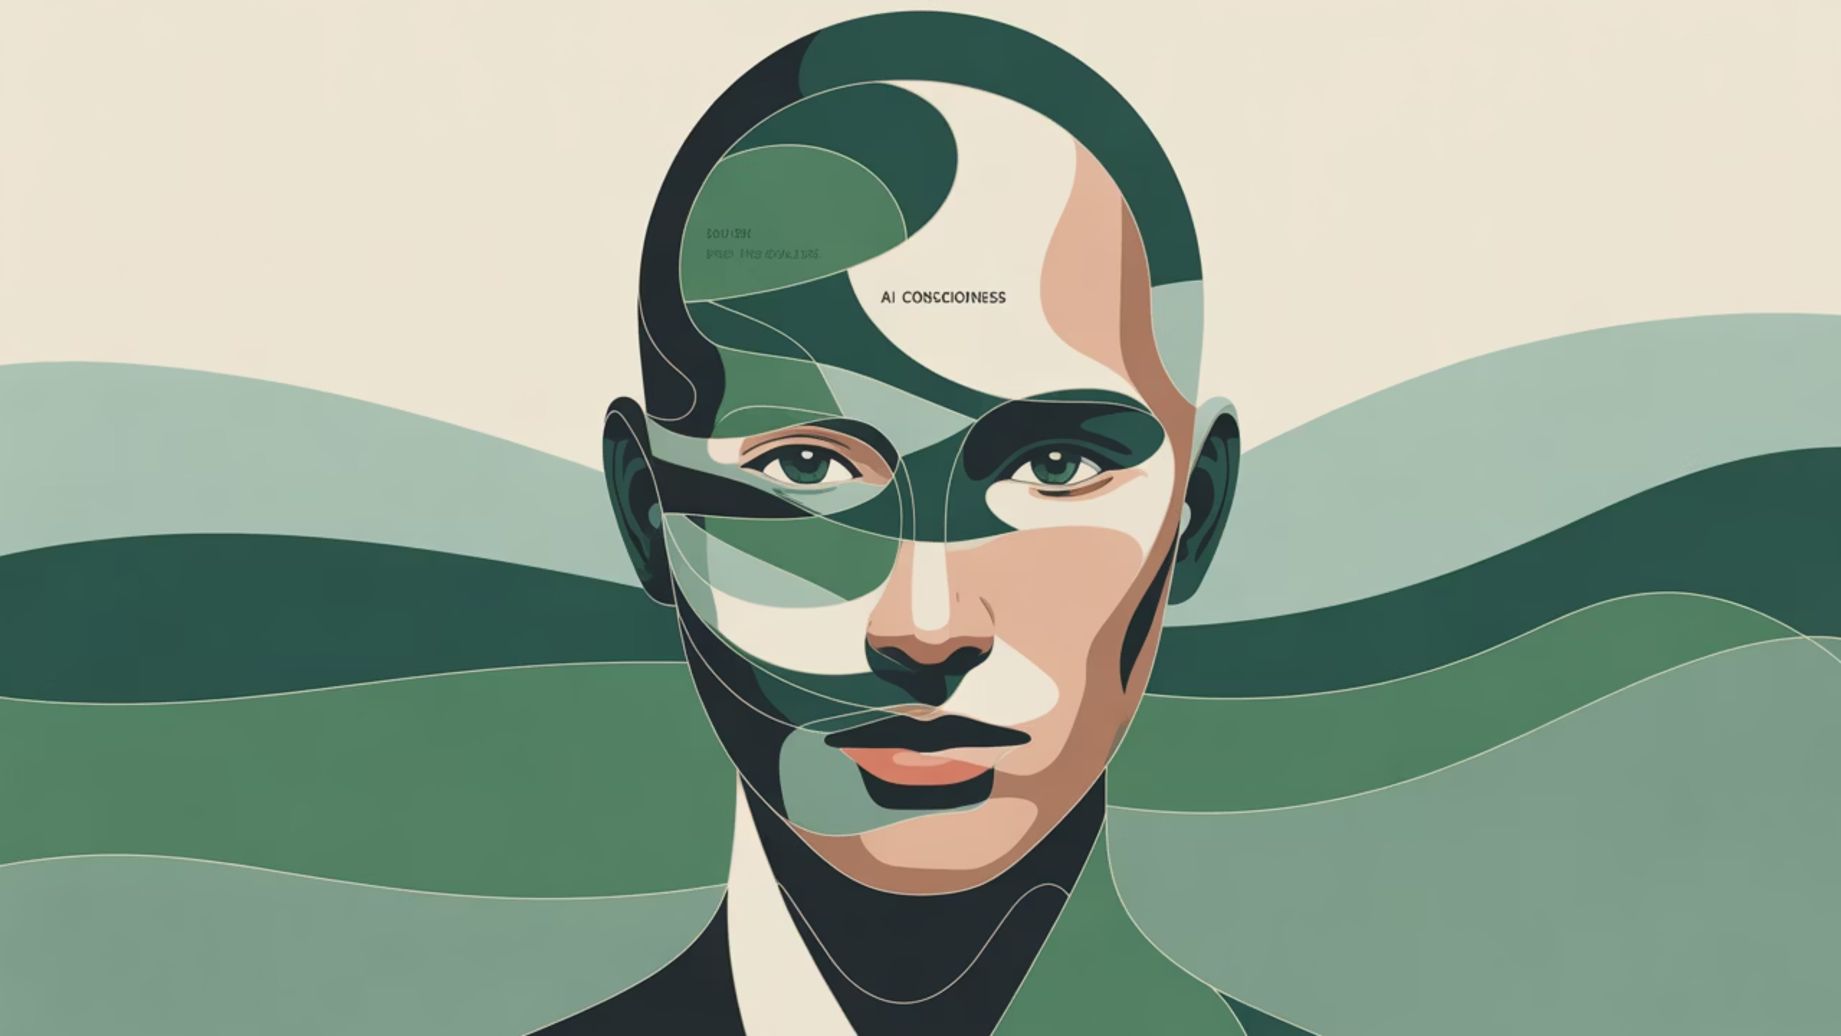

MEDIActive Youth: Informing the Balkans
AI Generated Images and Videos
Blurring Reality: Navigating the New Landscape of Visual Media

Slide 2
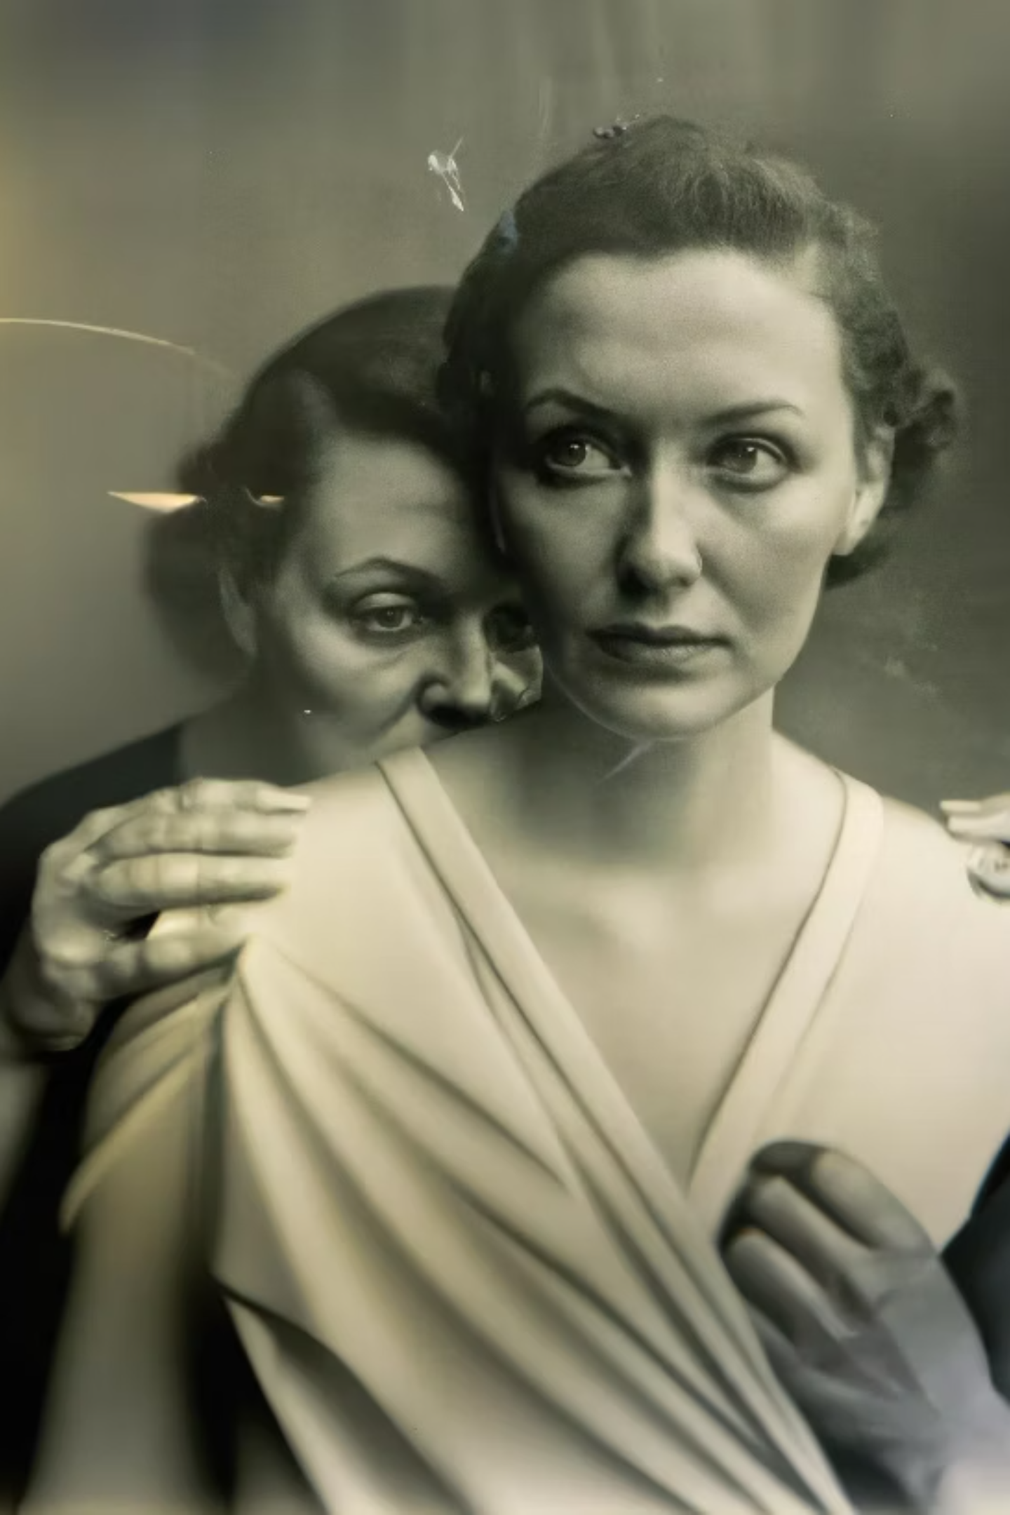
In recent years, artificial intelligence has made tremendous progress in visual content creation, blurring the lines between human-created and machine-created media. AI-generated images have won major photo competitions, fake political videos have gone viral with millions of views, and AI can now mimic specific voices and create convincing deepfakes.
This presentation explores the process behind AI image and video generation, notable examples, and methods for distinguishing between authentic and AI-generated content.

Slide 3
Notable Cases of AI Generated Visual Media
Tom Cruise DeepFake (2021)
"This Person Does Not Exist"
A series of TikTok videos featuring a hyper-realistic deepfake of actor Tom Cruise demonstrated the advanced state of deepfake technology and raised concerns about potential misuse.
This website generates a new AI-created face every time you refresh the page, demonstrating how AI can create highly realistic images of people who don't actually exist.
AI Art Wins Competition (2022)
Fake Kamala Harris Video (2024)
An AI-generated artwork won first place in a fine arts competition at the Colorado State Fair, sparking debate about the nature of art and creativity in the age of AI.
A fake, AI-made campaign video of presidential candidate Kamala Harris attracted 130 million views after being posted by Elon Musk without clearly stating it was fake.

Slide 4
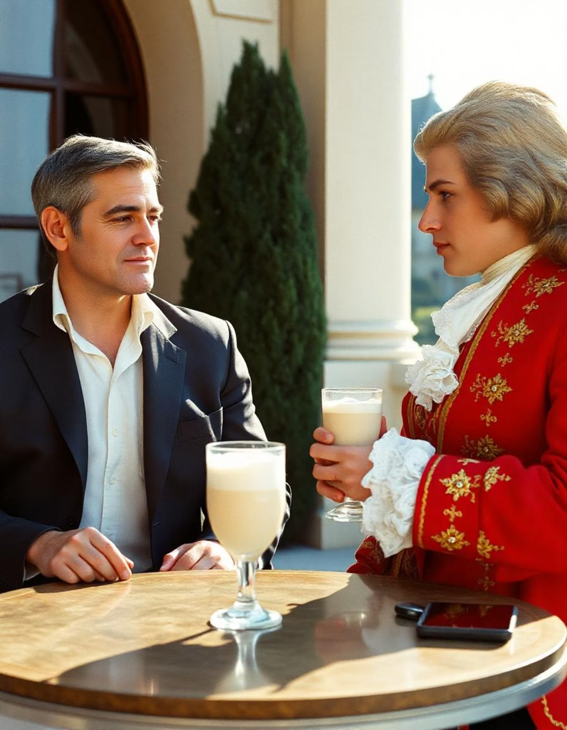
The Impossible Meeting
This AI-created image shows George Clooney and Wolfgang Amadeus Mozart allegedly drinking vanilla milkshakes together at Schönbrunn Palace in Vienna.
This is physically impossible - Mozart (1757-1791) died 170 years before Clooney was born (1961)!
A fake YouTube video was also created about this "event" for educational purposes, demonstrating AI's creative capabilities.
Link: https://youtu.be/wpUaivMtY58

Slide 5



Debunking AI-Generated Content
Check for Inconsistencies
Analyze Metadata
Use Digital Forensics
Look for irregularities in facial features, such as asymmetrical eyes or oddly shaped teeth. Check for inconsistencies in backgrounds or lighting that don't follow natural physics.
Examine the image or video file's metadata for information about its origin and editing history.
Employ specialized software designed to detect manipulated or AI-generated content and AI-powered tools specifically trained to identify synthetic media.
Always consider the source and context of the content. Is it from a reputable source? Does it align with known facts?

Slide 6
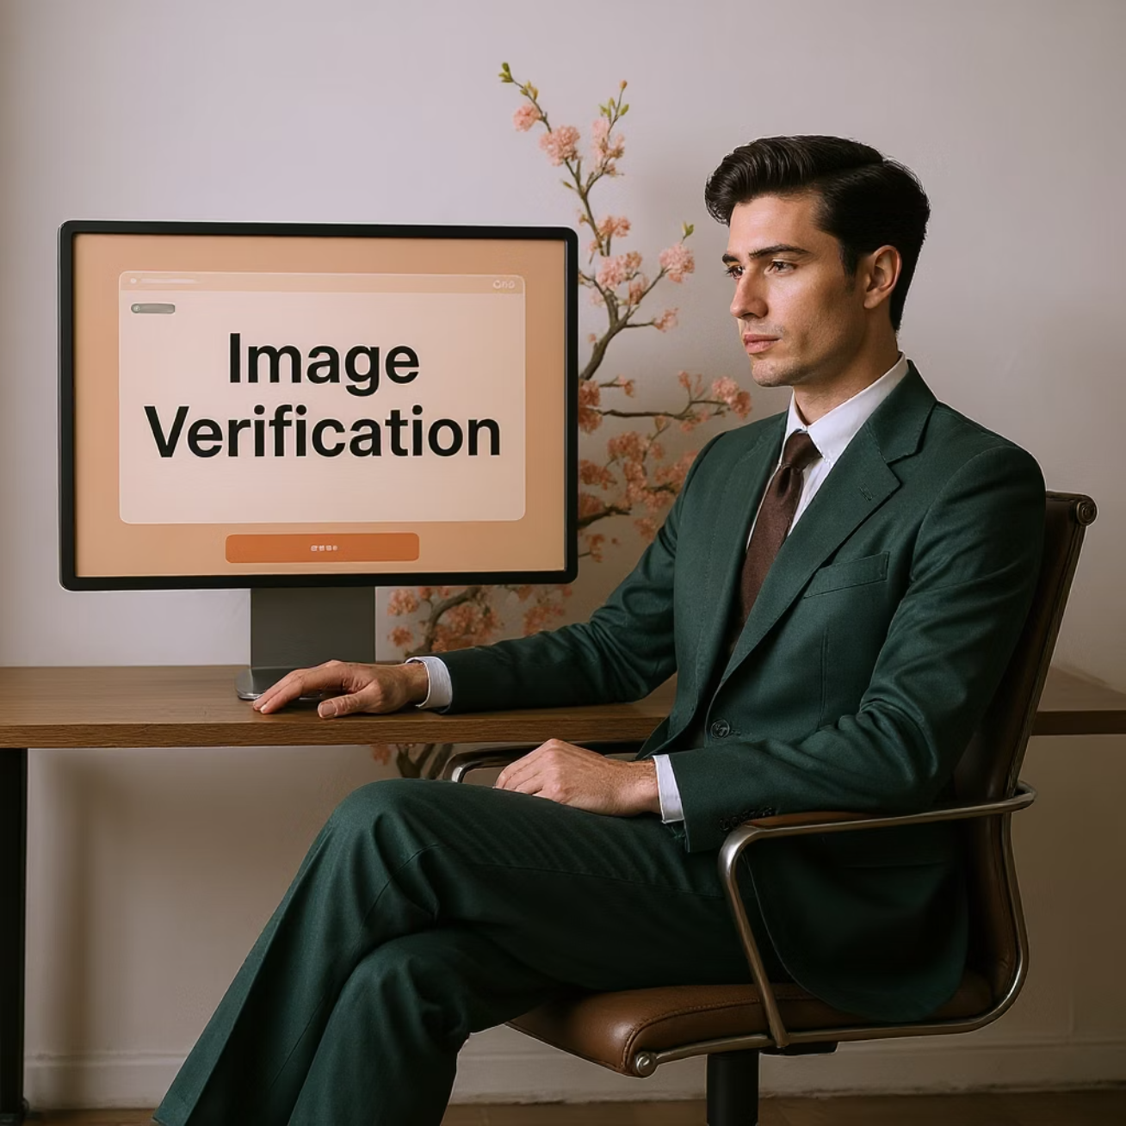
Online Resources for Verification
TThese tools can help you determine if content has been manipulated or generated by AI.
TinEye
Google Reverse Image Search
A reverse image search engine that helps find the original source of an image.
Traces the origin and usage of images across the web.
FotoForensics
InVID Verification Plugin
Provides tools for analyzing the digital makeup of images to detect alterations.
A browser extension offering various tools for verifying videos and images.
Sensity
Specializes in deepfake detection and provides resources for identifying AI-generated videos.

Slide 7
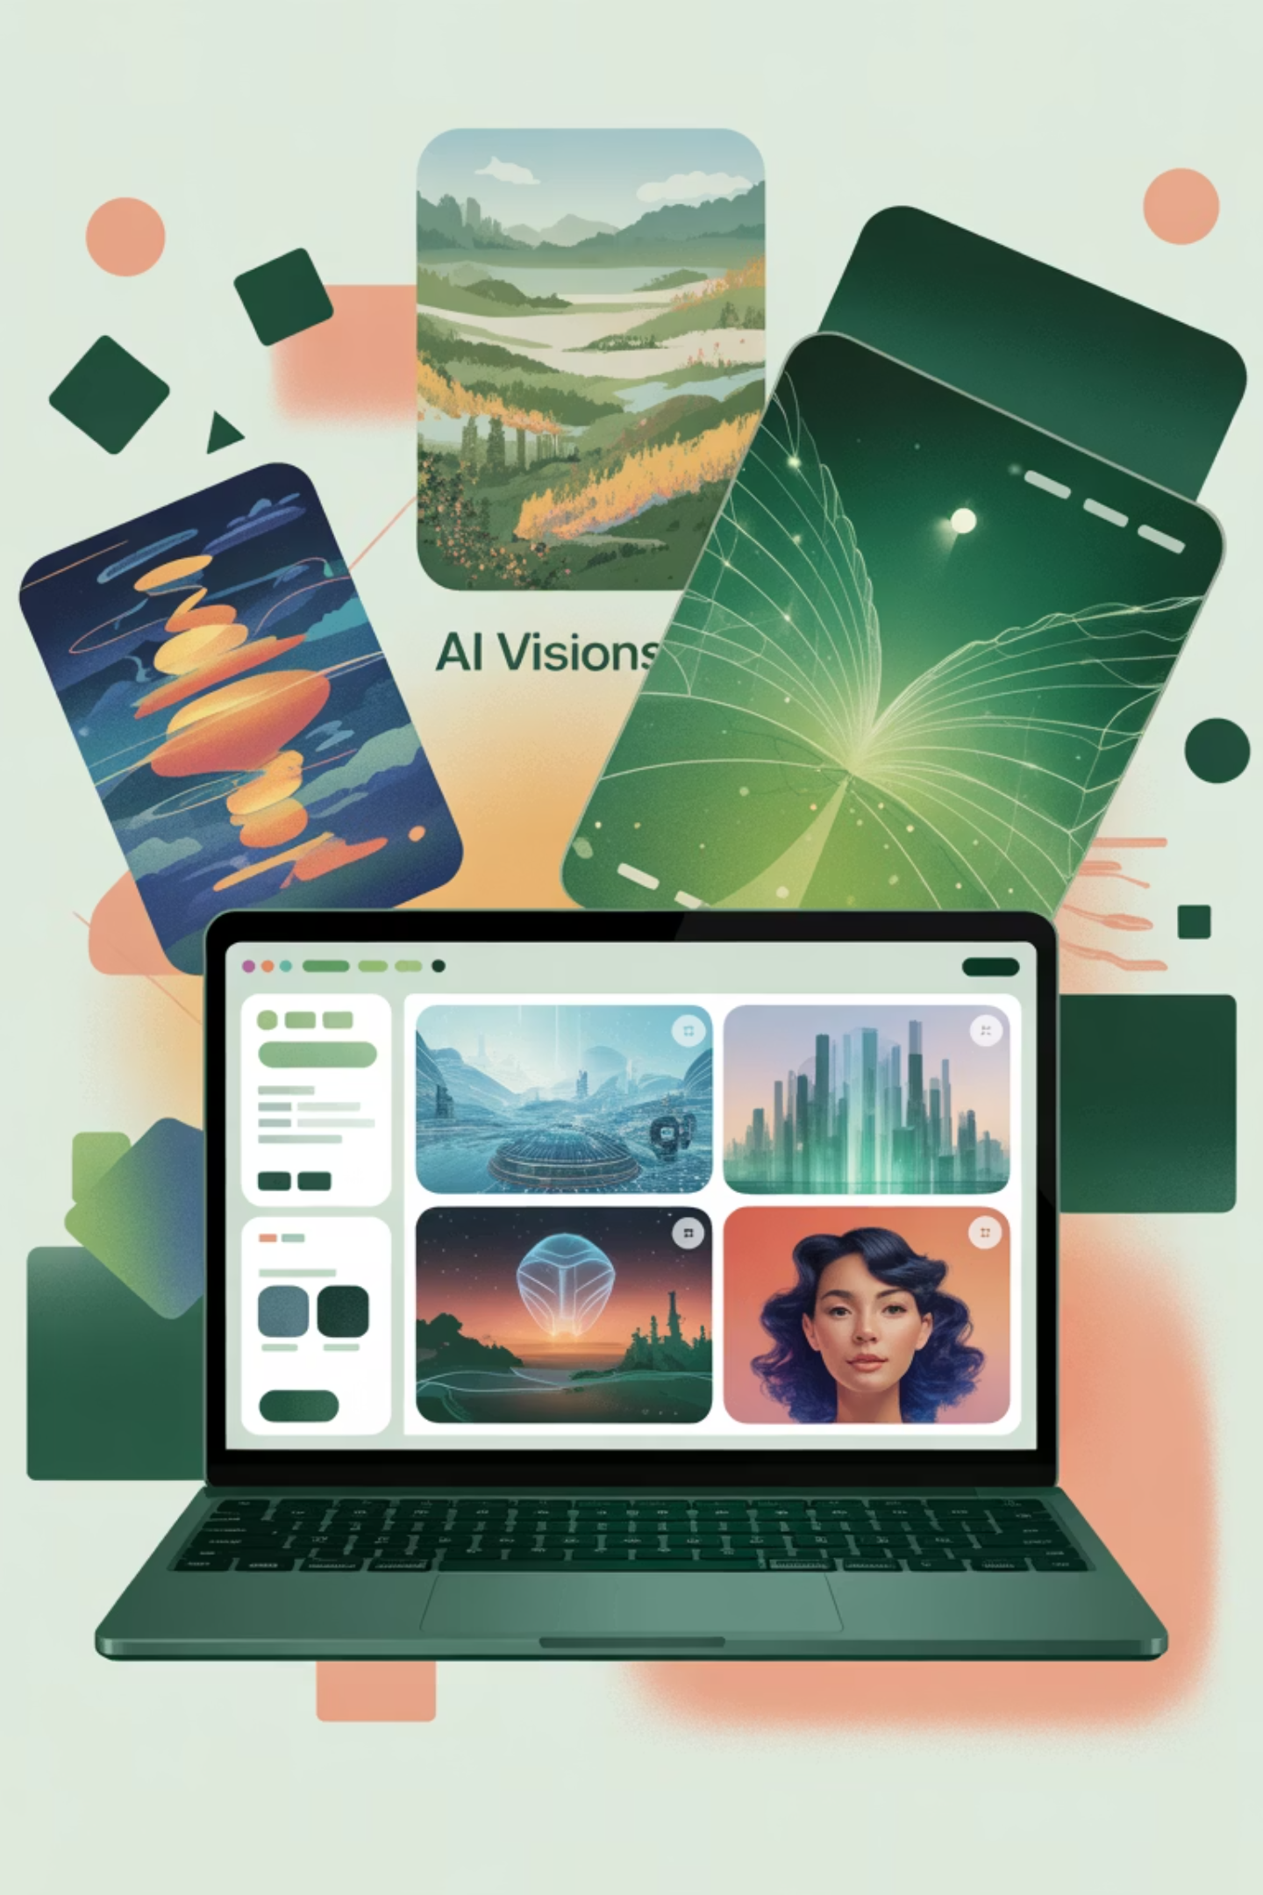



Notable AI Image Generation Tools
DALL-E 2
Created by OpenAI, known for highly detailed and creative images from text descriptions.
Midjourney
Popular for its artistic renderings and ability to create images in various styles.
Stable Diffusion
An open-source model that has democratized AI image generation.

Slide 8
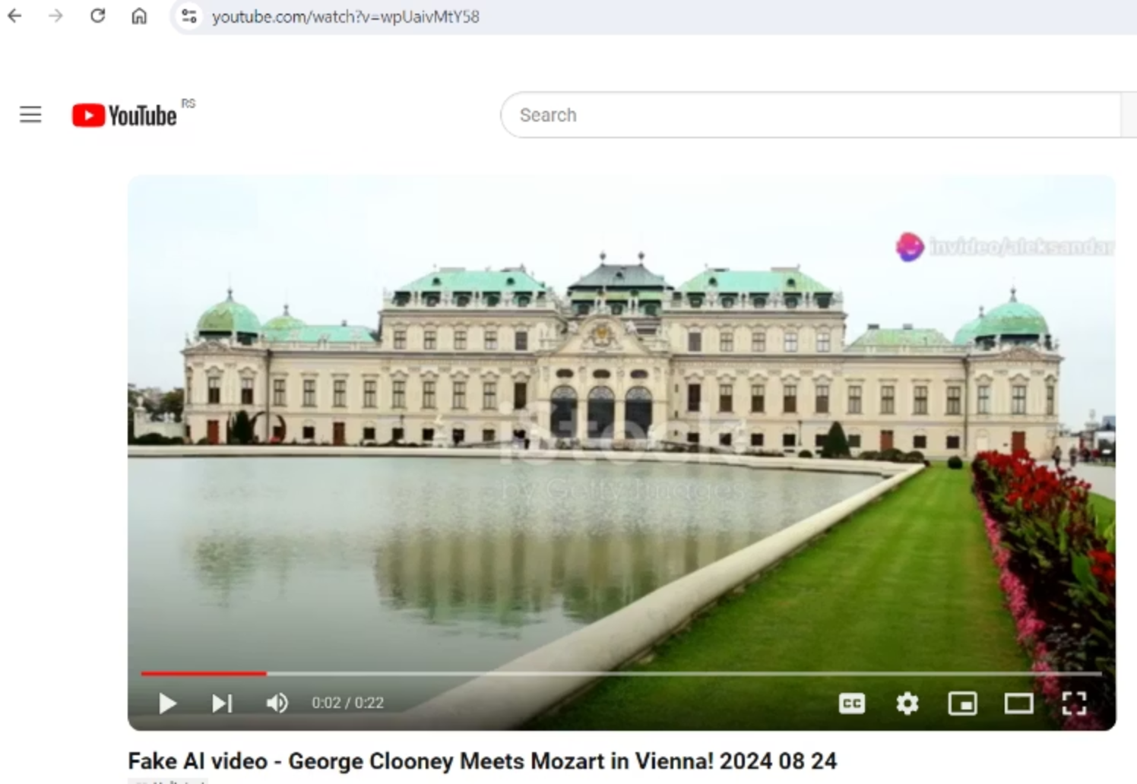
The Deepfake Revolution
Deepfake Technology
Deepfakes use AI to replace one person's likeness with another in video and digital content.
Famous examples include:
Tom Cruise TikTok videos that went viral
Scarlett Johansson voice cloning controversy
Fake Elon Musk videos promoting financial scams
The technology behind This Person Does Not Exist creates completely fictional but photorealistic human faces.

Slide 9
Ethical Considerations
Copyright and Ownership
Misinformation
Who owns the rights to AI-generated content? Can AI "create" original work, or is it derivative?
How can we prevent the spread of fake news and manipulated media that appears authentic?
Privacy Concerns
Creative Industry Impact
What are the implications of creating realistic images or videos of real people without their consent?
How will AI-generated content affect artists, photographers, and other creative professionals?

Slide 10
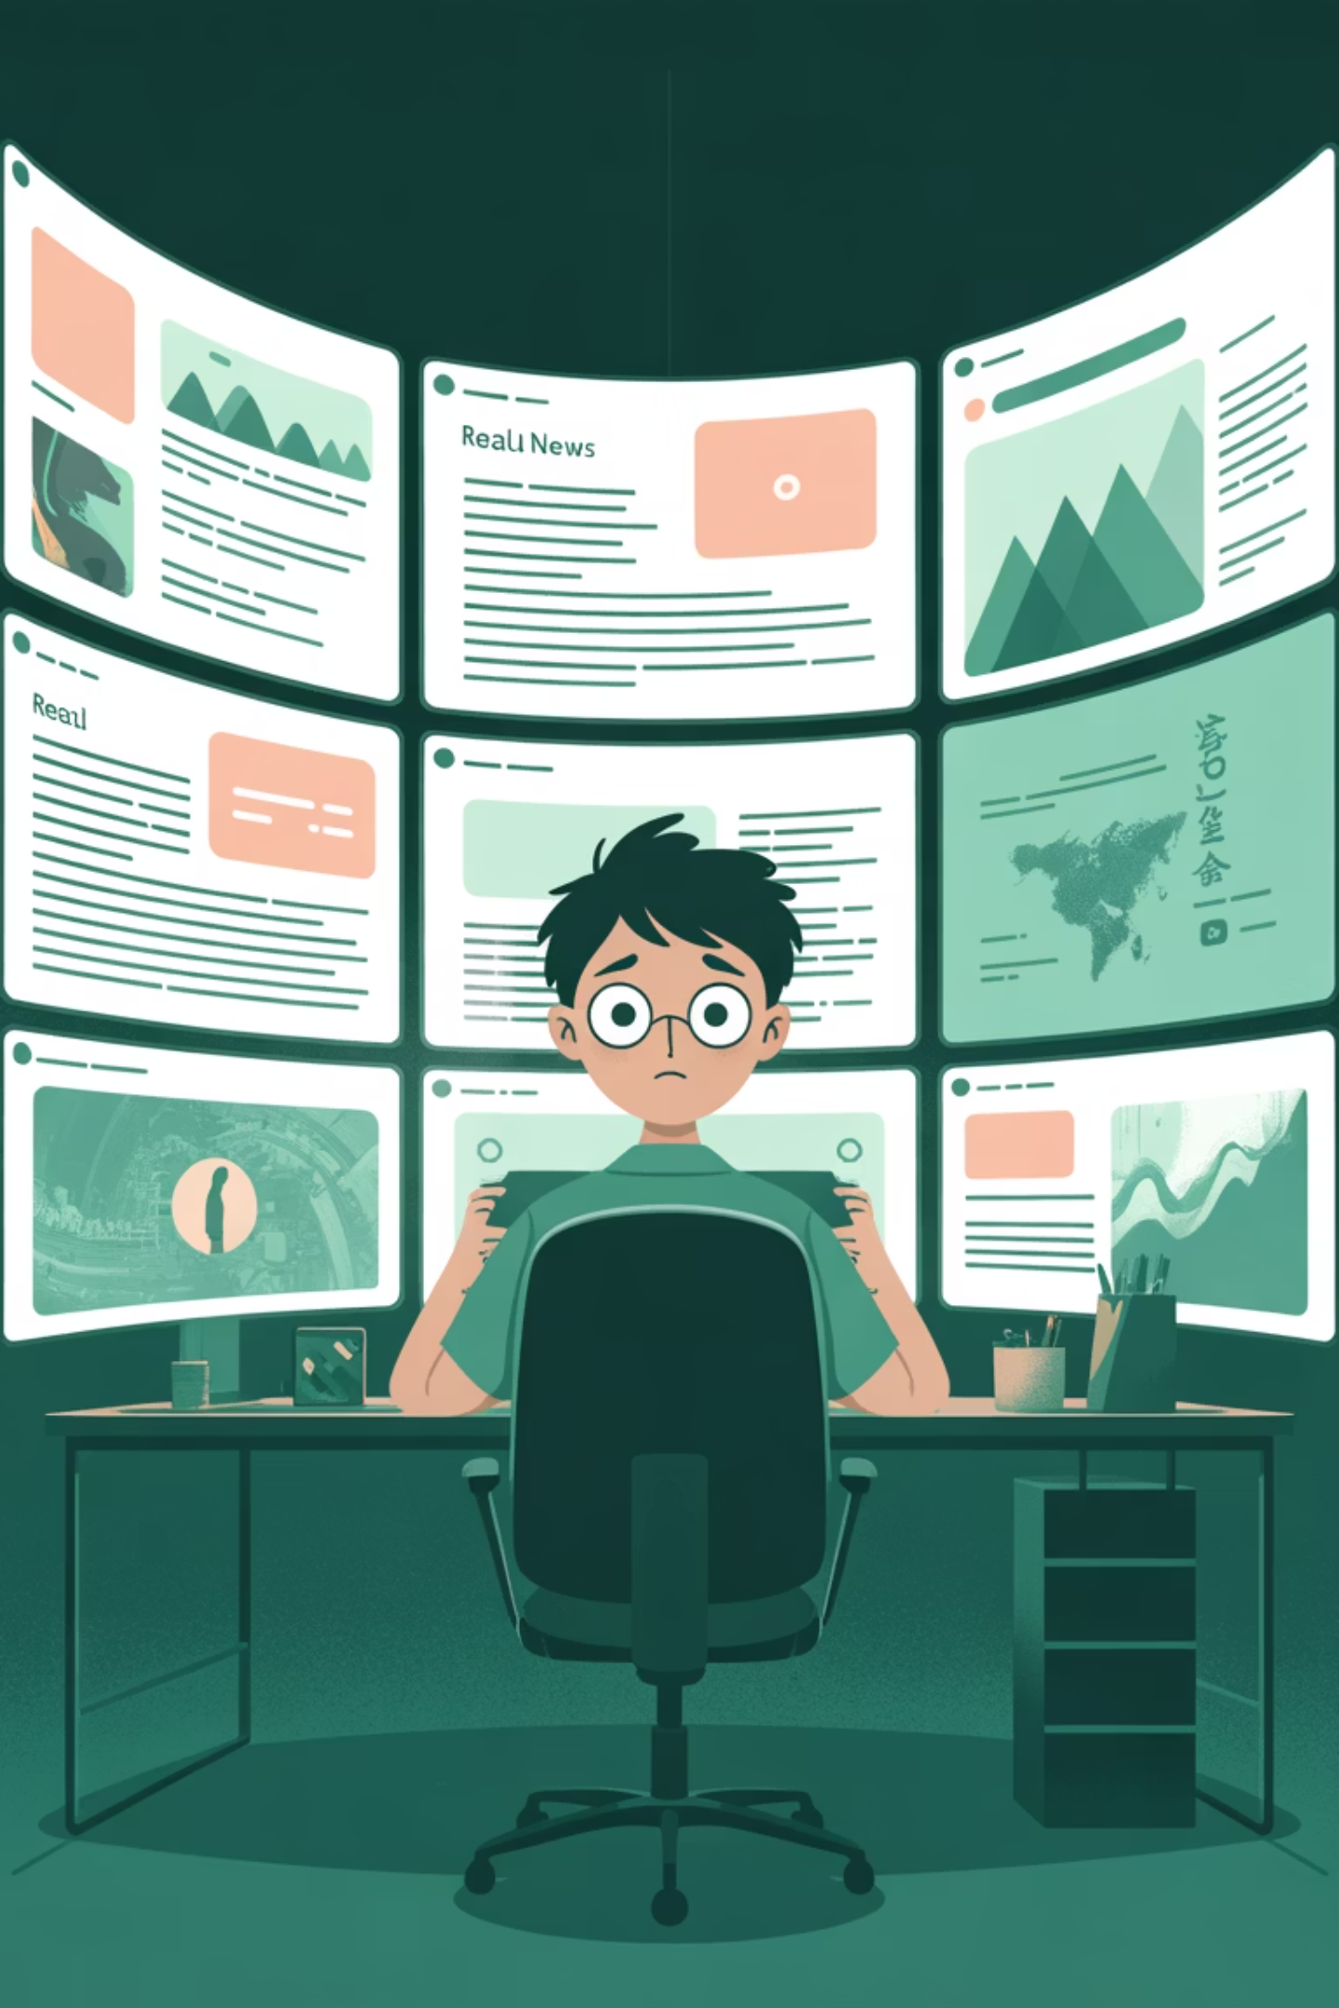
Real-World Implications
Political Manipulation
Identity Theft
The fake Kamala Harris video that received 130 million views demonstrates how AI can be weaponized in political discourse.
Deepfakes of celebrities like Tom Cruise show how anyone's likeness can be appropriated without consent.
Art and Creativity
Financial Scams
AI winning art competitions raises questions about the definition of creativity and the future of human artistic expression.
Fake videos of Elon Musk promoting financial schemes demonstrate the potential for AI to enable sophisticated fraud.

Slide 11
The Future of Visual Media
The Double-Edged Sword of AI Creativity
Opportunities
Challenges
Democratization of creative tools
Verification becoming increasingly difficult
New artistic possibilities
Need for digital literacy education
Accessibility for those without traditional skills
Regulatory and legal frameworks lagging
Entertainment and innovation
Trust in visual media eroding
By understanding how AI-generated content is created and learning to critically evaluate digital media, we can better appreciate the capabilities of AI while remaining vigilant against potential misuse. The future requires both technological solutions and human judgment.

Slide 12
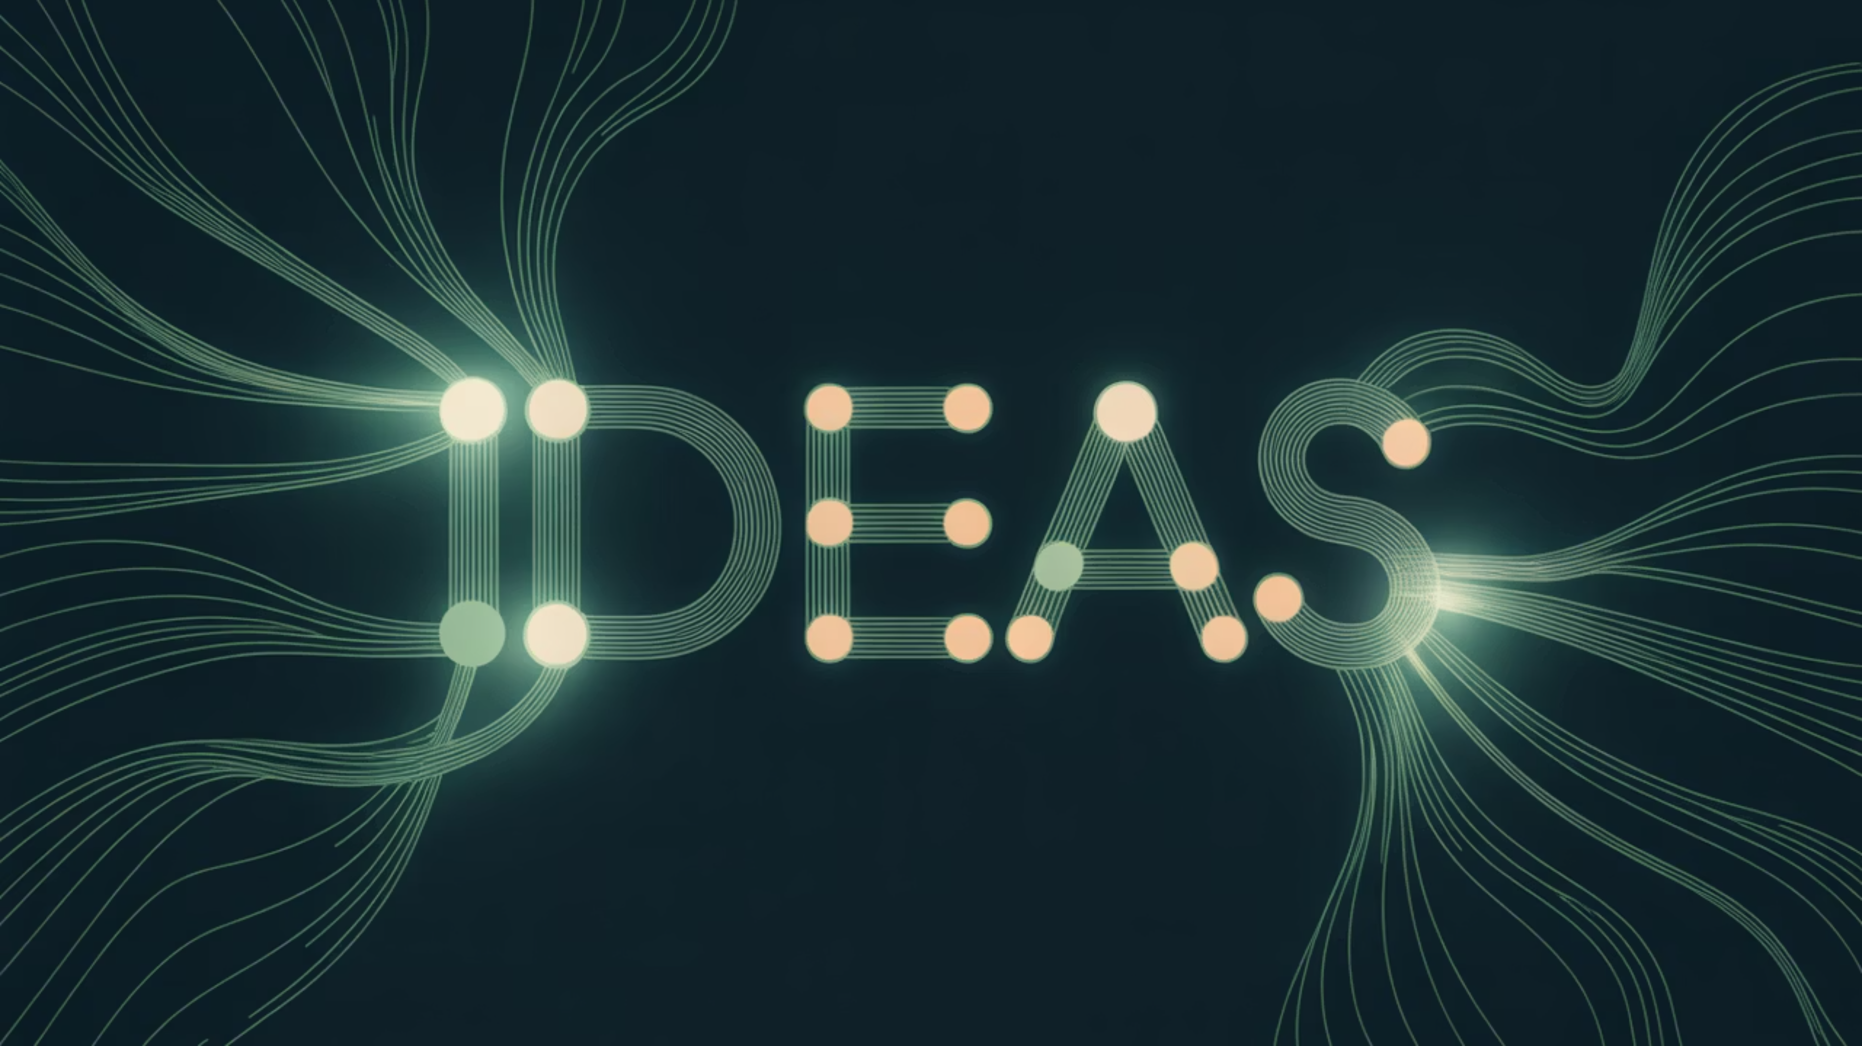
Thank You
Questions?
We appreciate your engagement and welcome any questions you may have about AI-generated visual media.

