Slide 1


MEDIActive Youth: Informing the Balkans
What is Critical Thinking?
Unpacking the core concepts and fundamental principles that shape informed decision-making.

Slide 2

Critical Thinking: The Foundation of Media Literacy
Critical thinking is an essential skill for distinguishing truth in our information-rich society. It involves analyzing information, evaluating evidence, and forming reasoned conclusions—fundamental abilities in both technocratic and democratic societies. This disciplined process requires active engagement with ideas, enabling individuals to think clearly and rationally about what to believe or do.

Slide 3
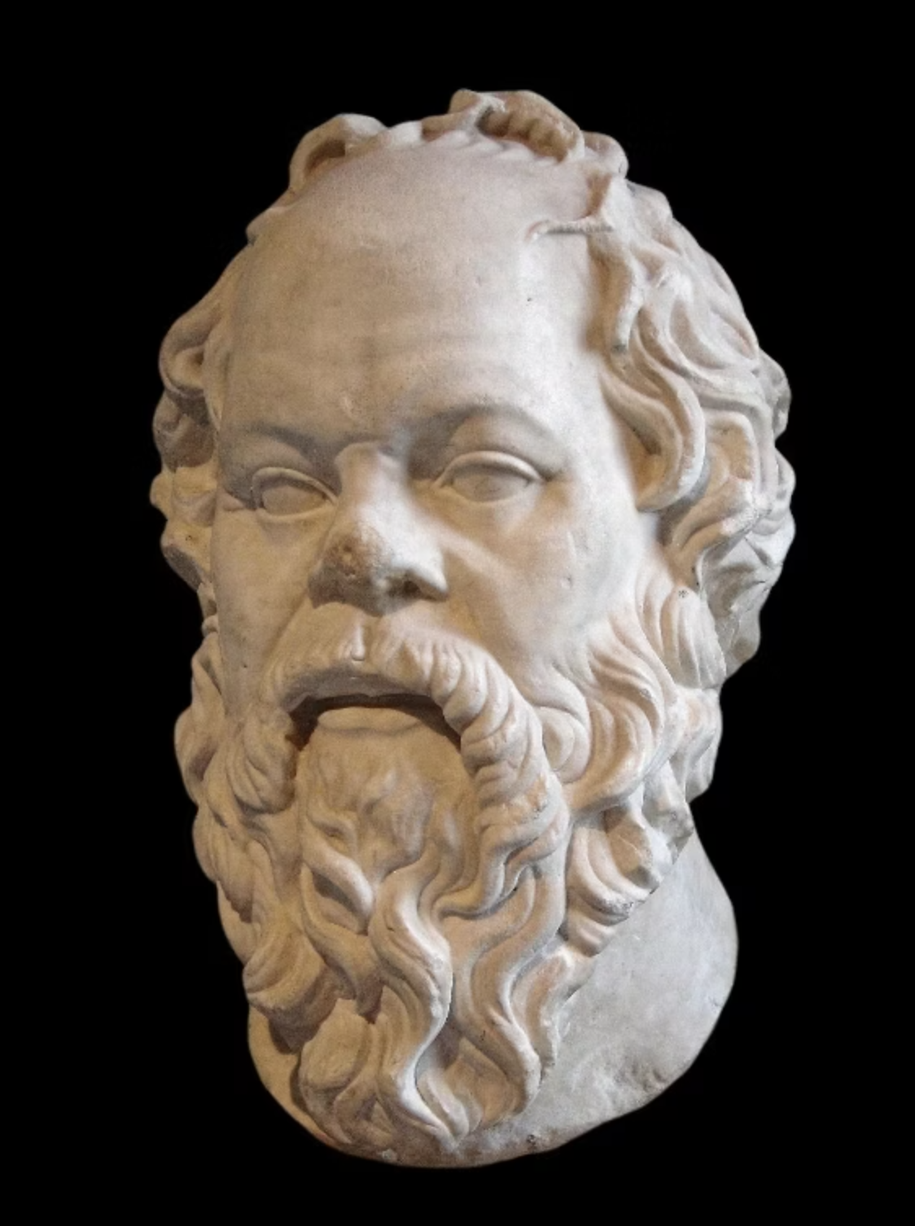
Origins: Ancient Greece and Socrates
Critical thinking was born in ancient Athens (5th to 3rd century BCE), where philosophers like Socrates, Plato, and Aristotle laid the groundwork for systematic inquiry and rational thought.
Before Socrates, Greeks sought truths from poets like Homer, believing they were divinely inspired. Socrates revolutionized this approach by claiming truth could be reached through rational conversation, gradually narrowing subjects to their essential notion.
Socrates developed the "midwife method," believing truth was already in a person's mind and needed only to be extracted. This Socratic Method uses cooperative dialogue to stimulate deeper thought through questioning assumptions.

Slide 4
Evolution of Critical Thinking
Ancient Greece
1
Socrates, Plato, and Aristotle established foundations of systematic inquiry
2
Renaissance
Humanism fostered development with thinkers like Descartes and Locke introducing skepticism and empiricism
Enlightenment
3
Emergence of rationalism and scientific inquiry promoted critical thinking as knowledge foundation
4
20th Century
John Dewey advocated for experiential education and reflective thinking for citizenship
Modern Era
5
Edward de Bono, Daniel Kahneman, and Richard Thaler examined cognitive biases and decision-making

Slide 5



Practical Applications
Education
Business
Healthcare
Students analyze texts, assess arguments, and develop perspectives on complex issues by examining multiple viewpoints and formulating conclusions
Leaders evaluate market trends, assess risks, and make informed decisions for organizational success, such as analyzing customer feedback to address declining sales
Medical professionals evaluate symptoms, consider various conditions, and determine best treatments by analyzing patient history and weighing benefits and risks

Slide 6

Political Role in Society
Critical thinking plays a pivotal role in fostering informed and engaged citizens, especially crucial in democratic societies.
It empowers citizens to:
Evaluate information critically in the age of misinformation
Discern credible sources from unreliable ones
Analyze political arguments effectively
Make informed choices during elections
Moreover, it contributes to social progress by encouraging dialogue and understanding across diverse perspectives.

Slide 7
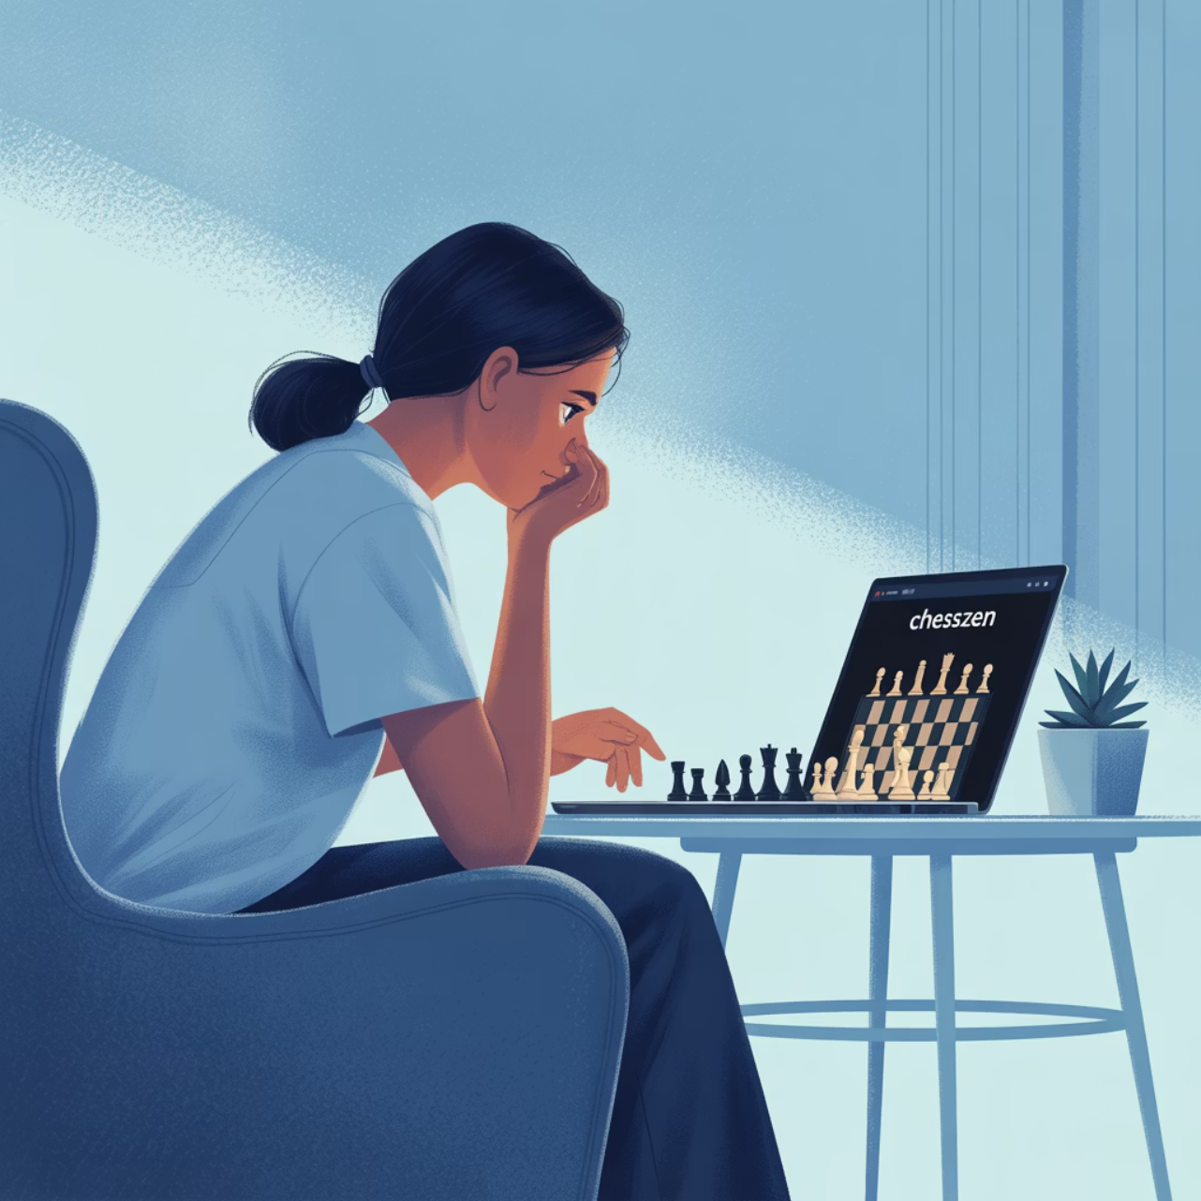
Games to Enhance Critical Thinking: Chess
Chess.com
A free online platform for playing chess that enhances:
Strategic thinking
Foresight and planning
Decision-making skills
Chess.com serves millions of chess players globally, offering a place to:
Share thoughts and strategies
Improve your chess game
Connect with the global chess community

Slide 8

The Talos Principle
The Talos Principle
A philosophical first-person puzzle game set in a contradictory world of ancient ruins and advanced technology.
Players are tasked with solving increasingly complex puzzles while confronting profound questions:
Who are you?
What is your purpose?
What are you going to do about it?
The game challenges players to decide between having faith or questioning their reality.

Slide 9
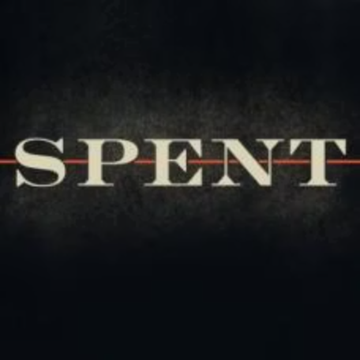
Poverty Simulation: Spent
Spent
An online game about poverty and homelessness developed for Urban Ministries of Durham, a nonprofit organization in North Carolina.
The game is based on budgeting and daily life challenges:
Players face multiple difficult scenarios
Must make crucial financial decisions
Experience how choices directly impact income
Develops empathy and social awareness

Slide 10
More Critical Thinking Games
Numberdyslexia.com
Brainstorm
Offers a collection of online games to improve critical thinking skills, including classics such as:
A multiplayer game that challenges players to:
Make decisions based on analytical observation
Sudoku
Complete tasks ahead of other players
Tangram
Push cognitive limits
Logic puzzles
Exercise critical thinking skills

Slide 11
Conclusion: The Vital Importance of Critical Thinking
Historical Foundation
Personal Development
Societal Progress
Critical thinking has deep historical roots from Socrates to modern cognitive scientists, evolving as a disciplined approach to knowledge and truth.
Enhances individual ability to analyze information, evaluate evidence, and form reasoned conclusions in education, business, healthcare, and daily life.
Fosters informed citizenship, enables democratic participation, and promotes meaningful dialogue across diverse perspectives.
By understanding critical thinking's origins and applications, and engaging in exercises designed to foster these skills, individuals can navigate the complexities of modern life and contribute meaningfully to their communities.

Slide 12

Thank You!
Questions?

