Slide 1


MEDIActive Youth: Informing the Balkans
Critical Thinking Skills & Tools
Mastering the essential techniques to analyze, evaluate, and synthesize information for better decision-making.

Slide 2

Critical thinking is a fundamental skill essential for success in academic pursuits and professional life. It involves the objective analysis and evaluation of information to form a judgment, encompassing skills such as analysis, interpretation, inference, explanation, self-regulation, and open-mindedness.
Developing these skills enables you to make more informed decisions, solve complex problems, and engage in meaningful discourse across various disciplines.

Slide 3
Understanding Critical Thinking
Analysis
Interpretation
Breaking down complex information into component parts to understand relationships
Understanding and explaining the meaning of information or events
Inference
Explanation
Drawing conclusions based on relevant information and evidence
Clearly communicating reasoning and justifying conclusions
Self-regulation
Open-mindedness
Monitoring and correcting one's own thinking processes
Considering alternative perspectives and being receptive to new ideas

Slide 4
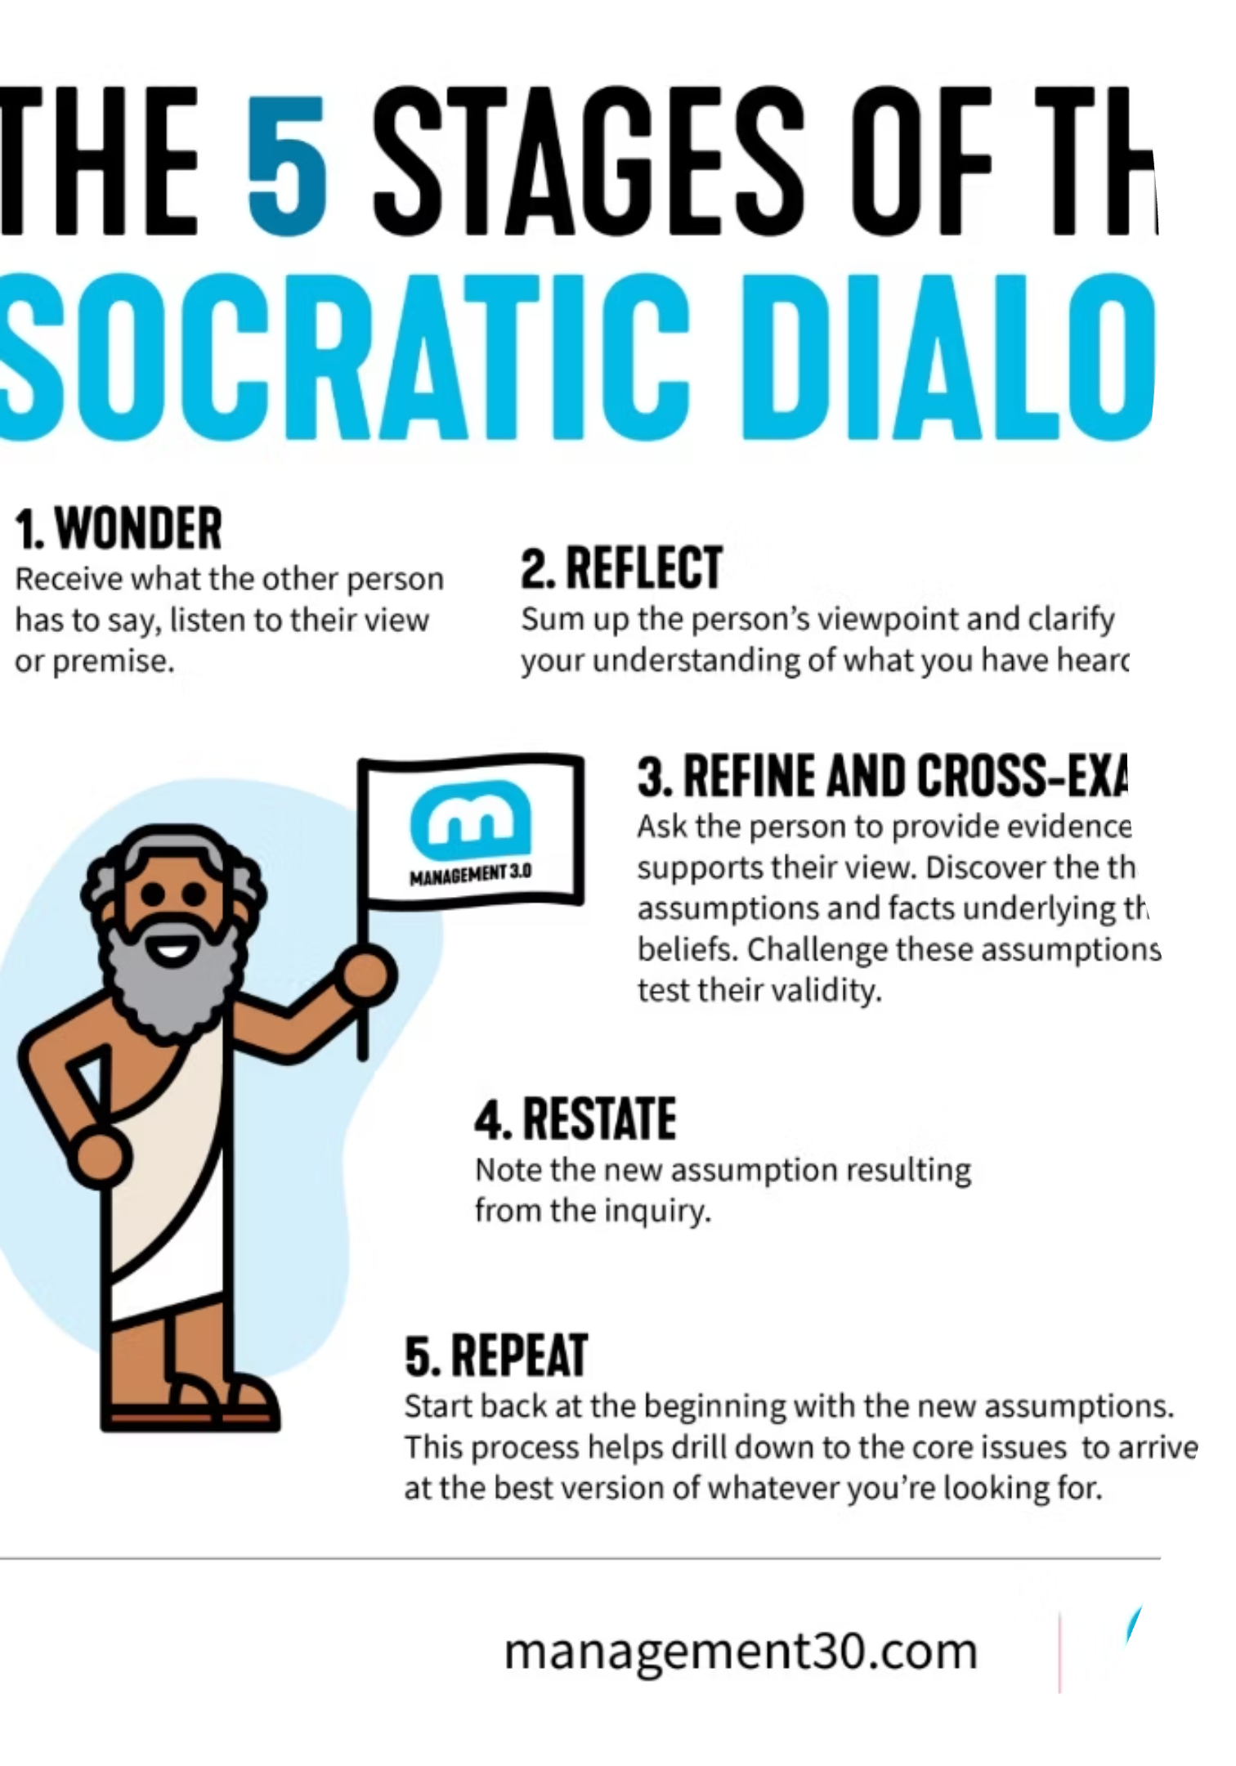

The Socratic Method
Named after the ancient Greek philosopher Socrates, this method involves asking probing questions to stimulate critical thinking and illuminate ideas. It encourages deeper exploration of assumptions and beliefs.
Historical Example: Socrates used this method in ancient Athens to challenge his students' beliefs and encourage them to question established norms, as documented in Plato's dialogues.
An excerpt from Plato's book On Beauty (4 C. BCE) illustrates the Socratic question/answer model that forms the foundation of this critical thinking approach.

Slide 5

Mind Mapping & SWOT Analysis
Mind Mapping
SWOT Analysis
A visual tool that helps organize and structure thoughts, revealing connections between ideas and concepts.
SWOT (Strengths, Weaknesses, Opportunities, Threats) analysis is a strategic planning technique used to evaluate a situation or proposal from multiple angles.
For an interactive mind mapping tool, visit MindMeister
Historical Example: NASA used SWOT analysis in the 1960s to evaluate the feasibility of the Apollo moon landing program, helping them identify potential challenges and opportunities.

Slide 6
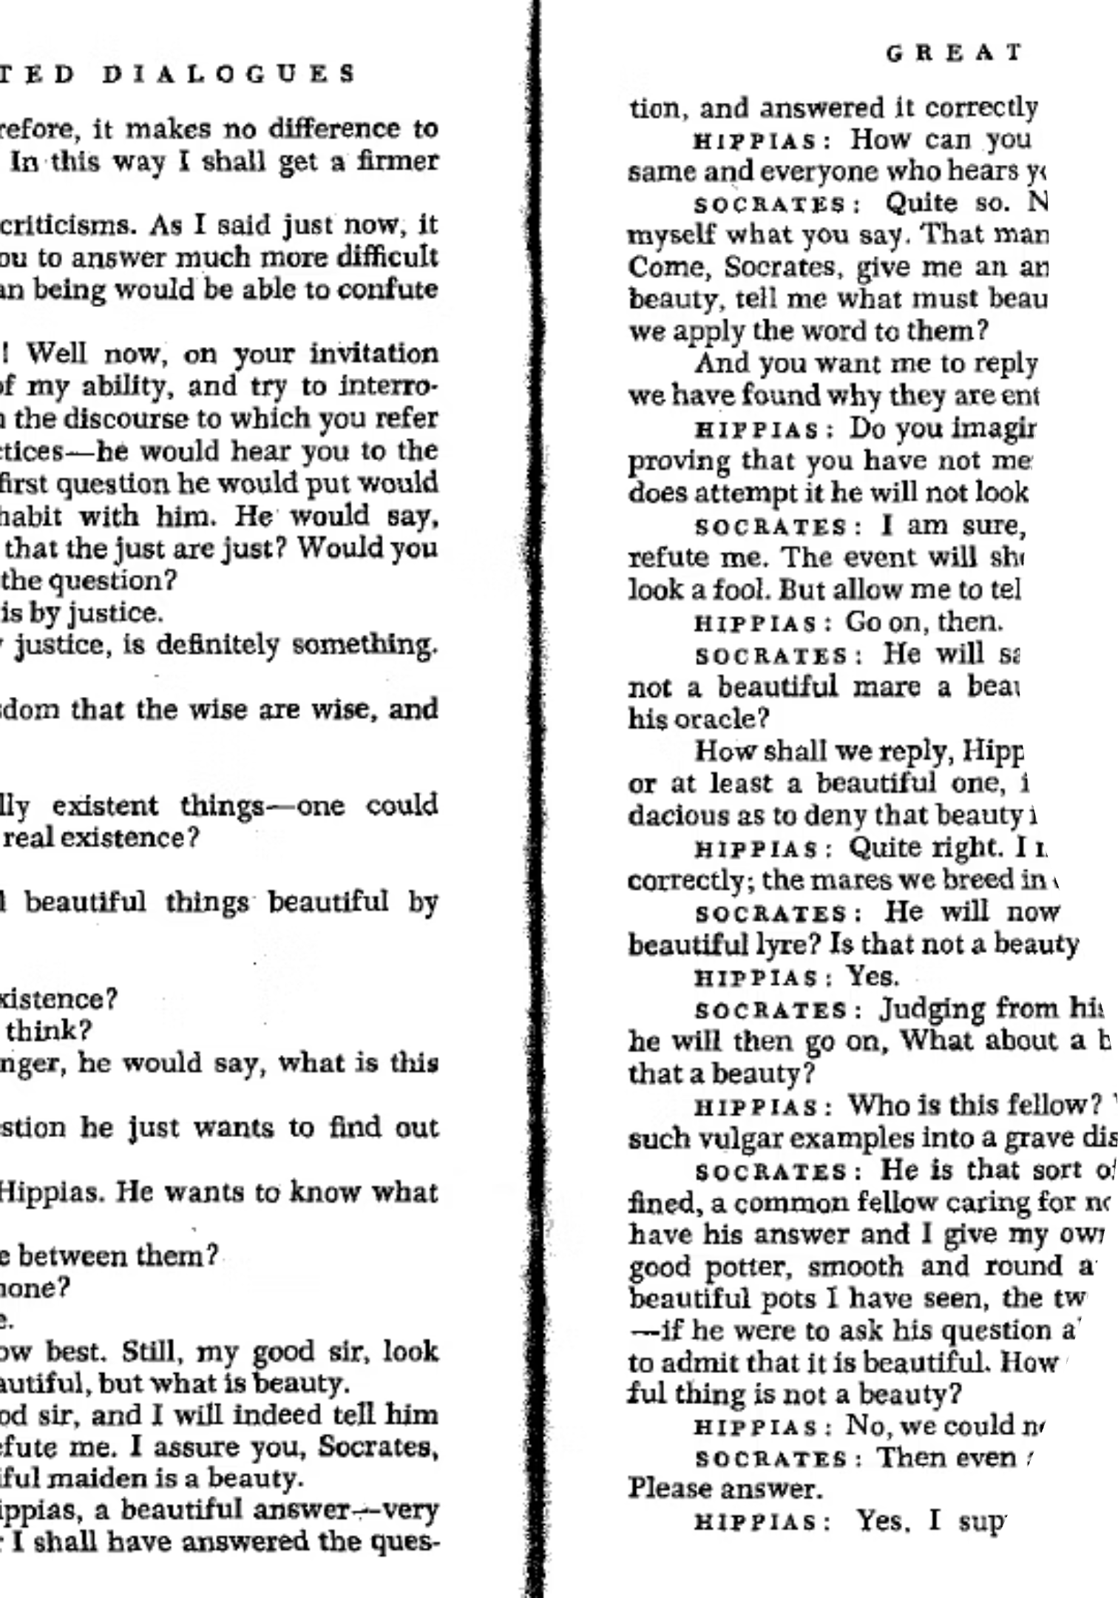


More Critical Thinking Tools
The Five Whys Technique
This iterative questioning technique helps identify the root cause of a problem by repeatedly asking "Why?"
Historical Example: Sakichi Toyoda, the founder of Toyota Industries, developed this technique in the 1930s to improve manufacturing processes.
Argument Mapping
A visual representation of the structure of an argument, showing the relationships between claims, evidence, and objections.
Explore argument mapping with Rationale

Slide 7
Applying Critical Thinking Tools
Identify the problem or question
Clearly define what you're trying to solve or understand
Gather relevant information
Collect data from credible sources
Apply appropriate critical thinking tools
Select and use tools that fit the situation
Analyze and evaluate the information
Examine evidence and consider different perspectives
Draw conclusions and make decisions
Form judgments based on your analysis
Reflect on the process and outcomes
Consider what worked, what didn't, and why

Slide 8

Historical Examples of Critical Thinking
The Scientific Revolution
The Enlightenment
In the 16th and 17th centuries, scientists like Galileo Galilei and Isaac Newton challenged long-held beliefs about the natural world through observation, experimentation, and logical reasoning.
Philosophers such as John Locke and Voltaire promoted rational thinking and skepticism of traditional authorities in the 18th century, influencing political and social reforms.
The Manhattan Project
During World War II, scientists and engineers applied critical thinking to solve complex problems in developing the atomic bomb, demonstrating the power of collaborative problem-solving.

Slide 9
Exercises to Strengthen Critical Thinking Skills
1
2
3
Analyze Media
Solve Logic Puzzles
Join Debate Club
Choose a news article and identify potential biases, evaluate the credibility of sources, and distinguish between facts and opinions.
Regularly engage with logic puzzles and brain teasers to improve analytical and problem-solving skills.
Practice articulating arguments, considering multiple perspectives, and responding to counterarguments.
4
5
Explore Interdisciplinary Studies
Practice Reflective Journaling
Connect different academic disciplines to broaden your perspective and enhance your ability to think critically across various domains.
Keep a journal to reflect on your thought processes, decision-making, and personal biases. This practice promotes self-awareness and metacognition.

Slide 10
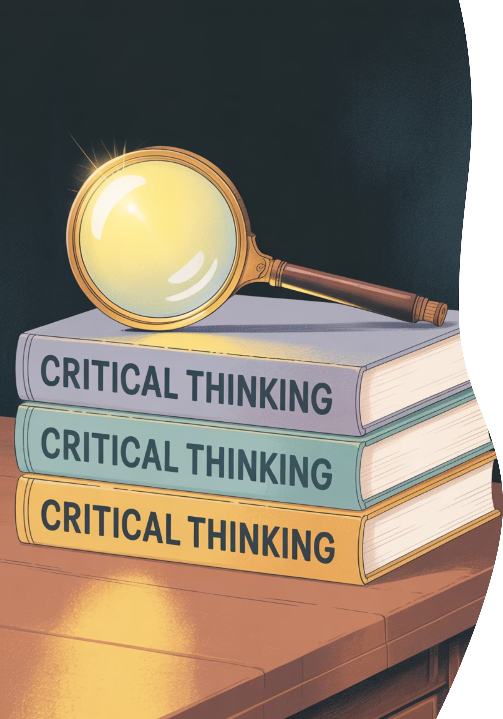
Further Reading
Facione, P. A. (2020)
Paul, R., & Elder, L. (2019)
Critical Thinking: What It Is and Why It Counts - A comprehensive overview of critical thinking, its core skills, and its importance in education and daily life.
The Miniature Guide to Critical Thinking Concepts and Tools - A concise guide offering a practical approach to understanding and applying critical thinking concepts.
Foundation for Critical Thinking
The Critical Thinking Community - A comprehensive resource for critical thinking tools, techniques, and educational materials.

Slide 11
Conclusion
Developing critical thinking skills is an ongoing process that requires practice and dedication.
By incorporating these tools and exercises into your academic and personal life, you can enhance your ability to analyze information, solve problems, and make informed decisions.
Critical thinking is not just about finding the right answers, but also about asking the right questions and approaching challenges with an open and analytical mind.

Slide 12

Thank You!
Questions?

